Slide 1
St. Avalanche School
By : Abby Powell

Slide 2
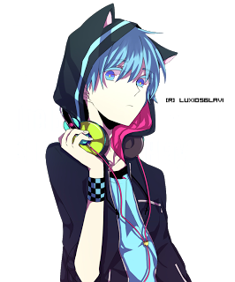
Choose Your Character!~
Ashlynn or Zackary

Slide 3
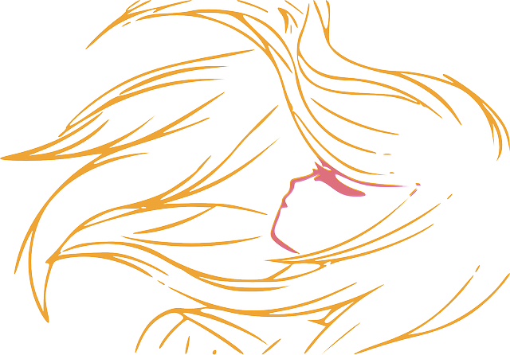
Ashlynn’s Bad Morning
You wake up to the loud ring of your alarm clock and the shouting of your mom yelling “ASHLYNN!! YOU SLEPT THROUGH YOUR ALARM AGAIN!!!”
Shout back at your mom
Get ready for school

Slide 4
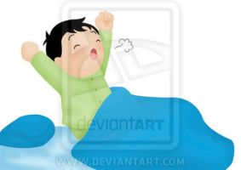
Zackary’s Lucky Morning
You wake up to the sound of your alarm and the smell of fresh pancakes.
Wake up and see what’s cooking
Play on your phone for a bit

Slide 5
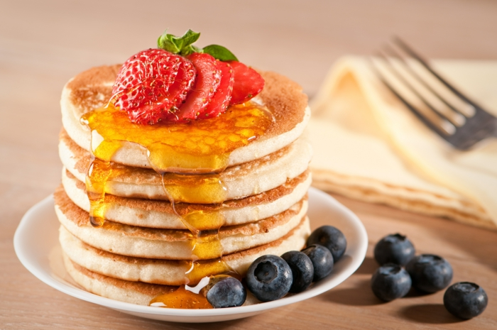
Yum!
You go out into the kitchen to see your mom cooking pancakes
“Good morning son, bacon is ready, have a piece if you want”
Gobble all the Bacon
Save some for later

Slide 6
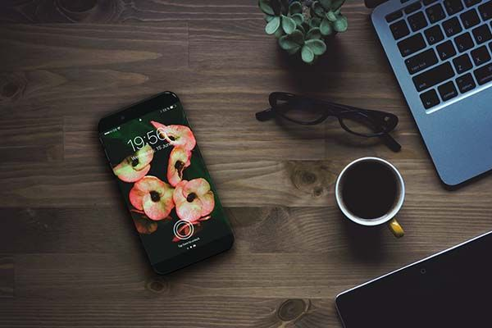
Oh Mom…
You call your friend for help on homework after playing some games
Then your Mom barges into your room in the middle of your call
Signal your on the phone
End the call

Slide 7
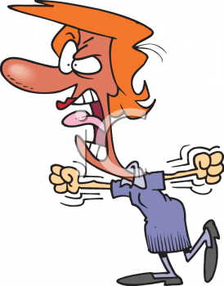
She’s a Momster!!!
You Signal that your on the phone, she looks like a mad tomato
End the call?
Continue the call

Slide 8
Late for breakfast!.. And school…
You End the call with your friend and go to eat breakfast.
Your pancakes and bacon is cold and not very tasty
But you are late for school
Hurry up
Take your time

Slide 9
YAY!!!~ YOU WIINN
You take your time, and you have a okay day
You got a brand new friend, Ashlynn
Got beaten up, but you laugh it off
Hang out at her house and have a great time
YOU WIN!!! ☺☺☺☺

Slide 11
Oh No!!
You yell at your mom very loud and mean, She gets super mad and grounds you for a week, and kicks you out of the house,
YOU LOSE!! ☹

Slide 12
Late For School
You get ready, Slowly, making sure nothing is left behind.
You almost forgot your house keys, phone and lunch money.
“I’m ready Mom!!” you say, running out into her car
“YOU BETTER BE READY!!” She shouts at you, angerly
You jump in the car and your mom speeds past the red Light!
Brace for impact
Yell at mom to stop

Slide 13
CRASH!!!!!
You brace for impact
Your mom crashes into a car right in front of your school
You make it to school on time
You are safe, but you are injured and your mom has been arrested for running a red light
Tell what happened
Keep quiet

Slide 14
The not so bad day
You tell what happened, but the teacher doesn’t care
You get a new friend, Zackary
You both get beaten up by bullies
You hang out at your house and try to make food
YOOOOOOOOOOOOOUUUUUUUUUUUUUUU WIIIIIINNN ☺ ☺☺☺

Slide 15
The Really Really bad bad day
You keep quiet and this is what happened
You are teased and beat up by bullies
Get a bad grade
And go home hungry because you cannot cook
You lose ☹

Slide 16
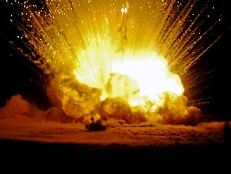
CRASSSSSSSHHHHHHHHHHHHHHHHHH
You yell at your mom to stop
She crashes into a car
You are both very hurt
YOU LOSE ☹☹☹☹☹☹☹

