Slide 1
SCHOOL
By ABBYGAIL BELGARDE

Slide 2
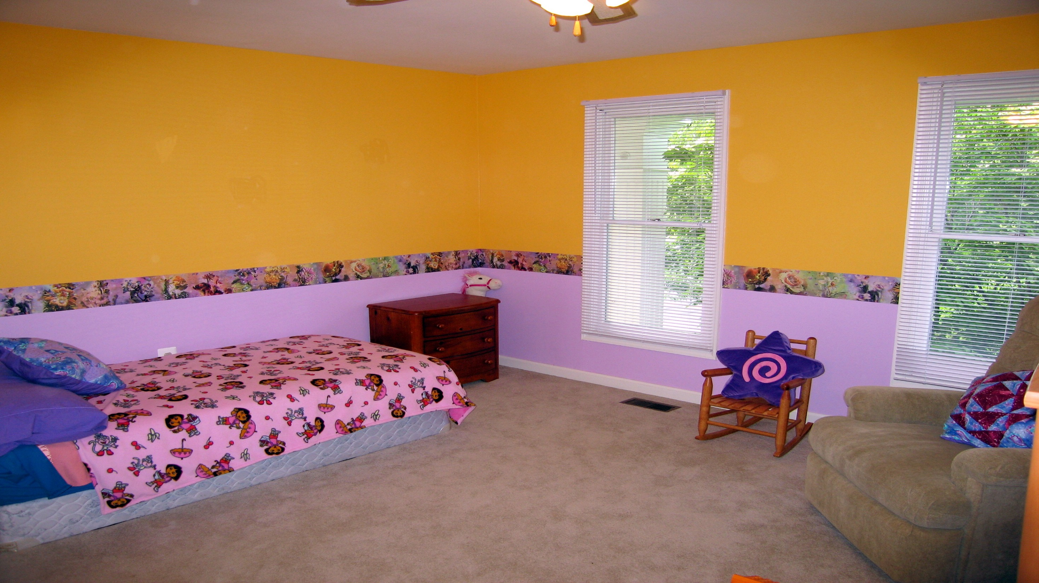
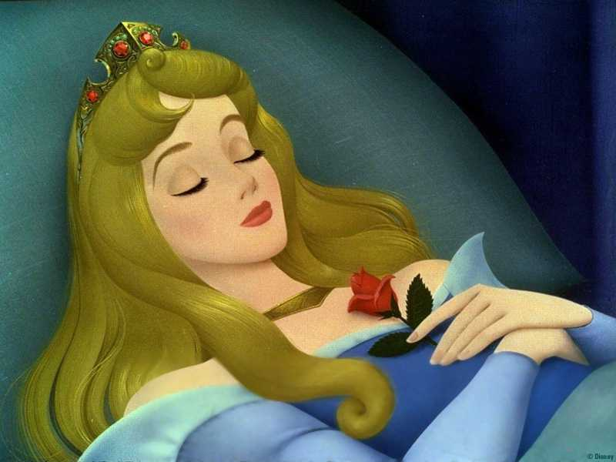
WAKING UP
Your mom comes into your room in the morning. “Wake up its time for school”
Choice 1, wake up and get ready
Choice2, sleep in

Slide 3
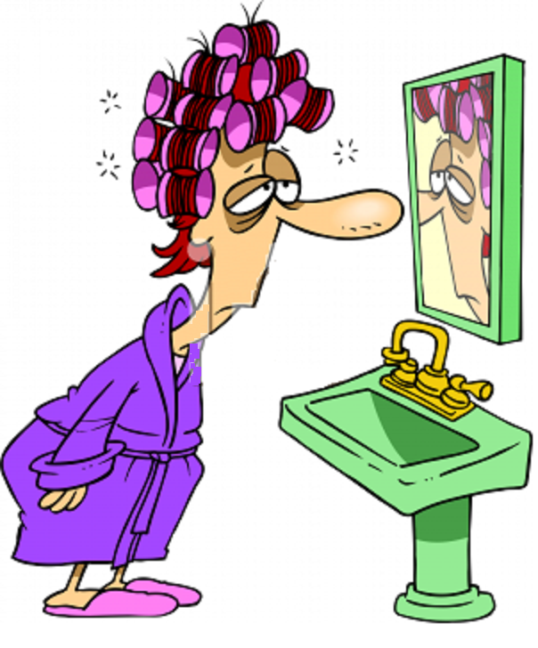
CHOICE 1
You wake up and get ready, you say goodbye to your mom and go out the door.
Remember nun of this said what time it was
The bus was right in front of your house it starts leaving, you run after it and get lost.
You call your mom, she comes and picks you up and takes you to school your late
YOU LOSE
RESTART?

Slide 4
CHOICE 2
YOU SLEEPT IN
You were not late
You rested nicely
YOU WON
GOOD JOB
RESART

Slide 5
RESTART IF YOU DARE!
Go back to beginning
Restarting
you have chosen to restart. Good luck

