Slide 1
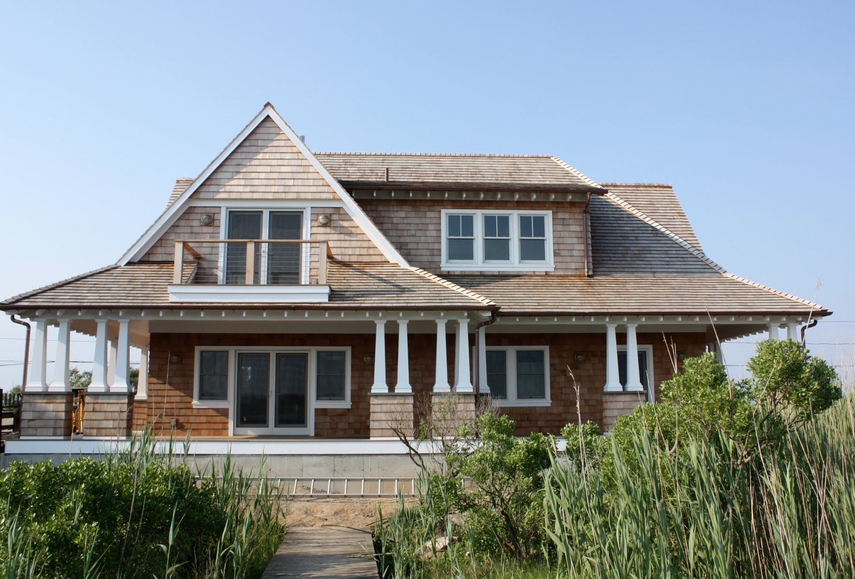
THE ESCAPE FROM THE BEACH HOUSE

Slide 2
Once upon at time, This family were going on a vacation to a beach that had a beach house next to it. The family had 4 kids named Jack, Emma, Daniel and Bob. The beach was a block away from the beach house. The beach looked nice but it was really windy.l;

