Slide 1
THE DRAGON

Slide 2
THE MAN
Once there was a man camping in the forest. He was climbing a mountain. When he reach the top he saw a cave. He whent inside. It was all red. Then he saw a dragon!!!
Choice 1 Climb down the mountain
Choice 2 Run for your life away from the dragon

Slide 3
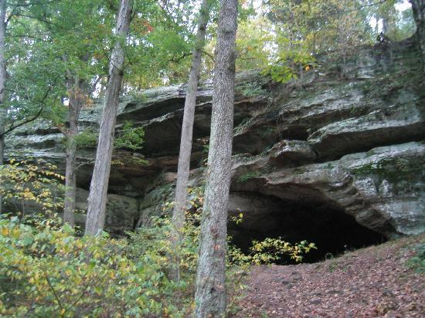
What Happen To The Guy
The guy ran all the way and he was so tired that he was calling for help but the dragon broke the phone and took him to there base.
Choice 1 Hit the dragon and fall
Choice 2 Let the dragon take you

Slide 4
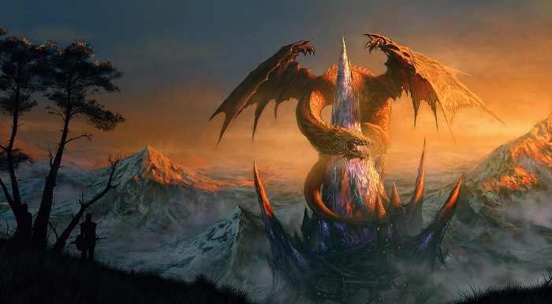
THE FUN PART!!!
Then the guy ran all the way to the forest but one of the dragon got him and took him to there kingdom!!!
Choice 1 go in a dark cage
Choice 2 Or try to escape

Slide 5
YOU LOSE ! HA HA HA

Slide 6
YOU WIN

