Slide 1
The jungle
DA DA DA!!!

Slide 2
ONCE IN THE JUNGLE
THERE WAS A BOY HE SAW A CLIFT AND HE WANTED TO GO TO THE OTHER SIDE
USE A TIGER TO JUMP
OR YOU JUMP OVER IT

Slide 3
LETS GO
YOU MADE IT THERE WAS A LONG
ROPE IN THE TREE IT WAS ALL SLIMY
USE IT TO GET TO THE OTHER SIDE
OR RUN TO THE OTHER SIDE

Slide 4
OH….
YOU DIED

Slide 5
YOU MADE IT BUT….
YOU ARE SO DIRTY AND THERE IS
A WATERFALL RIGHT NEXT TO YOU
CLEAN YOURSELF UP
OR KEEP ON GOING

Slide 6
COME ON MAN
FAIL

Slide 7
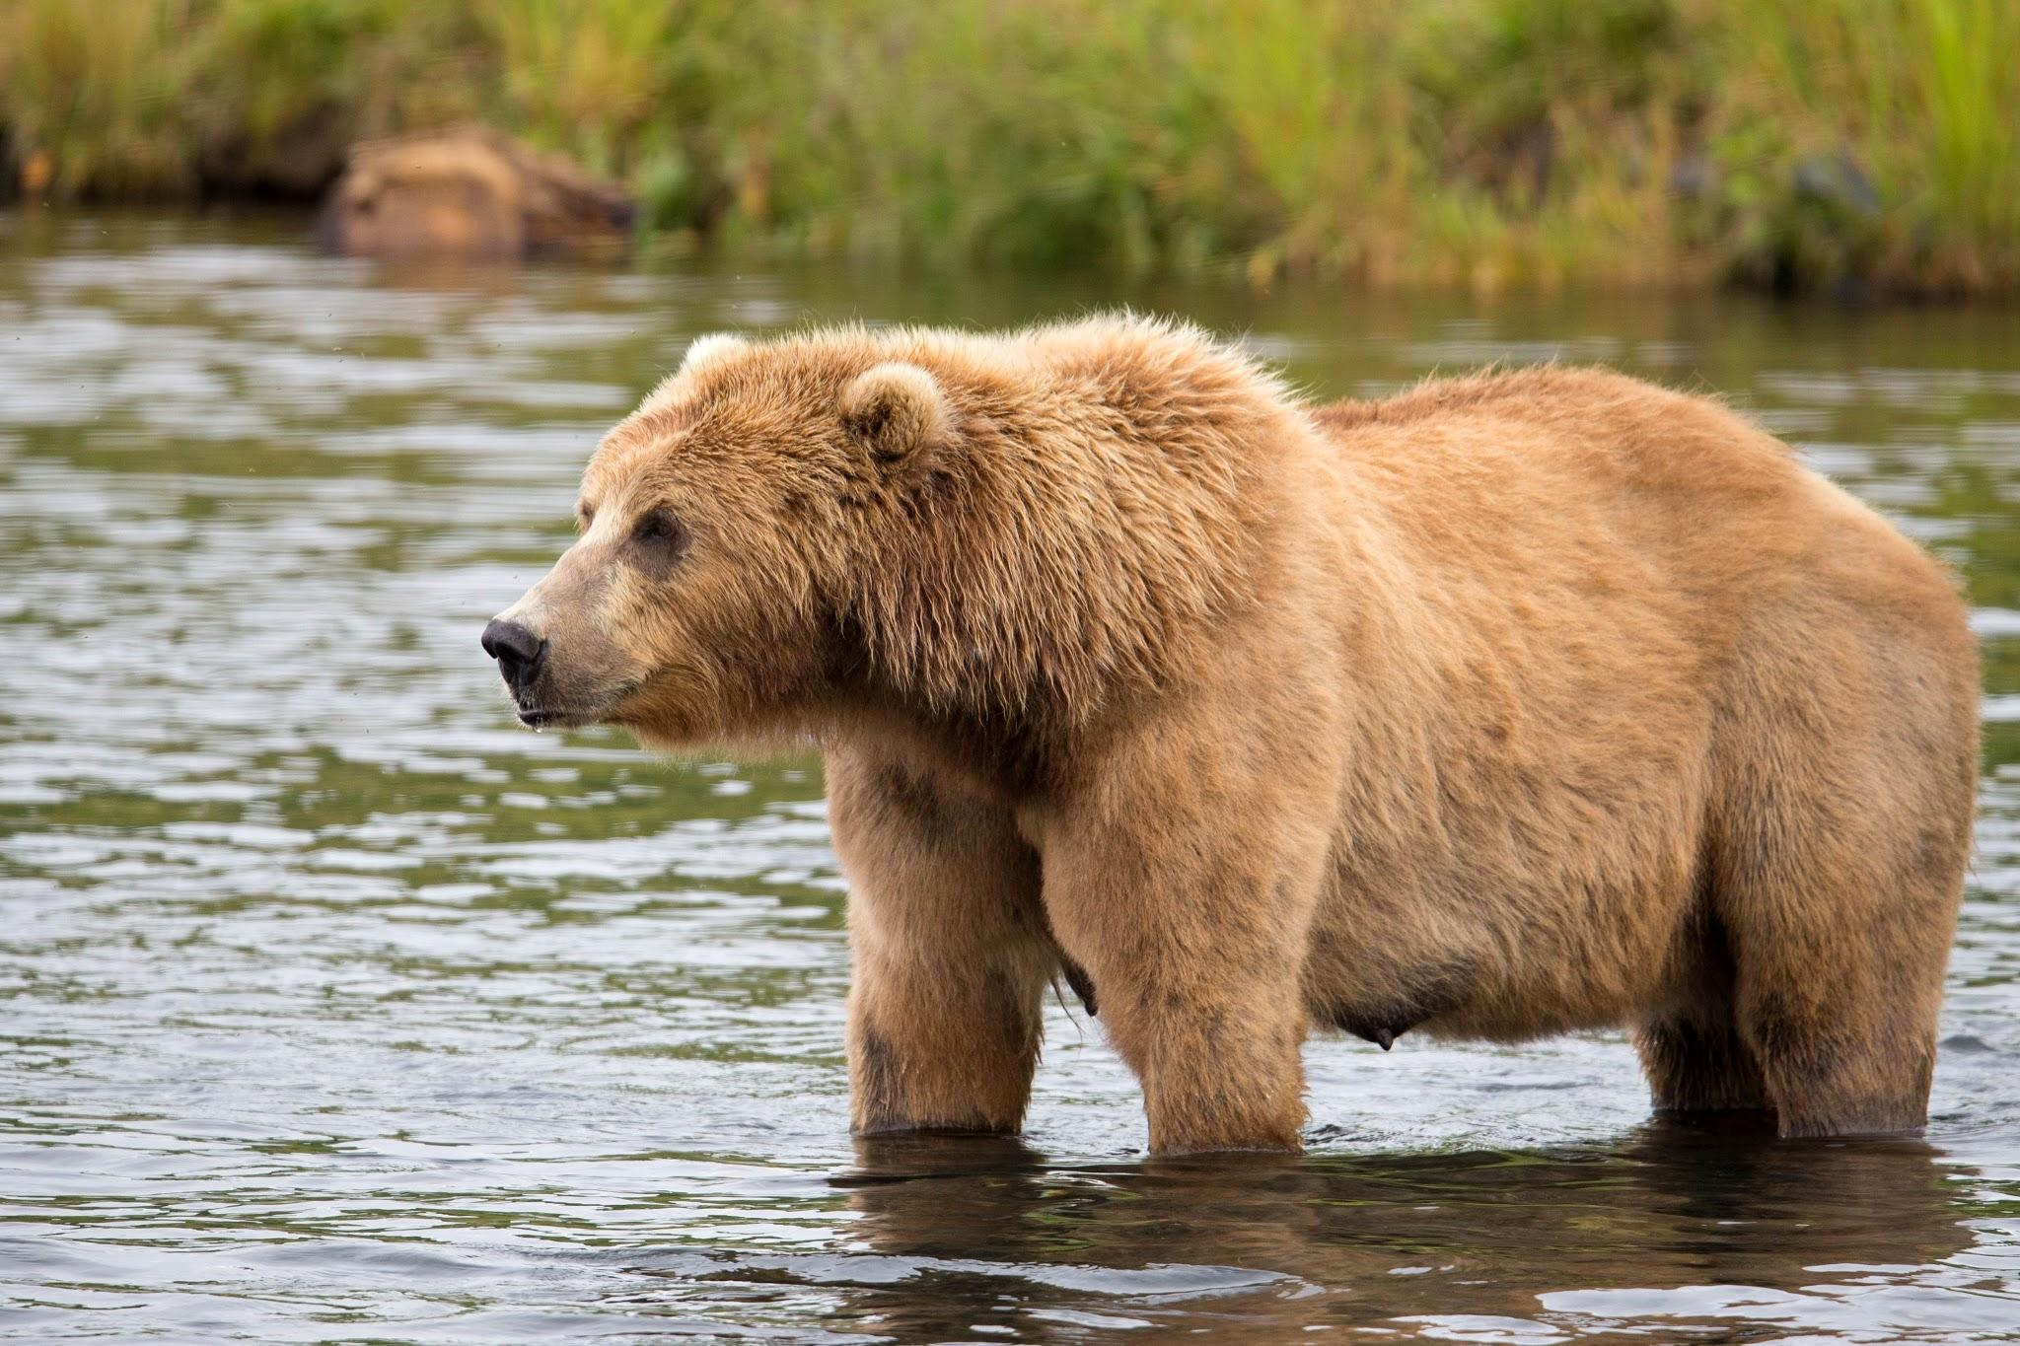
OH...
A BEAR ATE YOU UP FOR LUNCH

Slide 8
YES!!!
YOU MADE IT NOW YOU LEFT THE JUNGLE OF DEATH!!!

Slide 9
YOU SURVIVED

