Slide 1
Adventure story
BY abdulahi

Slide 2
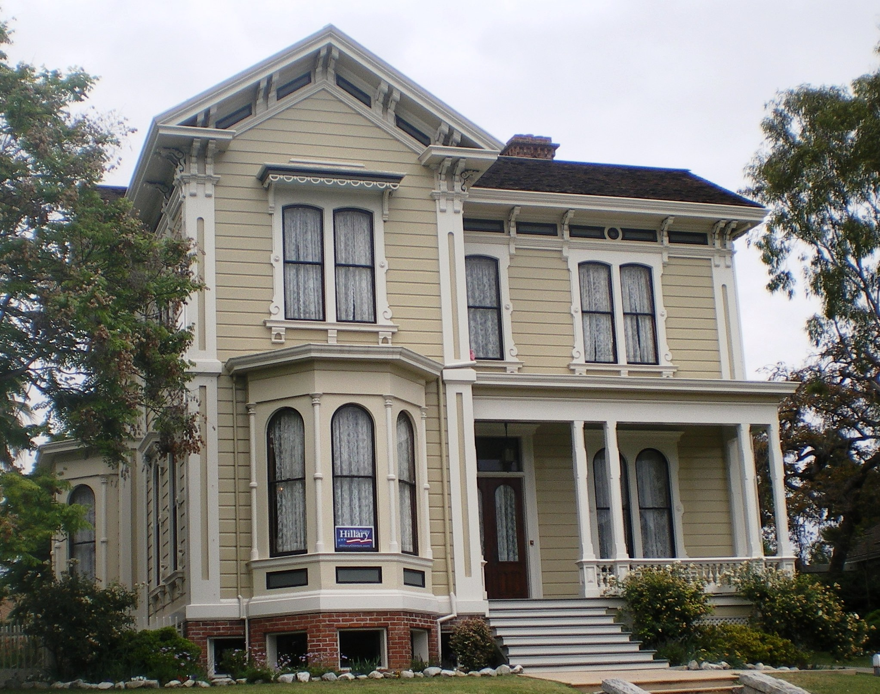
Introduction
Bob woke up and got dressed and ate oat meal and left the house. While he was walking there was a fork on the gravel path he was walking on. On the left was a Dark house & on the right there's a coffee shop and a McDonald's
1|Go left to the house
2|Go right to the coffee shop

Slide 3
Path 2 The Coffee shop
You relax and have a cup of coffee after you drink you go to work and die because coffee is addicting!!
|Restart

Slide 4
Path 3
You leave and go right to the Coffee shop You die because your allergic to coffee!
|Restart

Slide 5
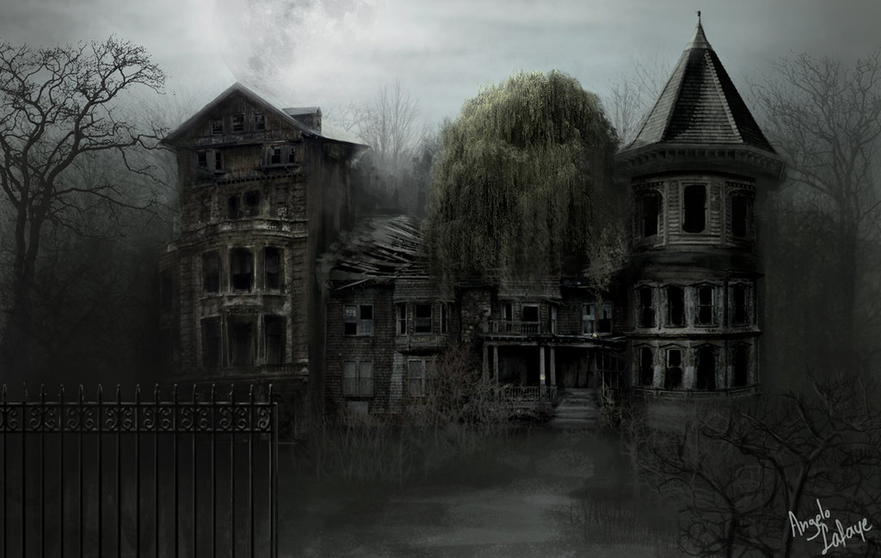
Path|1 The Dark house
You Chose to turn left and while you walk it gets darker. When you reach the house you knock on the door but no one answers. You feel that somebody is watching you should you leave?
1|Leave
2|Go in

Slide 6
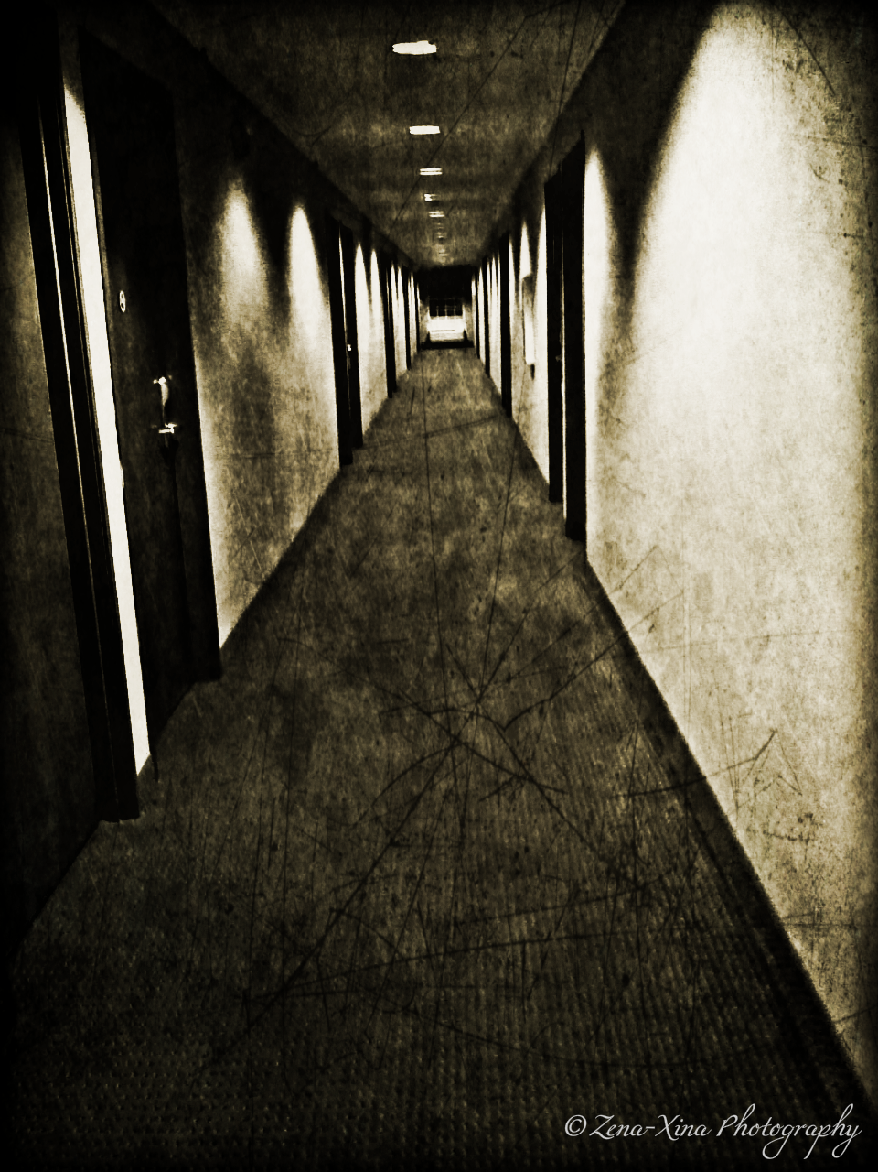
Path 4
You go in to the house because the door mysteriously opens you hear something the more you look around the house the louder it gets it seems like something is coming towards you
1|Leave the House?
2|Keep looking Around

Slide 7
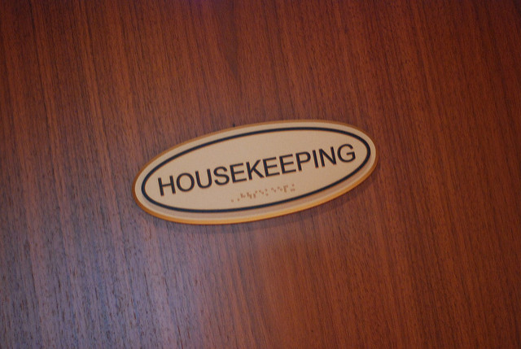
Path 7
You chose to stay and a man walks up to you and says ‘’why aren’t you cleaning this place is a mess!’’ You forgot you worked at the creepy house!

Slide 8
Path 8
You leave the house and notice a man watching you then you remember that the man watching you is the owner of the house and you’re the house keeper and he holds up a sign that says your fired.

