Slide 1
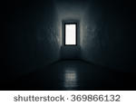
Once there was a boy who woke up in a mysteriouse room by himself he see’s a door

Slide 2
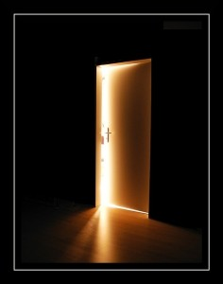
What do you do
Run out the door
Wait and see who comes in

Slide 3
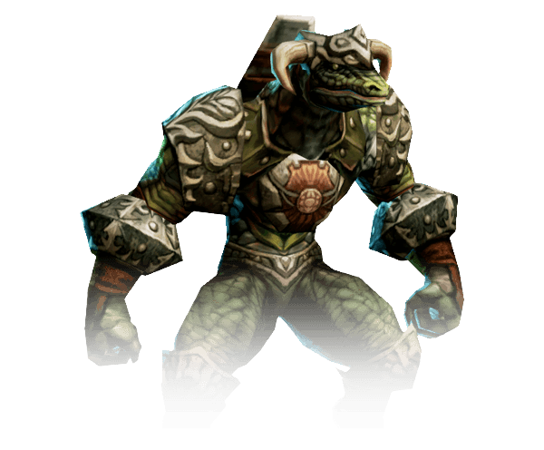
You chose 1
You ran out the door you see a weird looking lizard/human . It looks like it eats people to be more like a person
do you
Try to fight it
Try to sneak around it

Slide 4
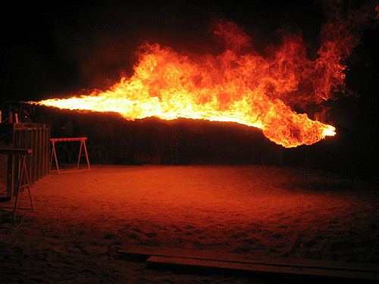
You chose 2
You waited and see who comes in then you see a robotic man he says ‘you will now die’ he pulls his flamethrower out and burns you to ashes.

