Slide 1
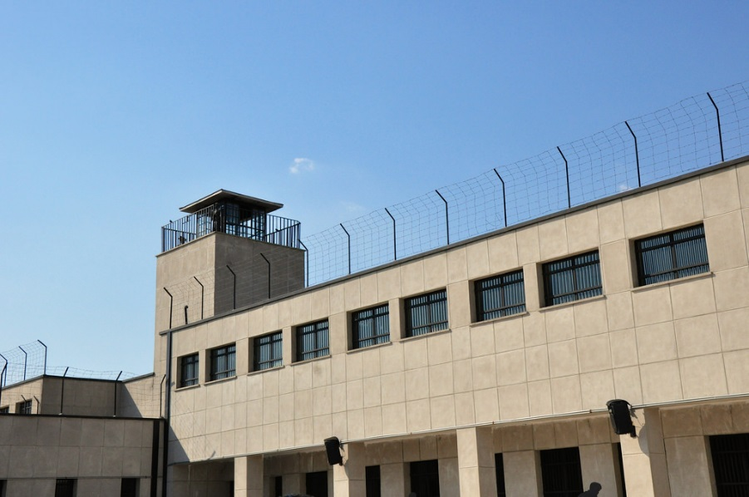
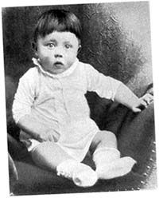
Prisoner of war WW2
Survive war by ahmad

Slide 2
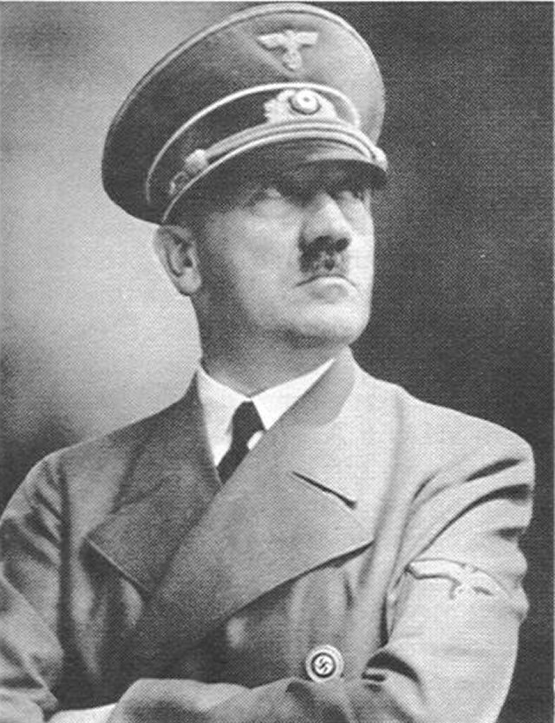
What to do
Hitler asks to go to army
Choice1 yes
Choice 2 no

Slide 3
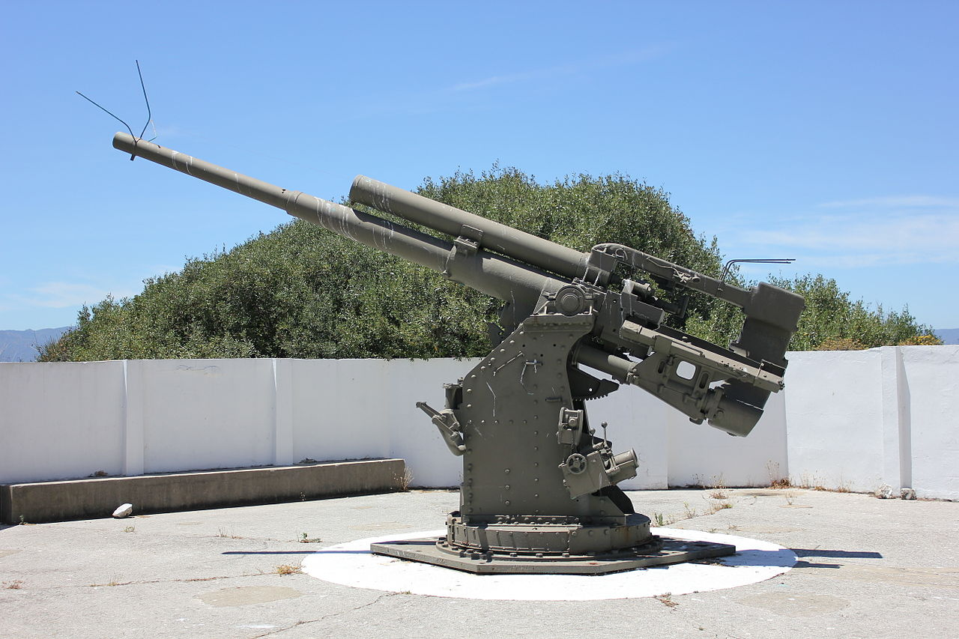
Choice 1
You go fight in airplane in blitzkrieg and can shoot enemy anti tank to save the tanks or anti air what to you do
Choice 1 anti tank
Choice 2 anti air

Slide 4
Choice 1 choice 1
You shoot anti tank and saved your friends but anti air shoot you

Slide 5
Choice 2 choice 1
You will shoot anti air
You can play roblox or minecraft
roblox
minecraft

Slide 6
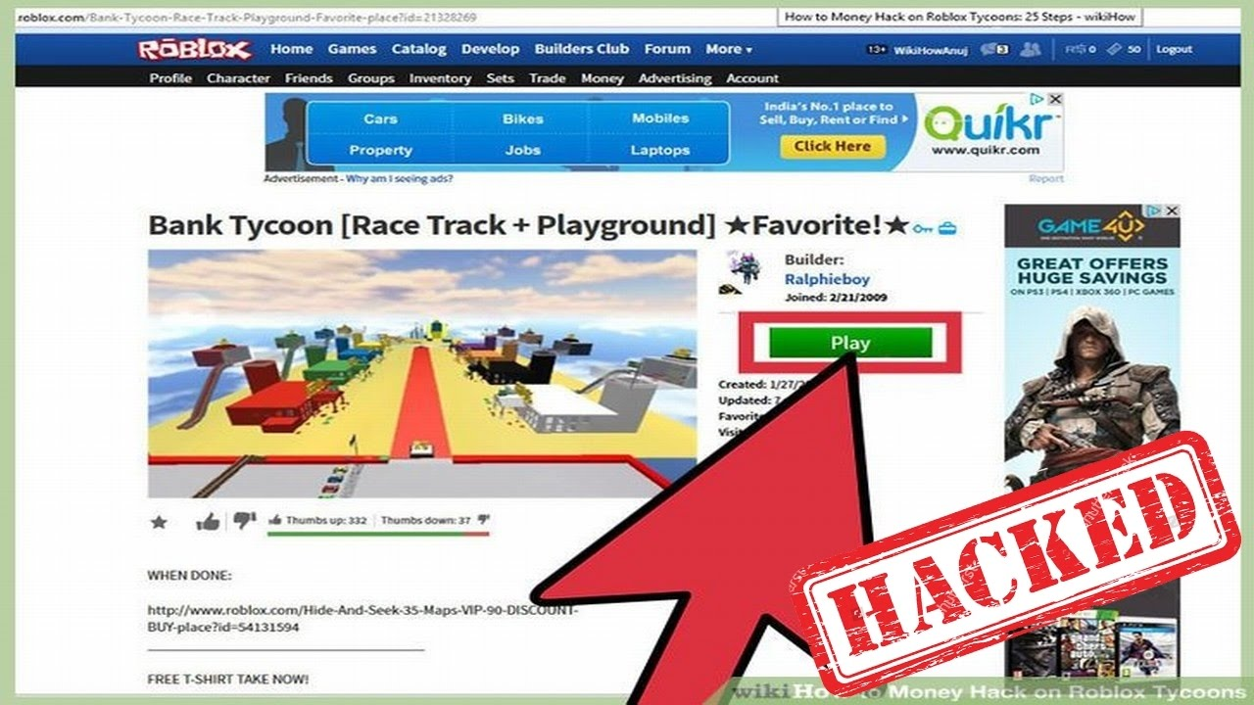
roblox
You get hacked
YOU LOSE

Slide 7
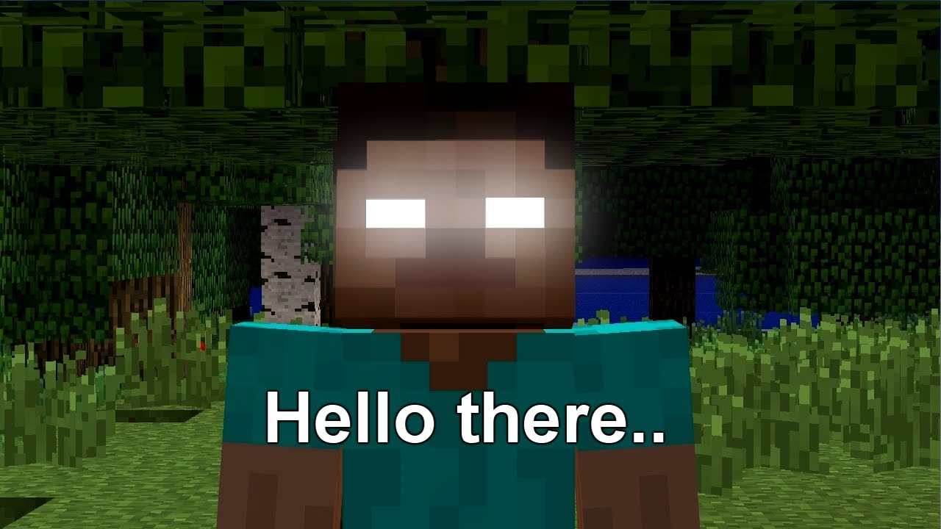
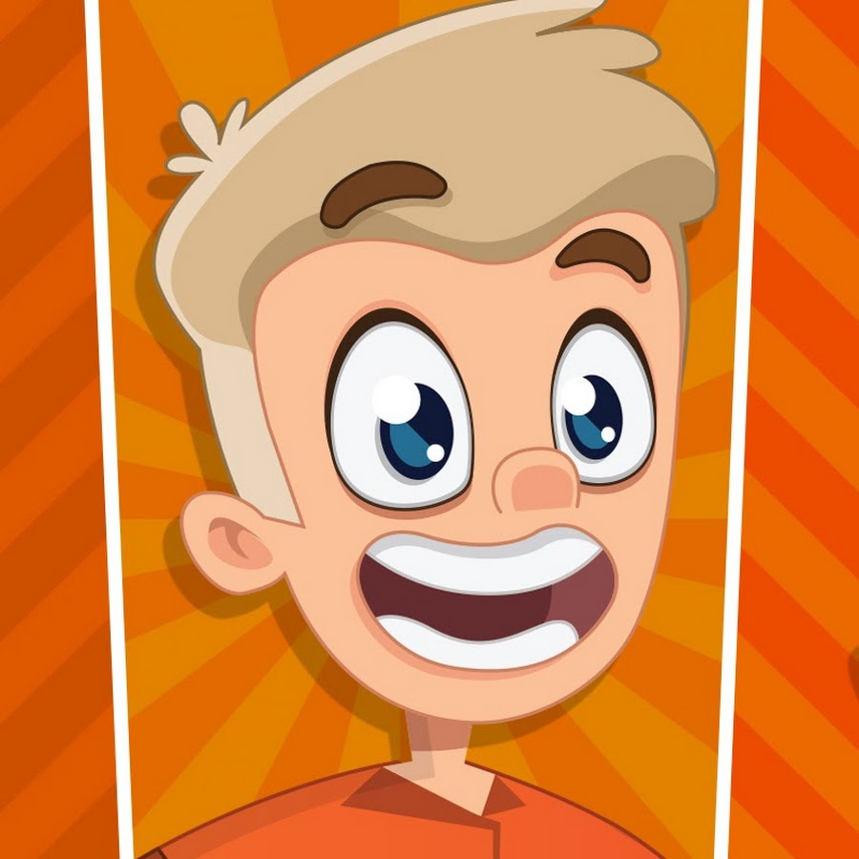
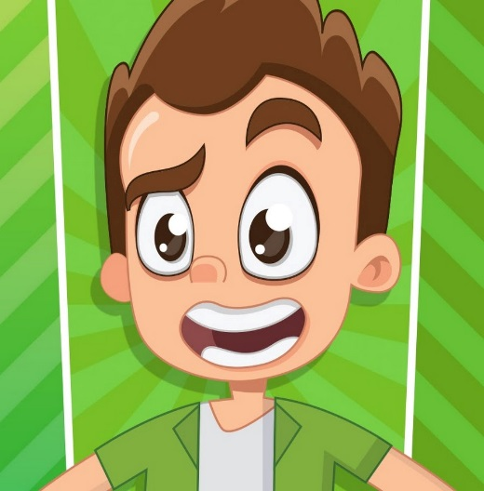
minecraft
You don not get hacked but you see someone called herobrine you also see the pals
ddd

Slide 8
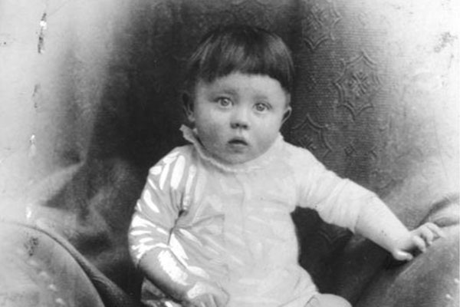
Choice 2
Hitler kills you. the end.

