Slide 1
It’s a drone world after all..
In a different time line humans have sent almost light speeding drones to other worlds to get information for new ideas to spread.
You are the first one in a family of SNWs- Search New Worlds - you being SNW-4, the last one of the SNWs.
You are sentient on propos- your first choice is here.
Choice One- Go with SNW-3 to a prosed white hole (opposite of a black hole, spewing thing out) for infine energy.
Choice Two- Go with SNW-1 into Titan to find usable water.

Slide 2
It’s helping at least.. 1
You go with SNW-3 to the white hole- maybe out of greed, friendship- whatever it is, you go to it.
You travel though empty space for about half an hour- in till you sense a gravitational wave
Then- you see it.
The white hole
Choice 1-1 –Use all your sensors to science it all you can
Choice 1-2 –Use your Reiller (your refuel tool) to steal all of the energy for only you two

Slide 3
For SCIENCE! Choice 1-1
You use all you can to SCIENCE! All of it, and you successfully get the info back to main control.
“Use your net to get the Q&Es.”
Choice 1-1-1 – Listen to MC
Choice 1-1-2 - Pretend that your sensors just messed up

Slide 4
For Earthlings! Choice 1-1-1
You- successfully- collect and travel back to Earth with them. They create a utopia powered by them
You are celebrated and loved for everyone around the world
Ending 1-1-1
For Humanity!

Slide 5
For The Better.. Choice 1-1-2
You say,
“Sorry, my sensors just got a wrong signal.”
MC says, “We’ll fix you right up!”
MC thinks you are telling the truth.
Ending 1-1-2
Keep the lying a secret, okay?

Slide 6
Greed… Choice 1-2
You are overwhelmed my the source of power and run next to it to steal it.
But you only are turned into electrons and quarks
Ending 1-2
Greed is life, is it not?

Slide 7
Only thing of your makers.. 2
You go to Titan to help your makers, with water.
You come to the planet in about 2 minutes by your faster-than-light-sail.
You nodise that some organic partials in the water
Choice 2-1 : Send your friend to investigate
Choice 2-2 : Send your self to investigate

Slide 8
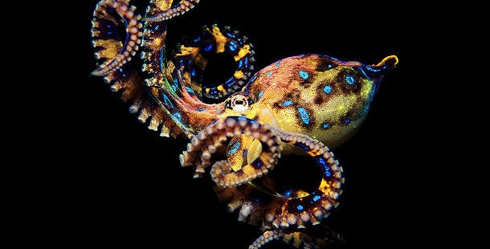
Chioce 2-1 : The New is The Leader
“Hey, SNW-1, can you investigate that weird matter for me?”
SNW-1 does, but he got eaten but a weird octopus looking monster eats him!
Choice 2-1-1 : Fight!
Choice 2-1-2 : Run and tell Main Control!

Slide 9
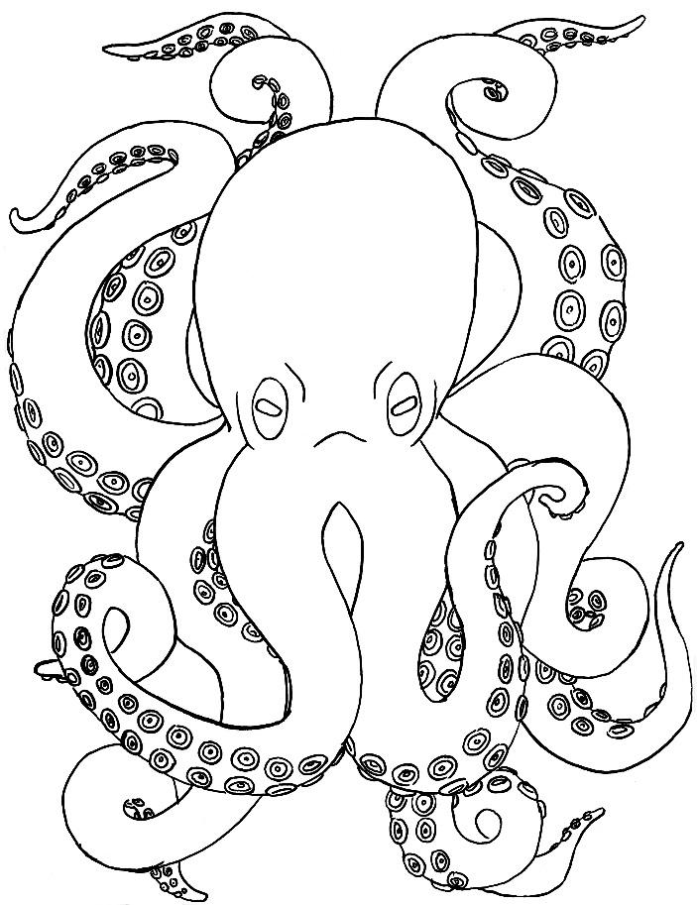
Choice 2-1-1 : FOR GLORY!
You fight the beast with your Glozer-7682 ver.
“GLOOO!” The beast says.
The monster eats you whole.
Ending 2-1-1
Fighting is life, and Life is a Fight.

Slide 10
Choice 2-1-2 : Scary is okay..?
You run away just in time to get away and get back to Earth.
They read your visual proesser and never go you Titan again..
Ending 2-1-2
Life is Scary, Right?

Slide 11
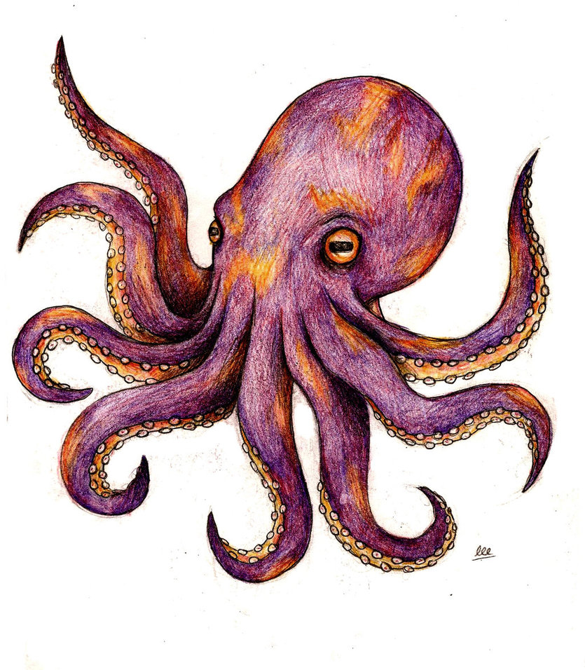
Choice 2-2 : Your Brave, Yes, Brave..
You dive in but are eaten by a octopus-looking monster!
Your last traction with humans are this:
“I’m going in-”
Ending 2-2
Brave, You are.

