Slide 1
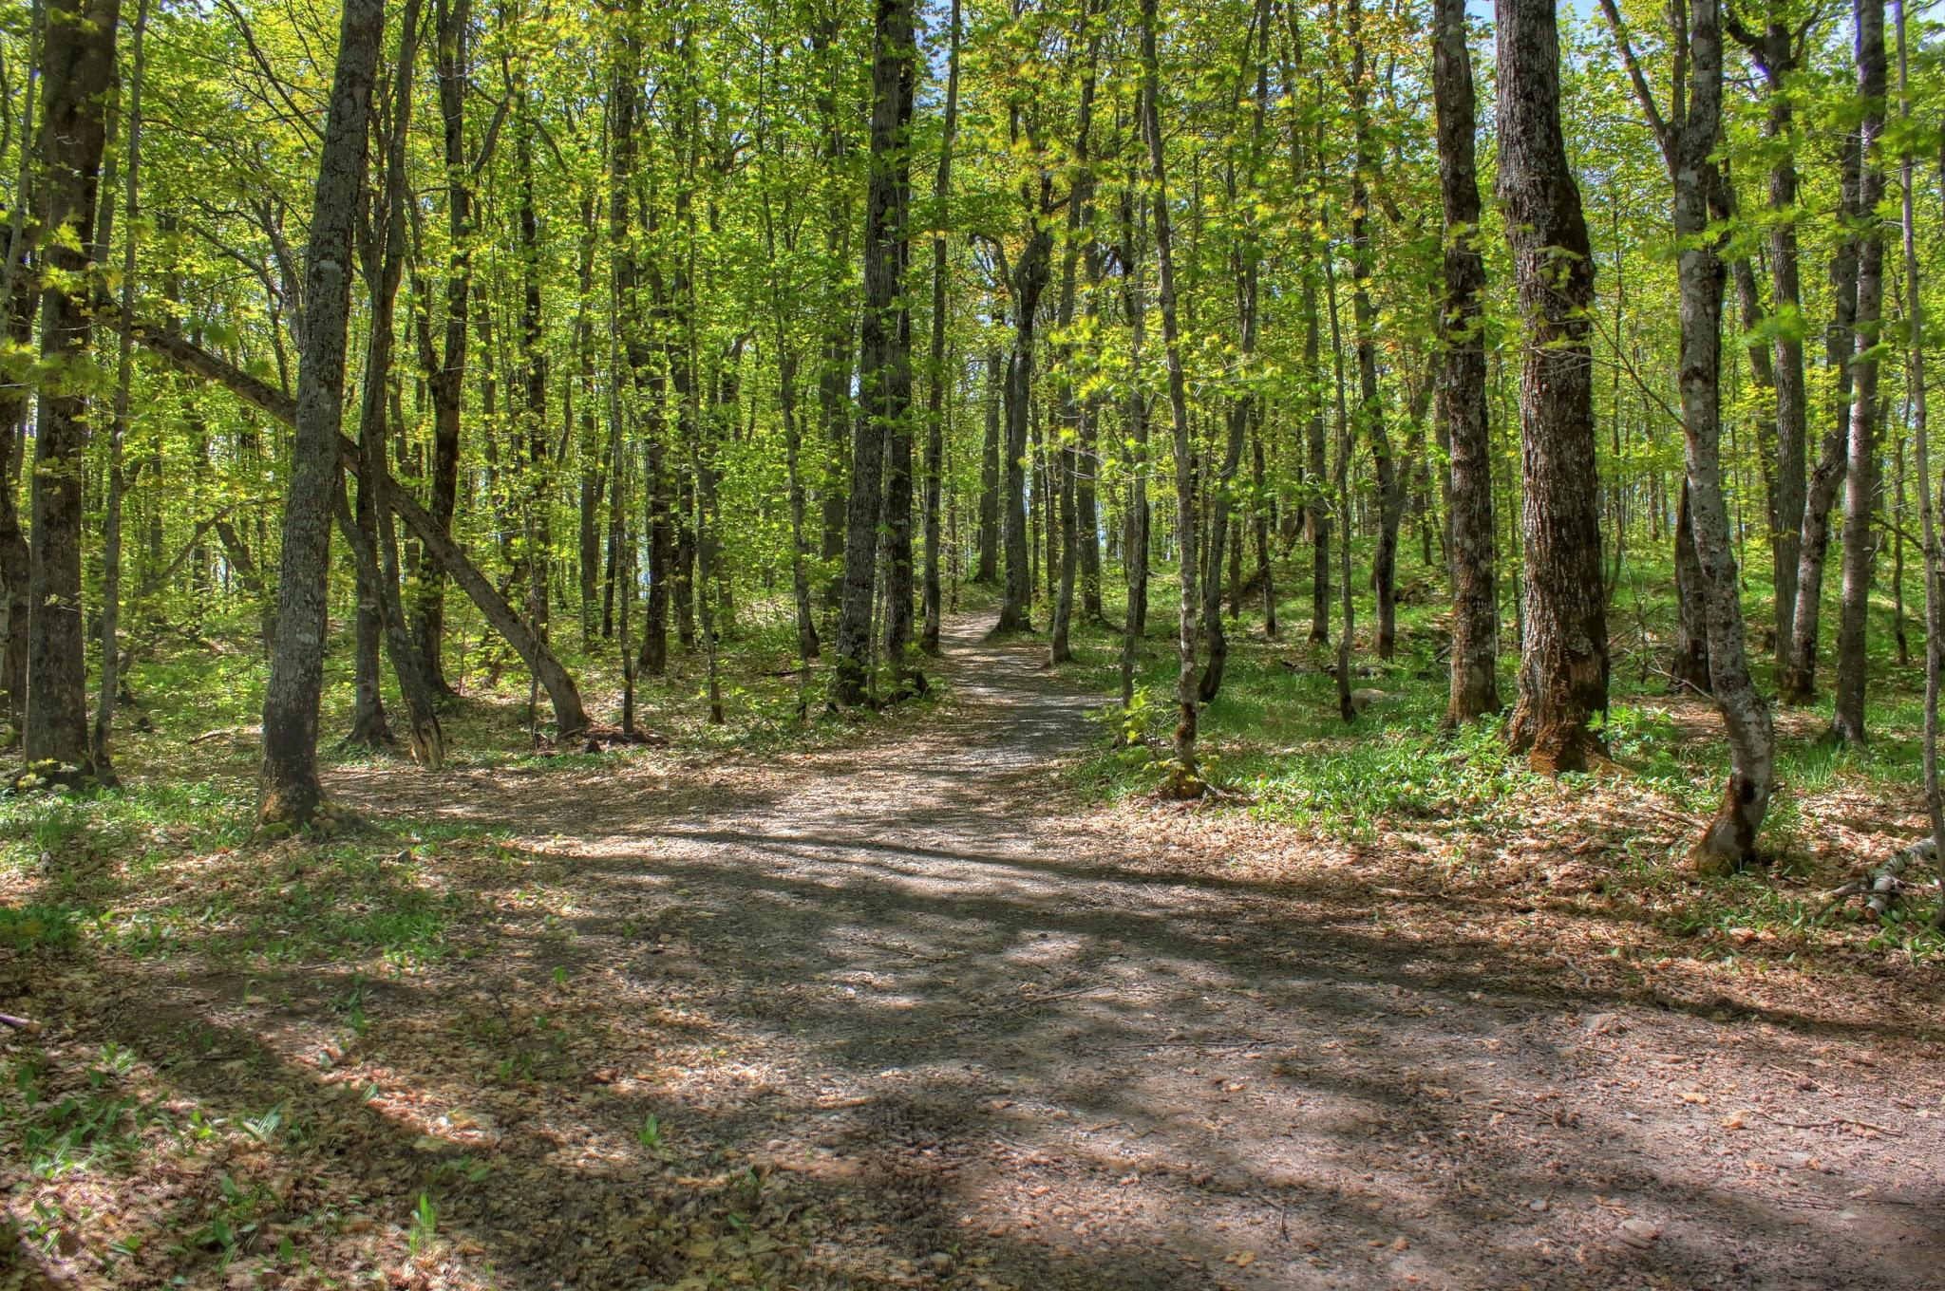
Lock and lost
By:Alexa

Slide 2
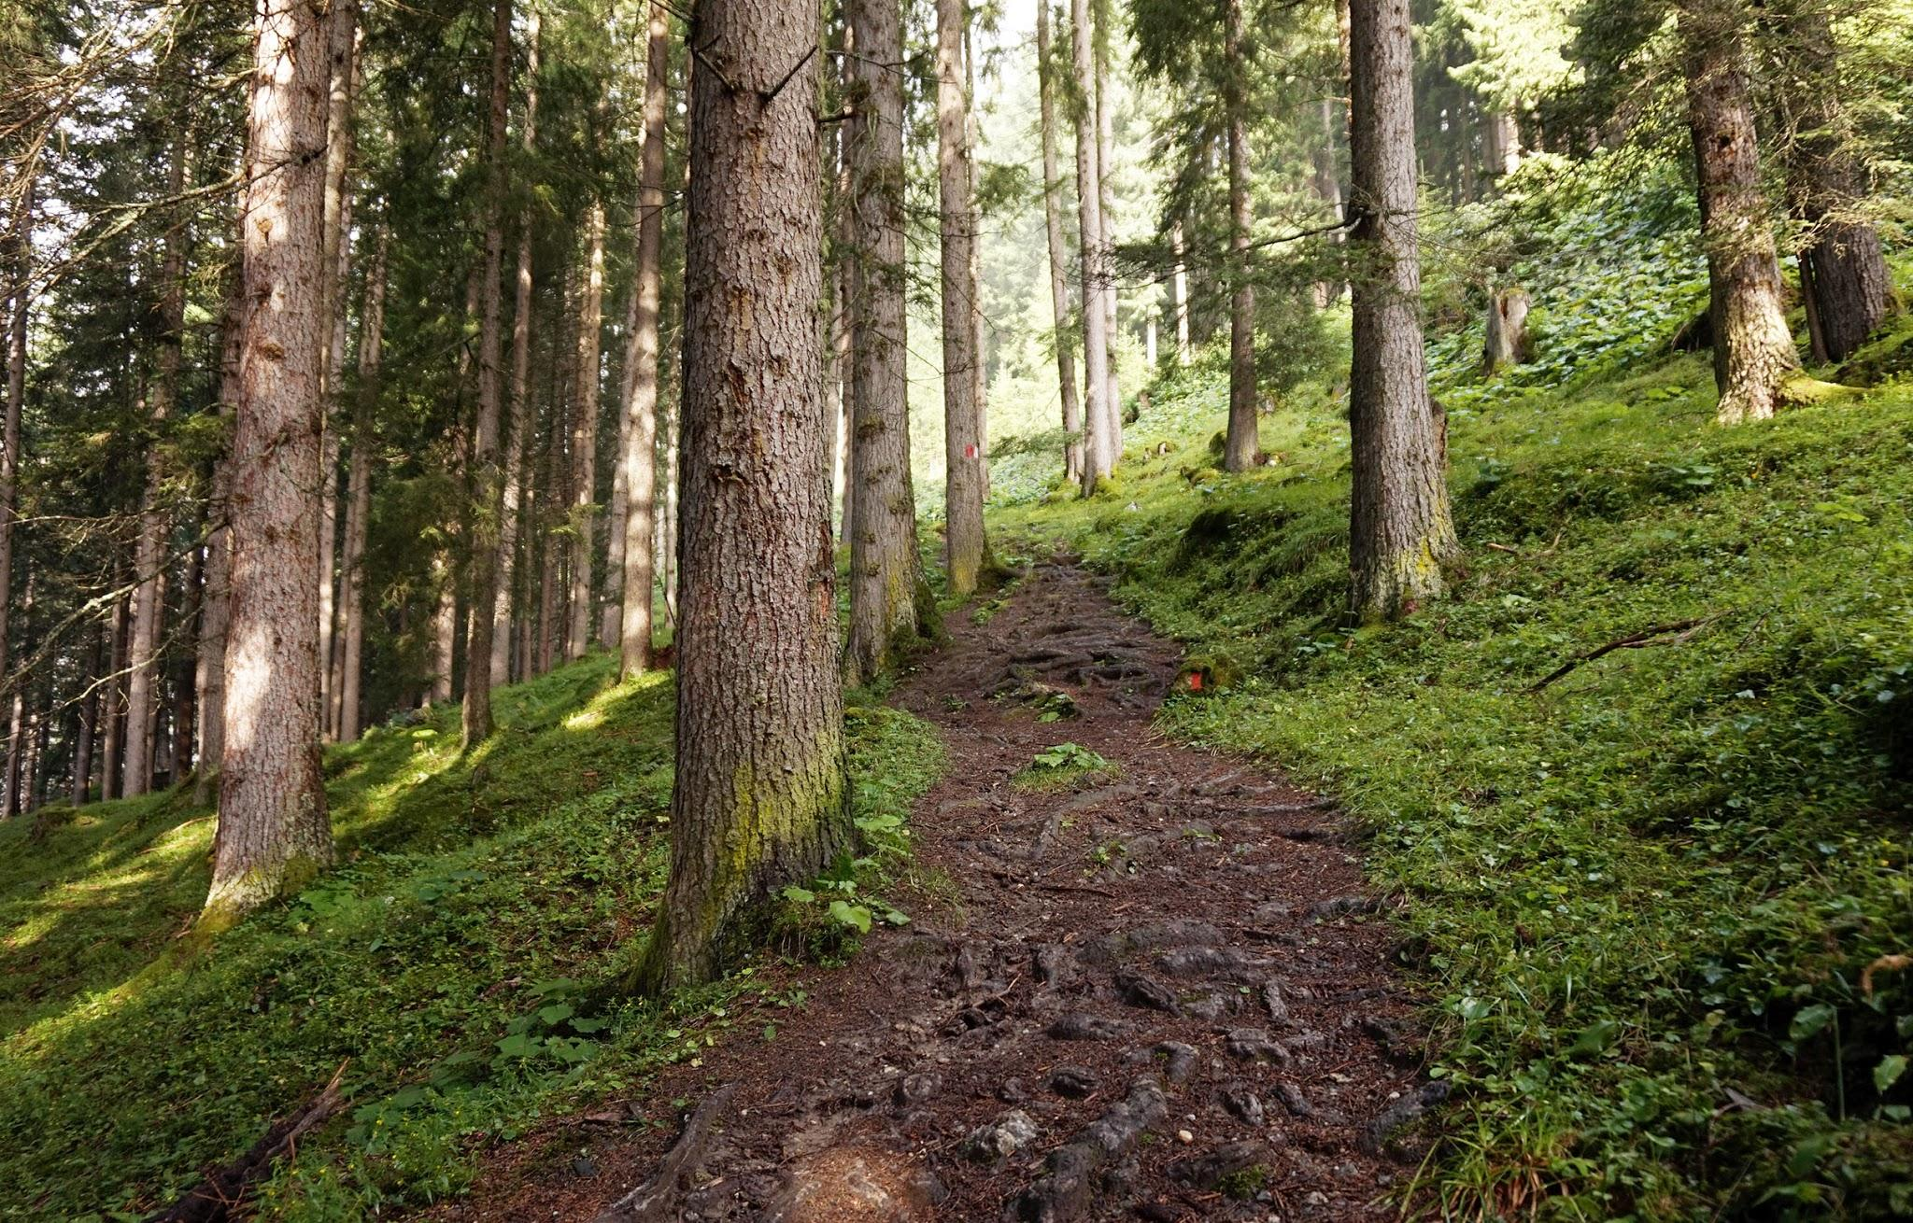
One time...
You were walking on a trail and suddenly it ended in the middle of nowhere. Dun dun dun! What should you do? Should you…
Walk back
Walk farther

Slide 3
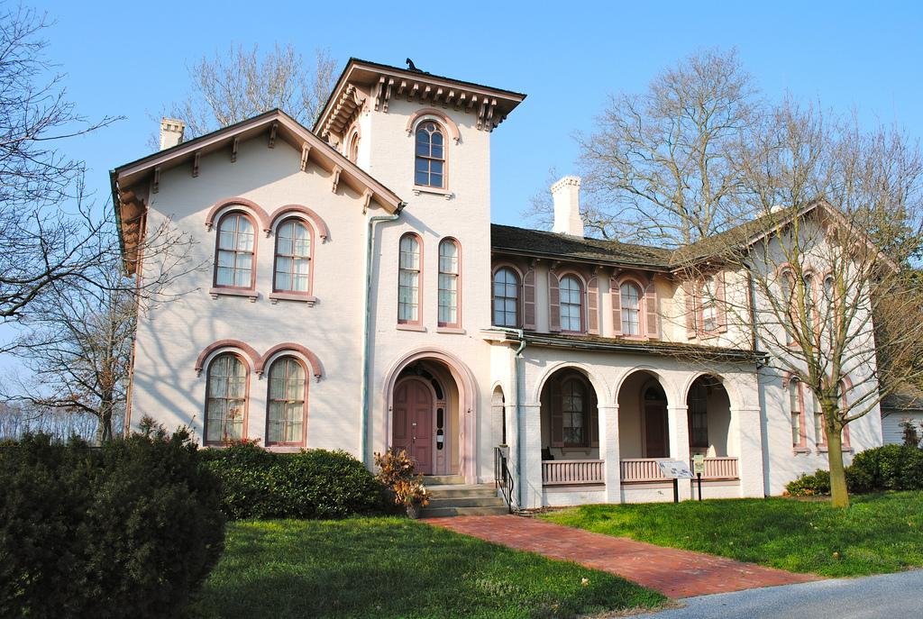
Walk back
You walk back and realize you are lost. You saw a big house far in the distance. Lets…
Go closer and go in
Walk away from it

Slide 4
Walk farther
You walk farther and fall through a small hole!
← ← Try Again?

Slide 5
Go closer and go in
You decided to walk closer and go in it was big but you realized you are trapped in now! Now what?...
Walk up some stairs
Kick the door open

Slide 6
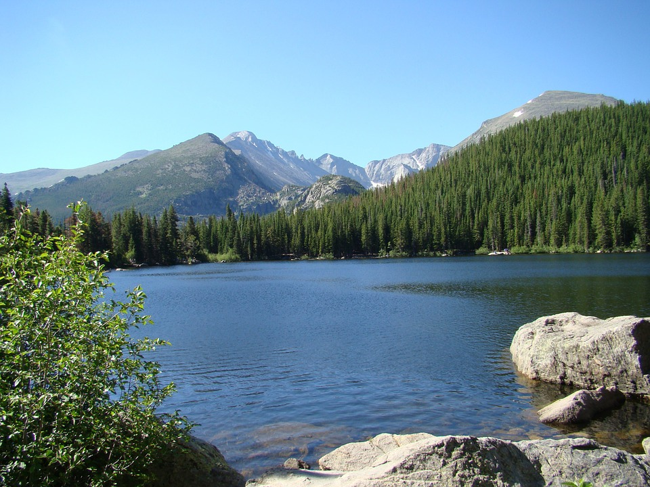
Walk away from it
You walked away and saw a tiger!!! You ran away as fast as you can but you fell in a deep long lake.
Try Again?

Slide 7
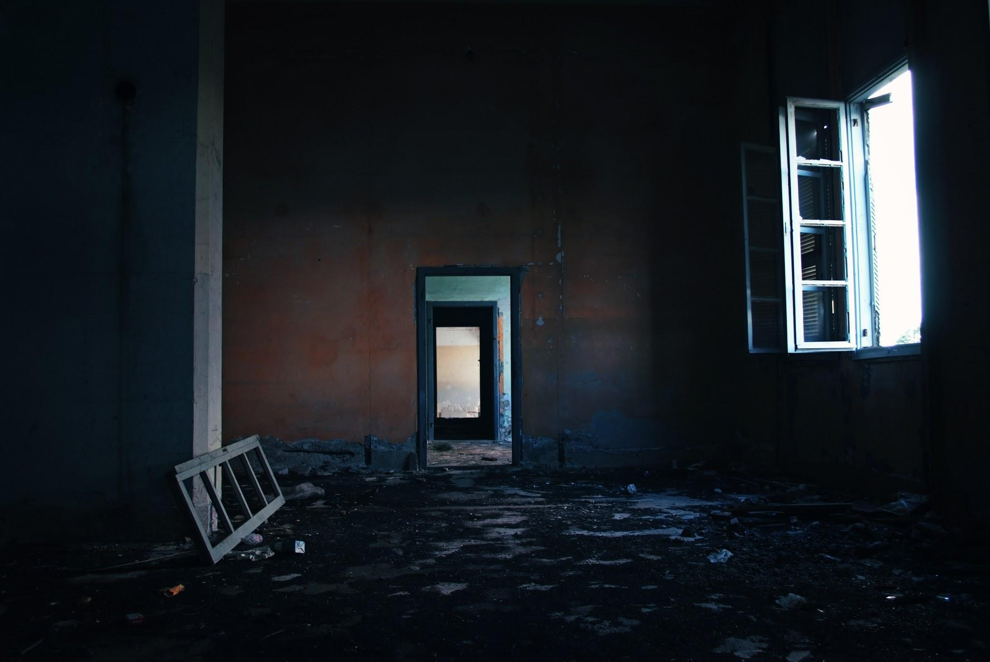
Walk up stairs
You decide to walk up some stairs and found a lot of scary things but you see something in the distance. It looks like a crack on the wall. Do you…
Go through
Leave it

Slide 8
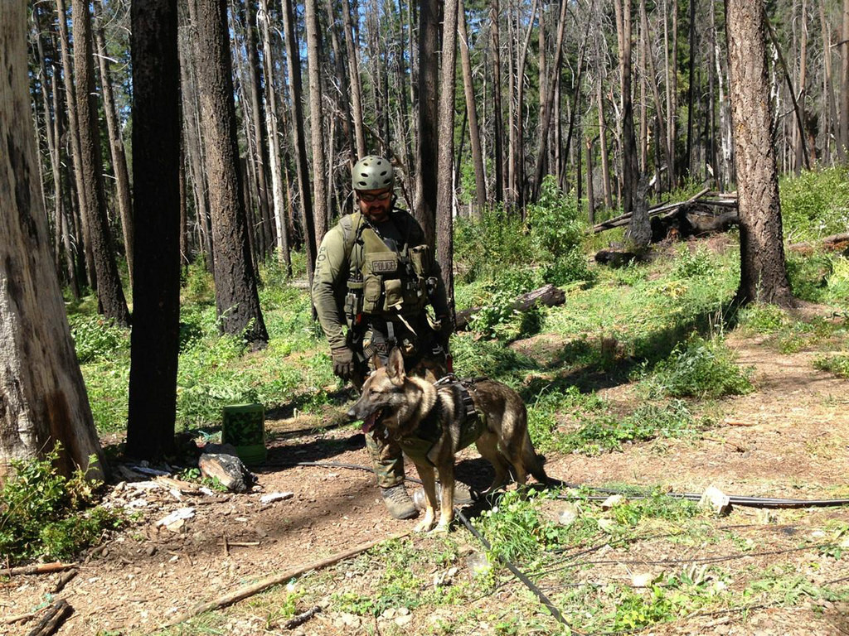
Kick the door open
You kick the door open and herd police outside they think you are a robber!!!!!
Try Again?

Slide 9
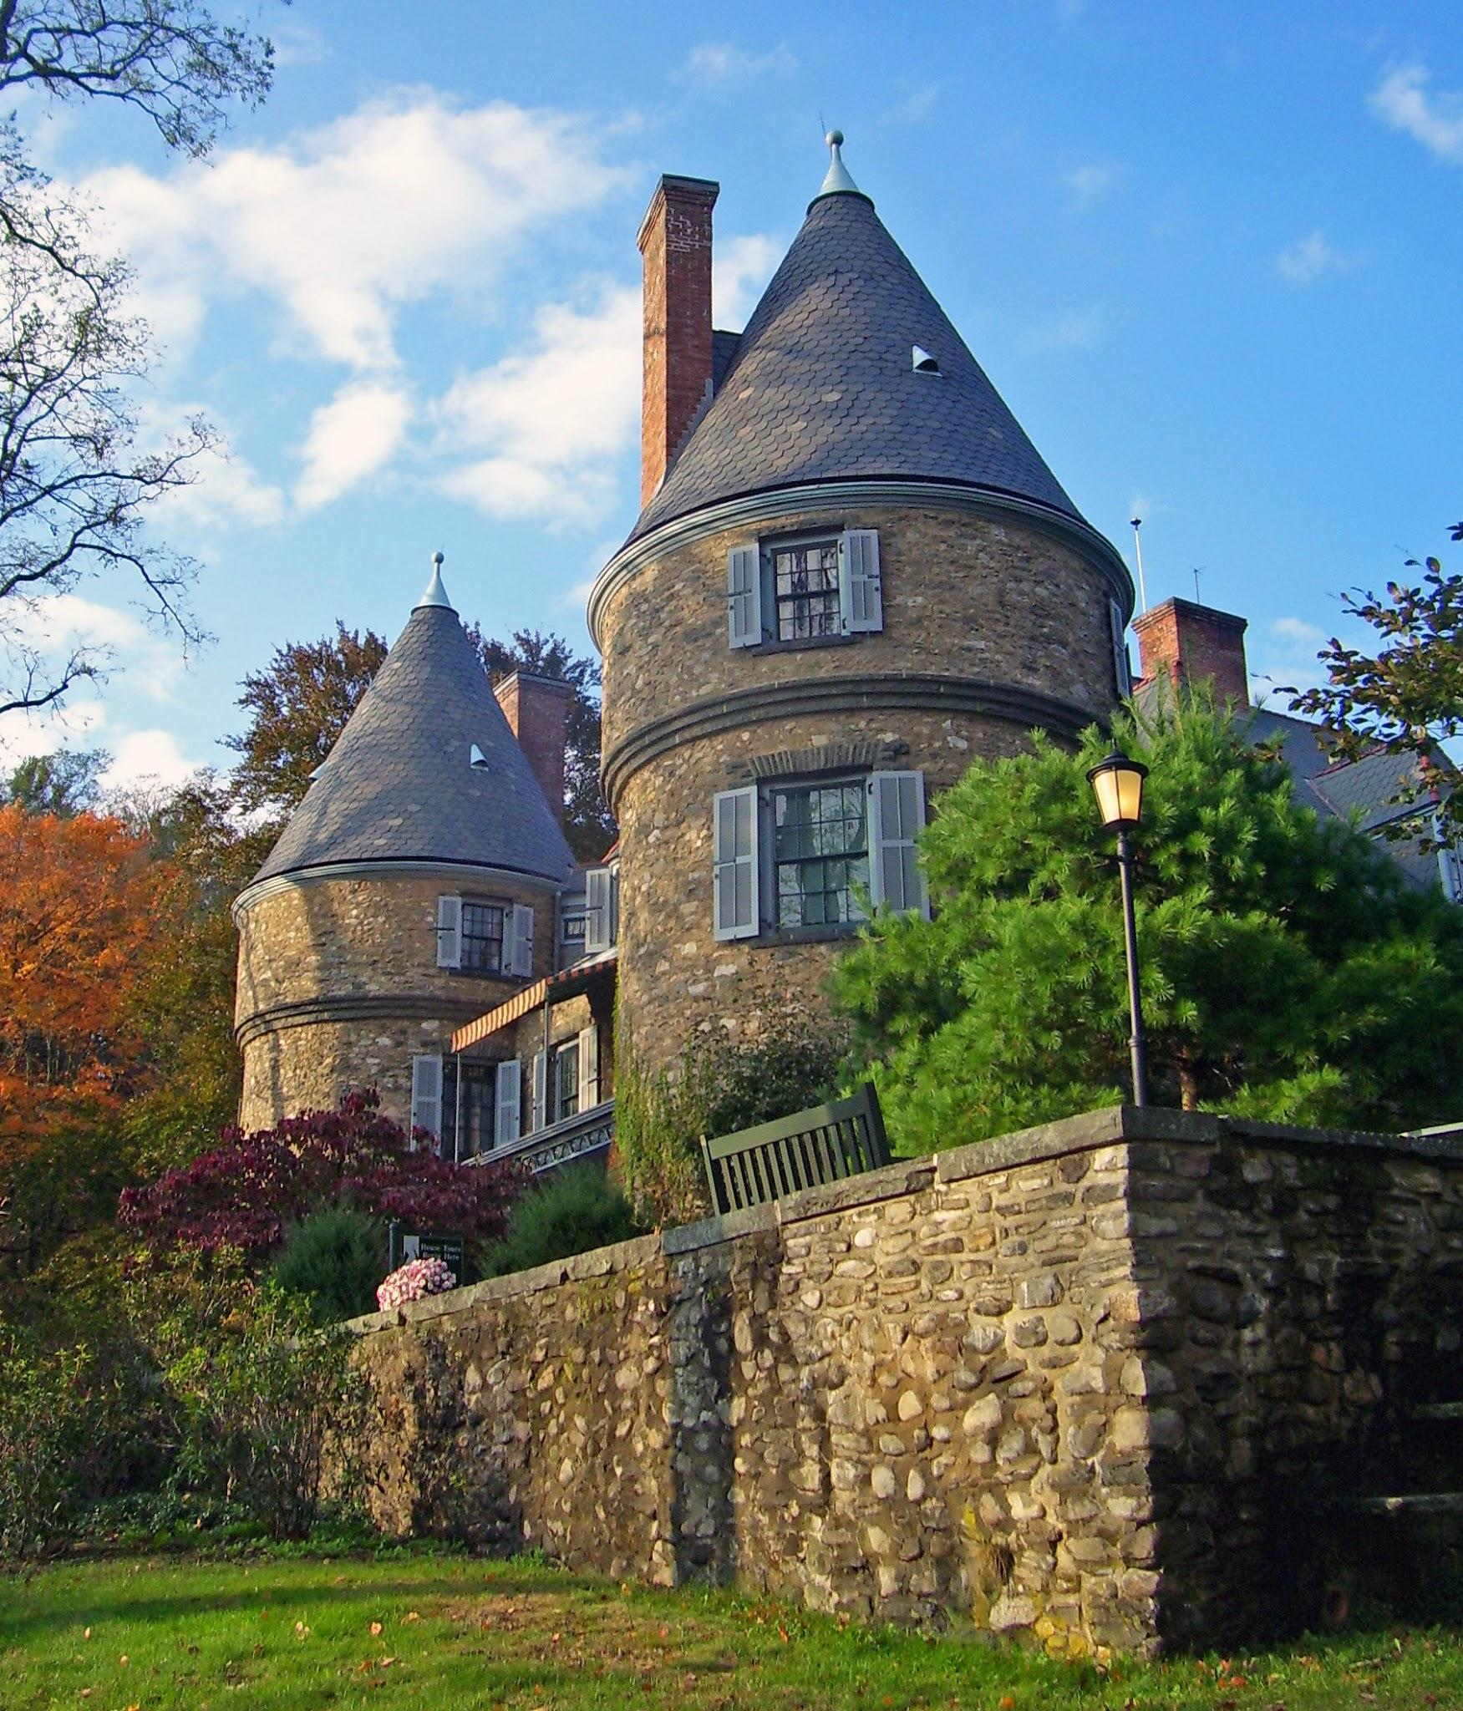
Leave it
You leave it but stayed trap in the house for 1 year.!!! Oh well
Try Again?

Slide 10
Go through
You go through and escape you ran away, it took a while but you see your house! Yay you made it! Now you know not to go in random forests. Lets rest. I wonder what is going to be my next adventure. “sigh”.

