Slide 1
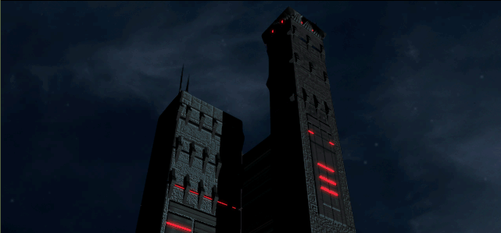
The dark night appears
By Alex Foreman

Slide 2
The machine
Some body is stuck in the machine some body is coming into his lab he freaks out some body is coming.
Find the key
hide

Slide 3
Part 1
HE FINDS THE KEY HE HAS SECONDS LEVED!!! WHAT SHOULD HE DO NOW.
Open the machine
Nocking him out

Slide 4
Part 2
You nock him out and he only has a minute until he is awake
Run and save his live
Open and run

Slide 5
Part 3
He opens the machine the guy walks he kills you
you lose good luck next lime

Slide 6
Part 3
You win ooh wait no more are coming
Jump out the window
hide in the basement

