Slide 1
Don’t get expelled

Slide 2
Once upon a time…
What is your character named
1 James
2 Jake

Slide 3
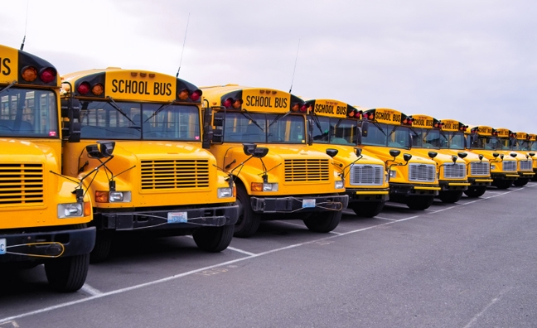
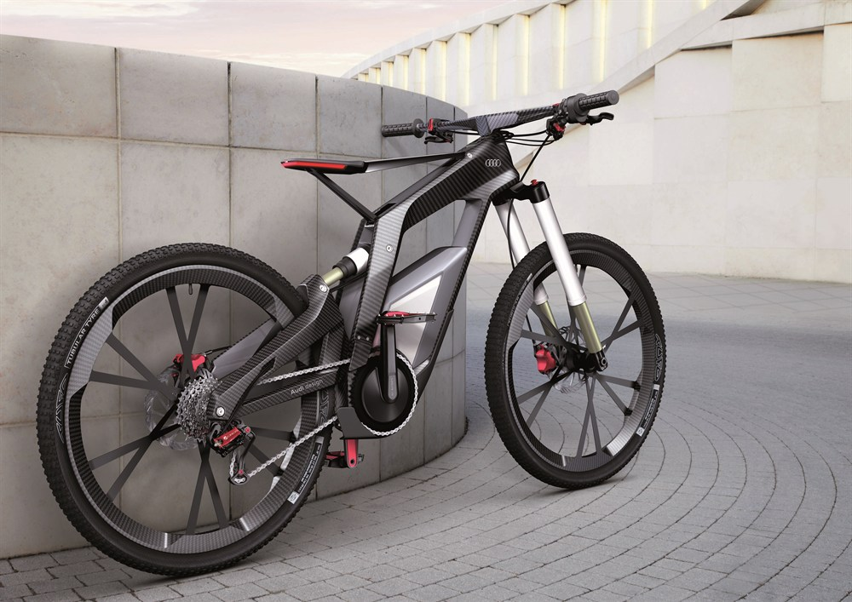
James school day
James's eyes slowly slide open and he suddenly realizes 2 minutes till first bell he gets dressed and run to the garage should he take the bus or his bike.
1 bike
2 bus

Slide 4
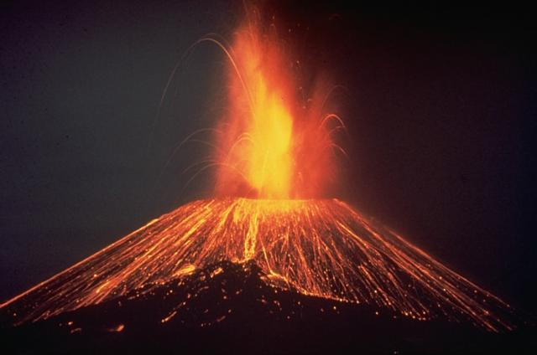
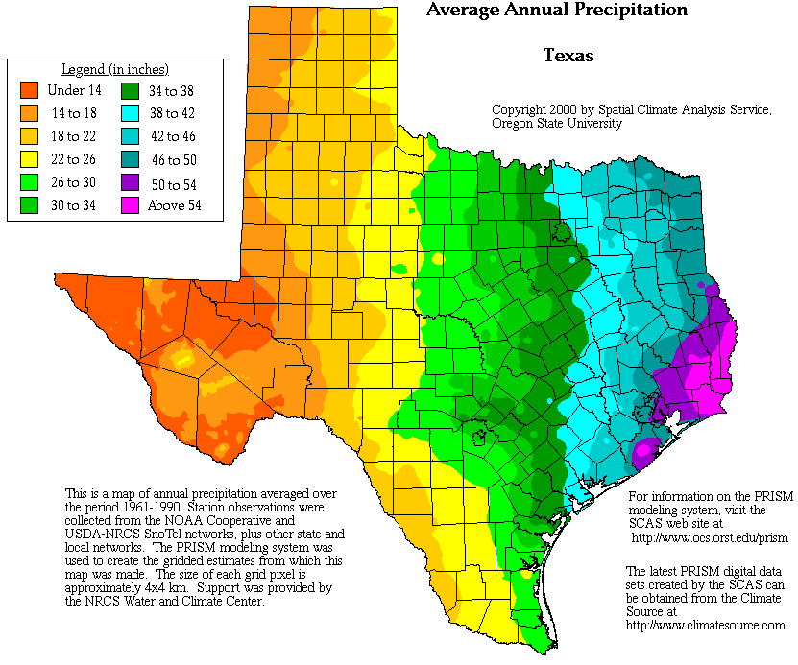
Jakes school day
He finishes right on time both of his science projects are done now he has to decide which to do
1 volcano
2 weather presentation

Slide 5
school
You and all the kids on the bus get into class on time and your teacher announces you get 15 minutes of study time for your big test.
Study
Mess around

Slide 6
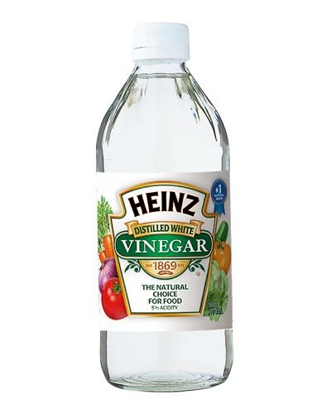
Volcano project
Your project works great except you put to much vinegar and you spray the whole class.
You cost 200 dollars in clean up you got expelled you lose

Slide 7
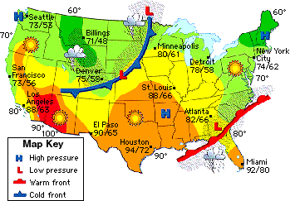
Whether project
Your project was a success and the whole class loved it you get an A.
You win

Slide 8
Test time 1
Since you studied you passed
You win

Slide 9
Test time 2
You messed around and failed
You lose

