Slide 1
Blood of the Olympians

Slide 2
Story Begins
It all starts one day when our hero wakes up and is Woken up by his mother Hera
Attack
Wake up
Go to sleep

Slide 3
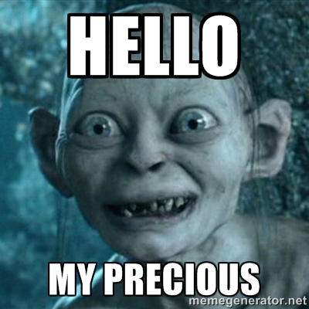
The Broken Road
You Fight your Mother And she Knocks you out And you wake up in Tartarus with your grandpa Cronus He Fight You He Glad to See you
Fight

Slide 4
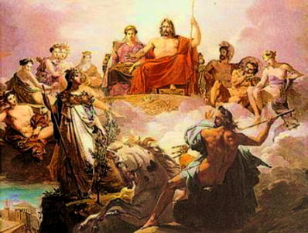
The Golden Path
You decide to wake up and not get on your mother Hera’s bad side And get invited to mount Olympus For Not Angrying Hera You’re Now A Olympian Your Mother Has been Hiding Your Name Your Hercules and your sent back down to earth to do your 12 labors And Hera Weakens You And You Die
You Lose

Slide 5
Road of Blood
You go to Sleep and Hera Leaves you alone For 15 mins then she gets Ares to scream And you wake You run to the door cut Ares up send him to Tartarus You do the same to Hera Who screams for dear life witch Wakes Up the Big 3 Who Don’t Have there Weapons You Turn and Grab Poseidon's Trident And Turn Apollo,Zeus,Hermes,Athena,Hades,Posidon,Artmeis And All The Rest of the Olympians into Fish sticks
You Win?

Slide 6
Kronos
You Fight You're Grandpa who stops Time Eats Your Soul And Takes Over Everything
You Lose

