Slide 1
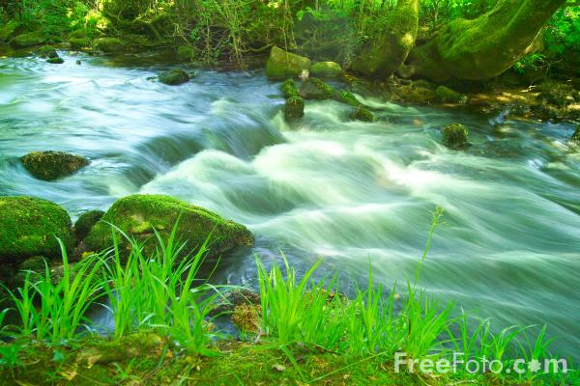
Adventure through the woods
By andre h

Slide 2
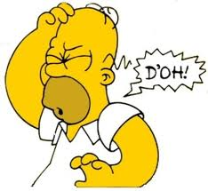
you were running through the wood enjoying my self until I ran into a tree. “What happin” walking around dizzy
Would you keep walking around
Lay down were you are at right now

Slide 3
You where walking around going side to side

