Slide 1
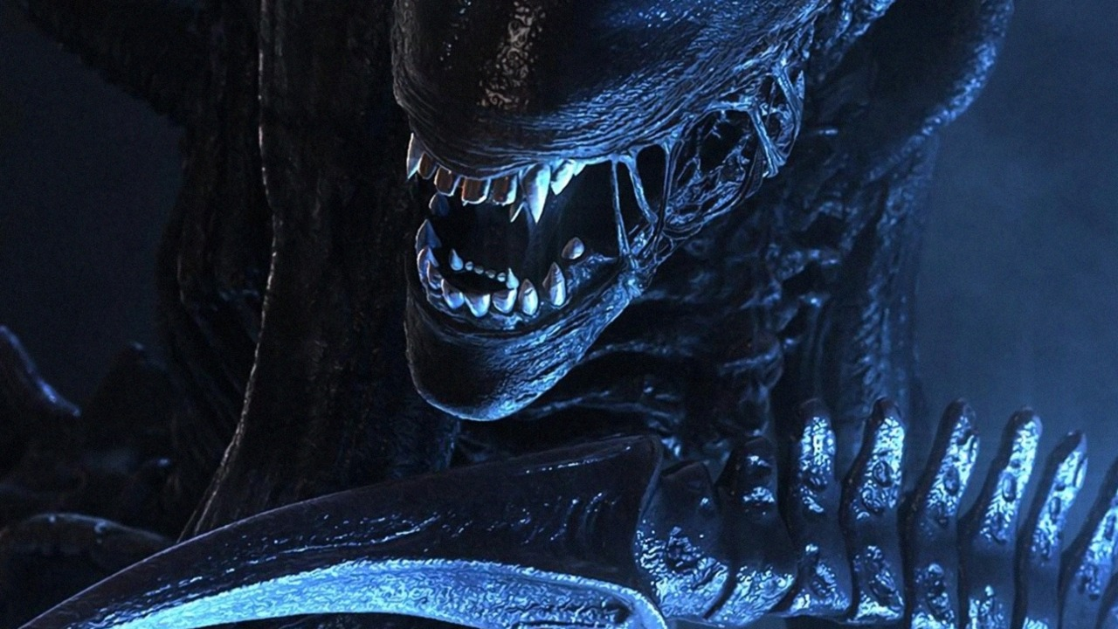
The Alien attack
By Asho A.A

Slide 2
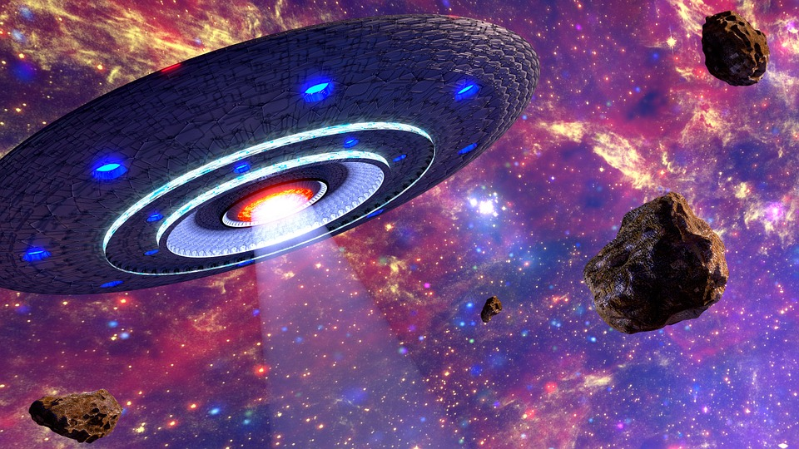
The creepy alien
It was a perfect day. You turn On The Tv You saw Alian Space Ship. It Say That They will Be a Huge space crushing. What should You do. Stop it. But There were One problem. You Were Grounded. For a week! “oh What should I do” If the Alian Attack we will all Died He said worried. What should You Do? Suddenly When The Allen came. The police Use gun on him. But it did not kill him. Which make the alien more anger and kill half of the people in the country. Than you said “ I have to fight This monster no matter what.

Slide 3
The Alien attack to plant earth
“ Oh the alien is here what should I do?” Just about when the alien attack The cops try to distract him. Would You
Run
Hide
Fight

Slide 4
Fight
You went out side Than The alien Pick a whole house and through it at you.
THEN YOUR LOSS!!!!!!!!!.

Slide 5
Run
You run Away and suddenly You look Behind And There was a spaceship that was speeding and it hit you and you
You DIE!!!!!!!!!!!!!!!!!

Slide 6
Hide
You were so scared where would you hide?
.Under your Bed
.Under The Kitchen table.

Slide 7
Hide chioce2
You hide and the alien came home and crush everything Except the the bed.
You should have hide under the bed
. You Loss!!!!

Slide 8
Bed
You hide under your bed The evil alien couldn't found you any where
You WON

