Slide 1
THE MYSTERIS ADVENTER
The mystery awakes By: asmaa

Slide 2
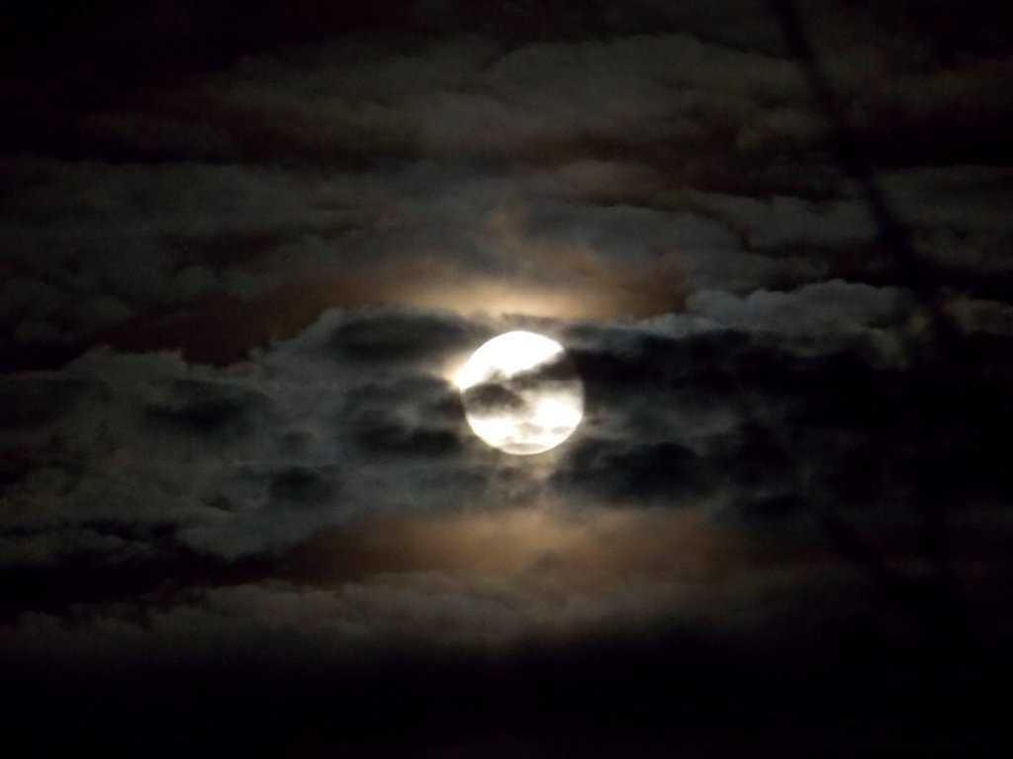
A mysterious time
One night there lived an young girl She woke up 12:00 midnight because there was some one at the door
Should she open the door
stay and hidePath

Slide 3
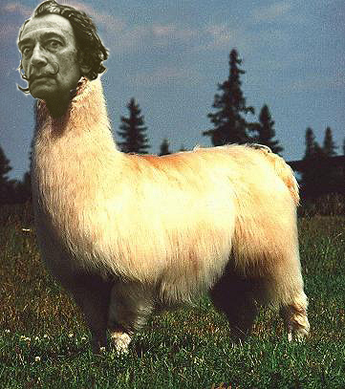
Path 1
You chose stay there and hide
big fat llama will brake your home and you die
GAME OVER!

Slide 4
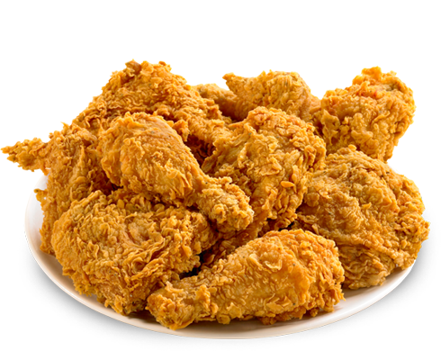
Path 2
He will ask you
“YOU WANT SOME CHIKEN”

Slide 5
Take the chicken or not
When he asks you do want the chicken
Would you take the chicken
Or would you run away.

Slide 6
The chicken is toxic and you die
GAME OVER!

Slide 7
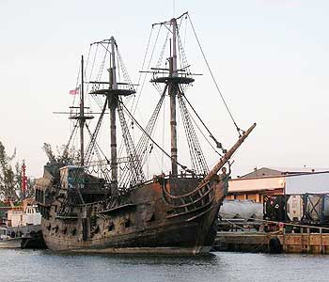
Pirates ship
You chose to run away the llama will case back to a pirate ship
The pirates will throw you of in to the ocean.
YOU LOSE

