Slide 1
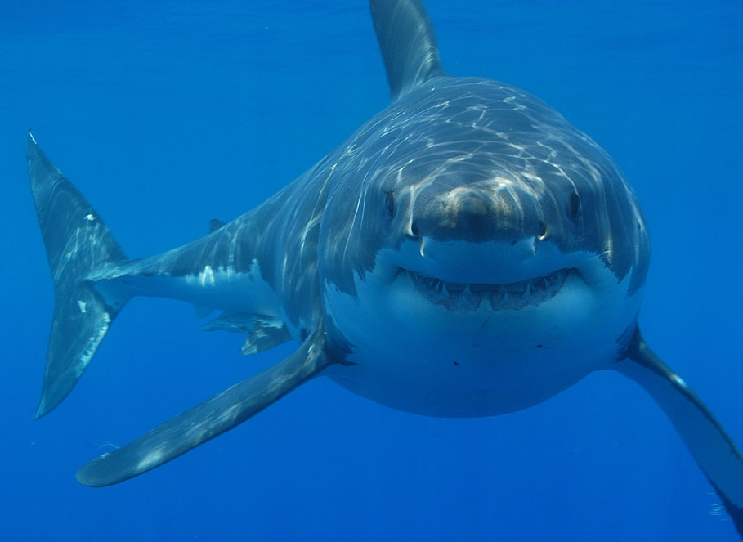
The story about a shark
By Ayubmohamed

Slide 2
Once upon a time there was a kid swimming at the beach then he saw a great white shark and the kid was yelling
What would you do
Save the boy
Or ignore him

Slide 3
Save boy
Then you saved the boy then the shark was following you
What would you do
Go to the ship
or
Swim to shore

Slide 4
Ignore him
The boy was your son he died
The end

Slide 5
Go to ship
You made it on the ship and they were going to another place
Stay on ship
Get off the ship

Slide 6
Got off the ship
You got of the ship and you were in a new place then you made a family and a new house you
WIN

Slide 7
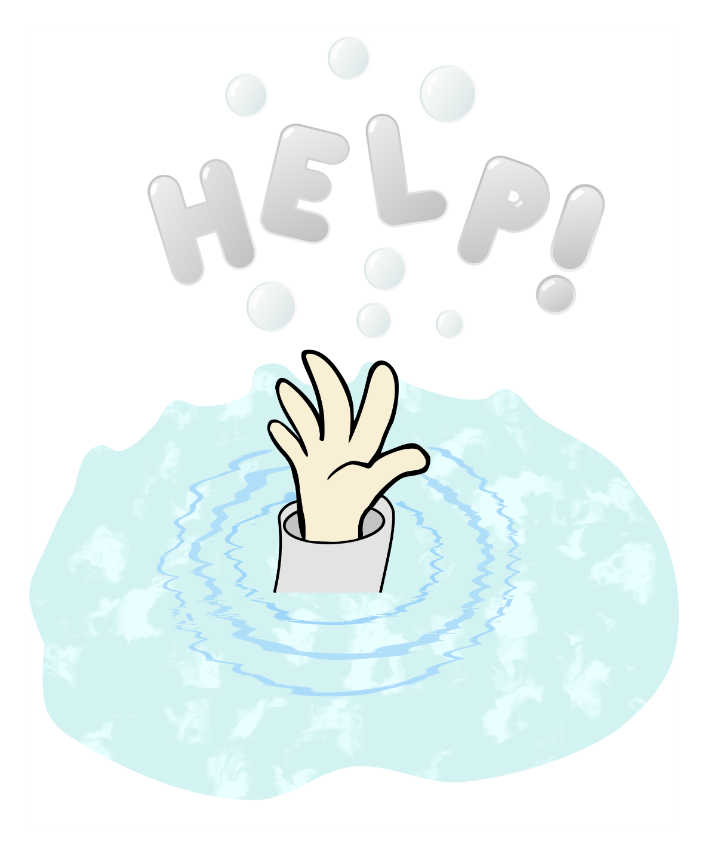
Swim to shore
The boy drowned and he died

Slide 8
Stay on the ship
Then you came to the new place with the kid and you said who are you and the kid said I am your son
leave him
Take him to the creepy house

Slide 9
Leave the kid
You were alone you die

Slide 10
Take him to a house that was kreepy
You lose

