Slide 1
Adventure story
By: Caleb Stonecliffe

Slide 2
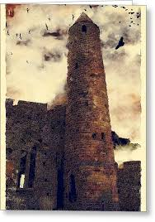
Wizardry
You wake up in the morning in your small bed, in your tower. Then the top of your tower explodes, what do you do.
1 go up to see what’s going on
Or
2 go down to confront the source

Slide 3
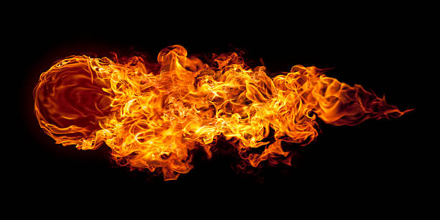
Path one
You go up to see what's going on
You go up and you see a wizard throwing explosive spells up to the top of your tower.
1 you throw a fire spell at them
Or
2 you summon a dragon to try to attack the people

Slide 4
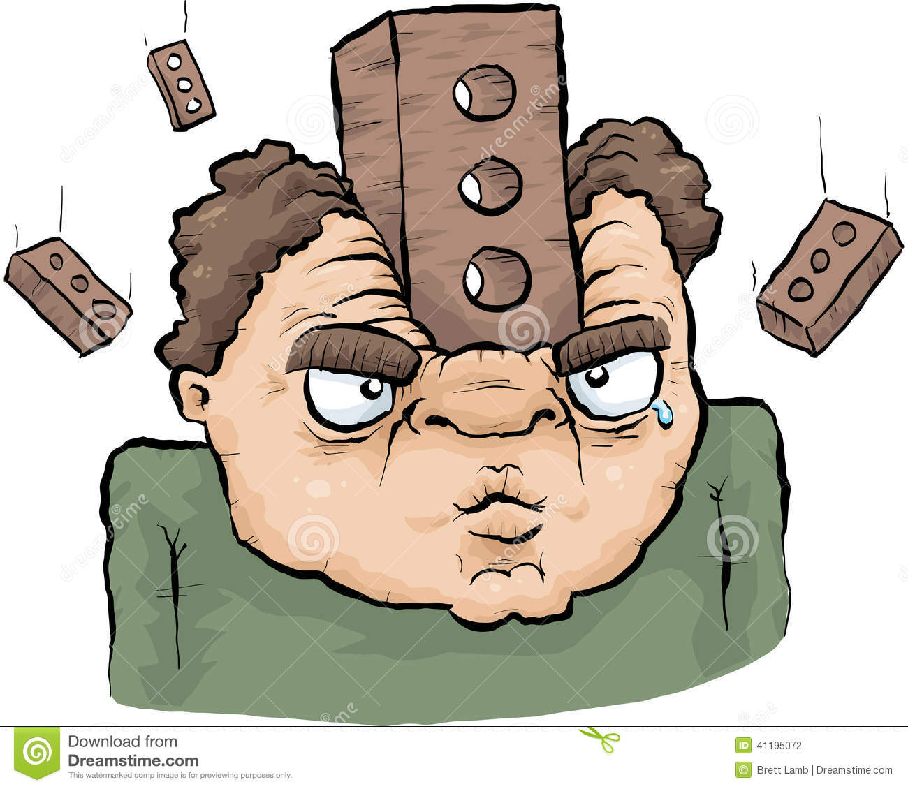
Path two
You go down to confront the source
You go down and look up just in time to see a brick fall on you
You dead>:)
restart

Slide 5
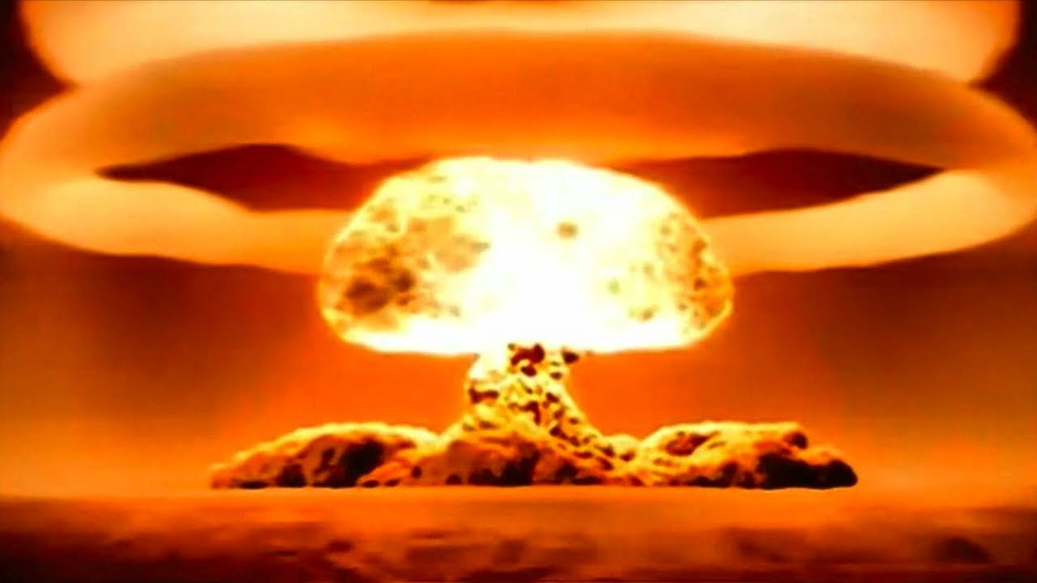
Path 3
You start throwing fire spells at the evil wizard a mini war begins but the spells collide and makes a nukulier explosion and you die ☹
restart

Slide 6
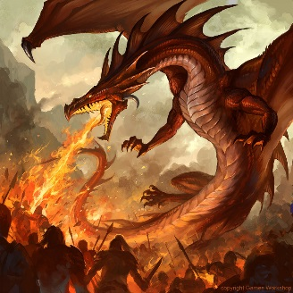
Path 4
You decide it would be beter if you summoned a fire breathing dragon to attack him
The dragon goes at him so he starts running away shooting spells at the dragon a few hit the dragon and it dies
1 revive it
Or
try avada kadavra

Slide 7
Path 5
You revive the dragon the wizard did not know you had this sort of power the dragon gets up and shreds him!
You win gg

Slide 8
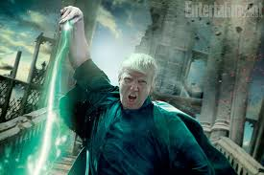
Path 6
O you forgot it was not the world of harry potter a spell hits you and you die ☹
restart

Slide 9
You win

