Slide 1
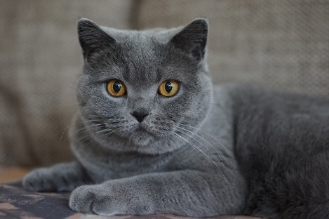
Code S.S.K
By Sarah Hobaish

Slide 2
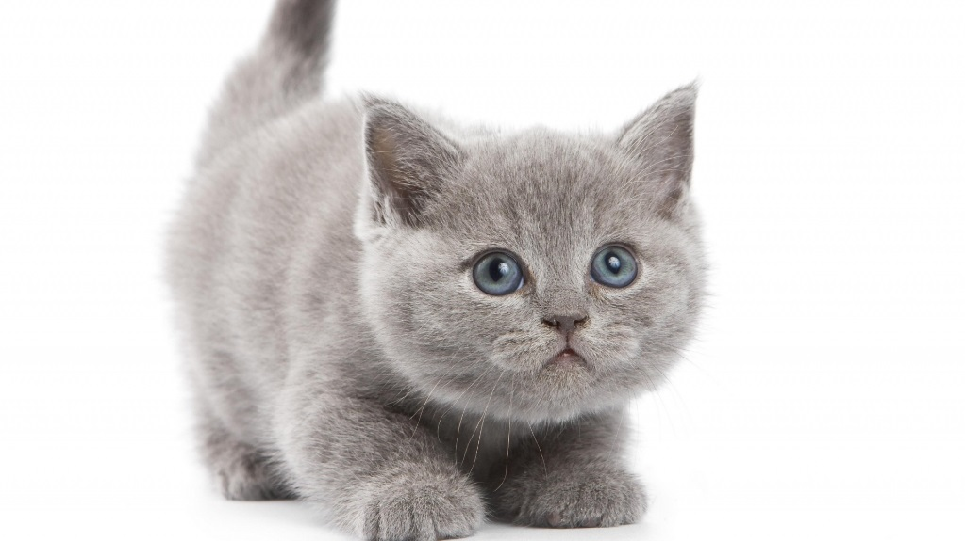
One day…
Bob is a cat person. He has over 100 cats and kittens living in his house. One day he realizes 10 of his cats were STOLEN DUN DUN DUN!!!!!!!!!!!!!!!!!!!!!!!!!!!!!!!!!!!!!!!!!!!!!!! Its up to YOU to find them!!!!!!!!

Slide 3
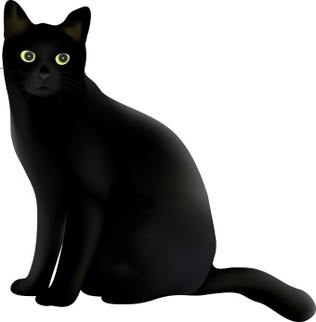
Clues clues clues…
You search far and wide for his cats then you see a guy selling a bunch of cats. You investigate, and see he has 7 of the cats! You speak to him and he gives you all 7 and says ``the other 3 were stolen by the evil Cat Master! Most sinister person to ever own a cat!!``
Find that evil Cat Master
Give up and leave Bob in disapoinment

Slide 4
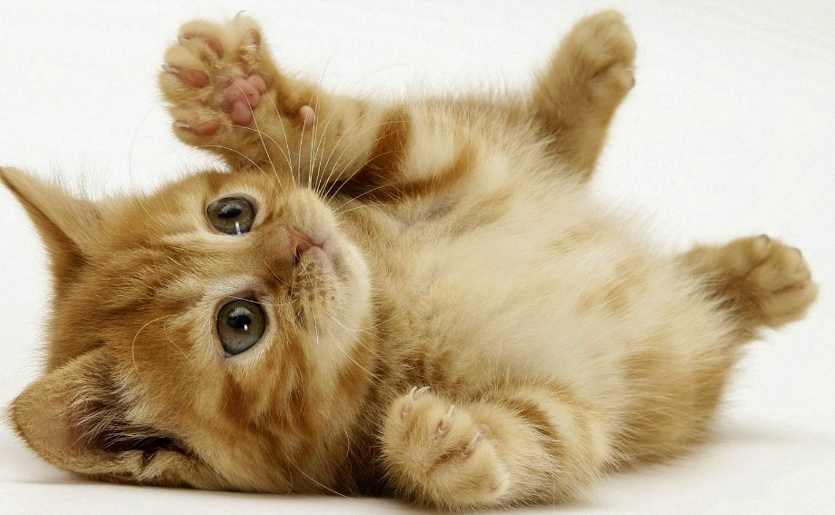
Find that evil Cat Master
You found his lair and find 2 of Bob`s cats so you take them then you search for the 3rd ``Why hello you ugly poopy face!`` sneered Cat Master ``How nice of you to drop by but I don’t really want visitors right now!!!! Bye bye now!`` you take Bob`s last cat and return to Bob. You decide to do something to Cat Master!
Hurt him
Make sure he never does that again

Slide 5
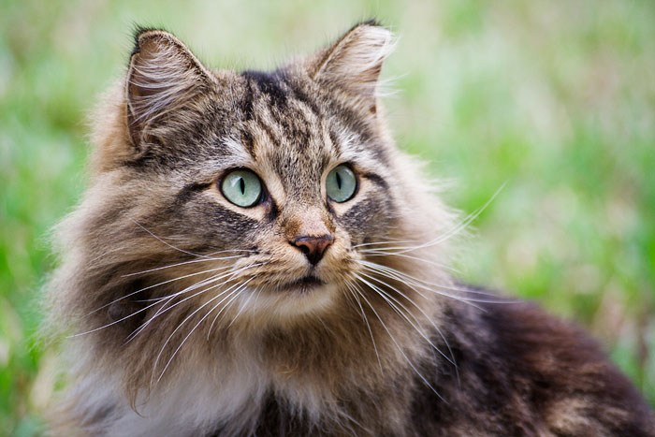
Hurt Him
You assult Cat Master to teach him a lesson.

Slide 6
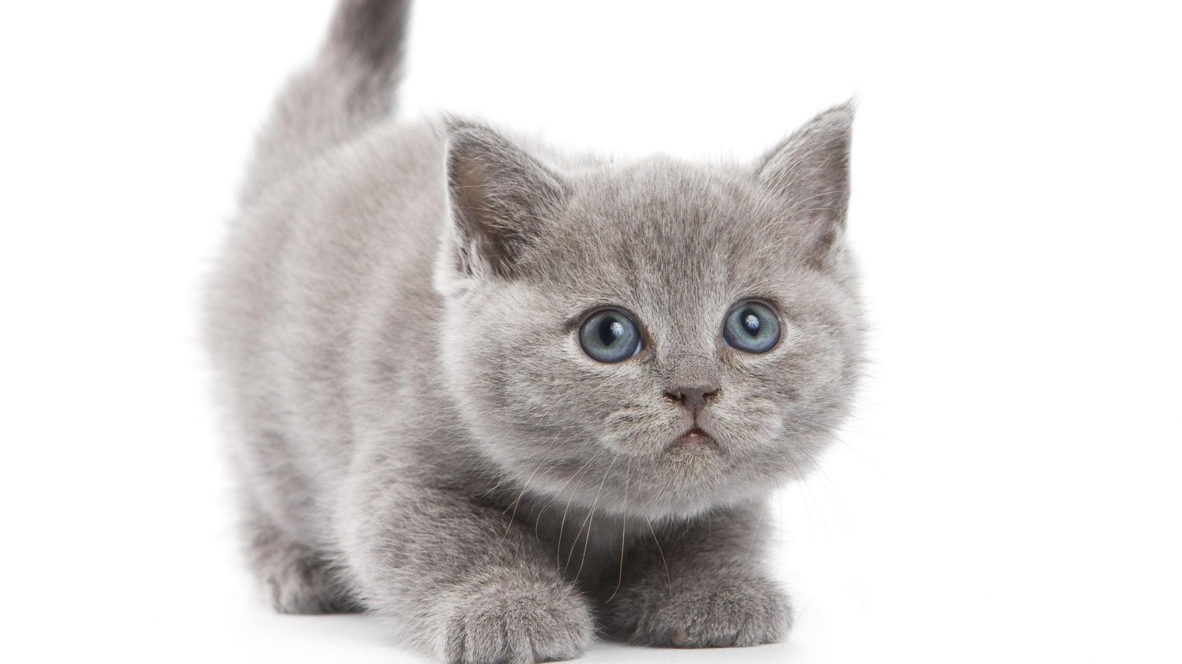
Make sure he never does that again
You make sure Cat Master never steals a cat again.

Slide 7
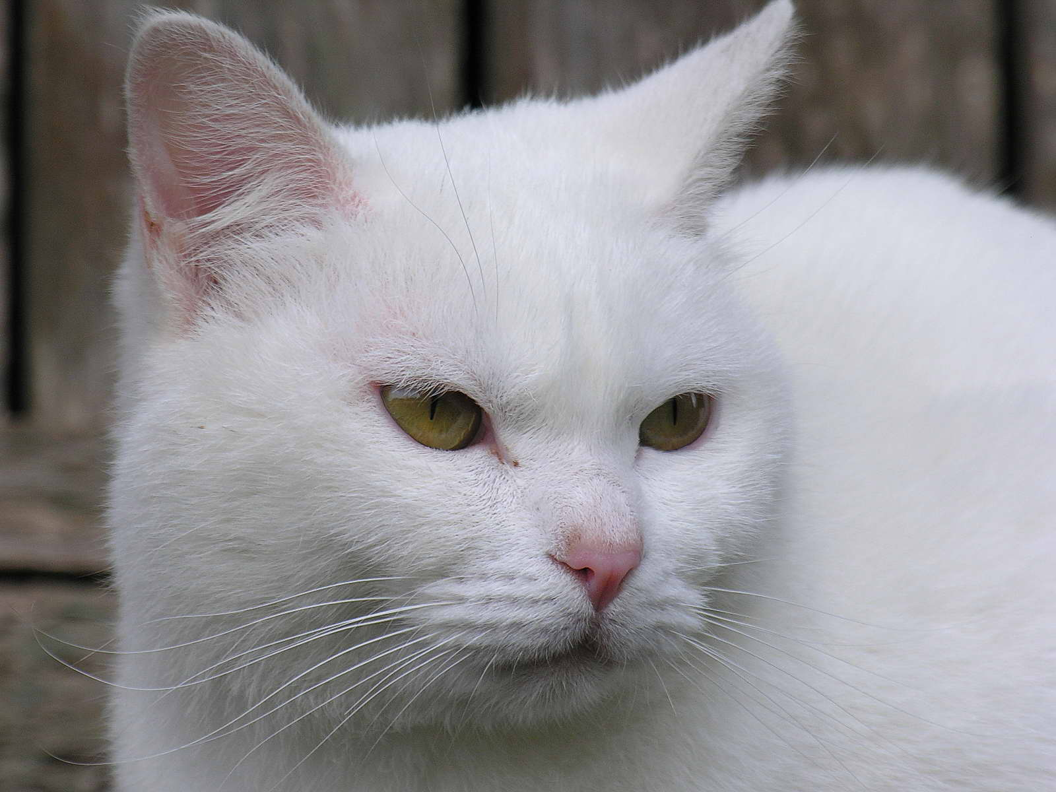
Give up
You gave up.
Restart?

