Slide 1
Five nights at freddy’s
By chance logan dorton grohs

Slide 2
It was my first night in the office I automatticaly knew there was something off but I needed the money. Leave stay

Slide 3
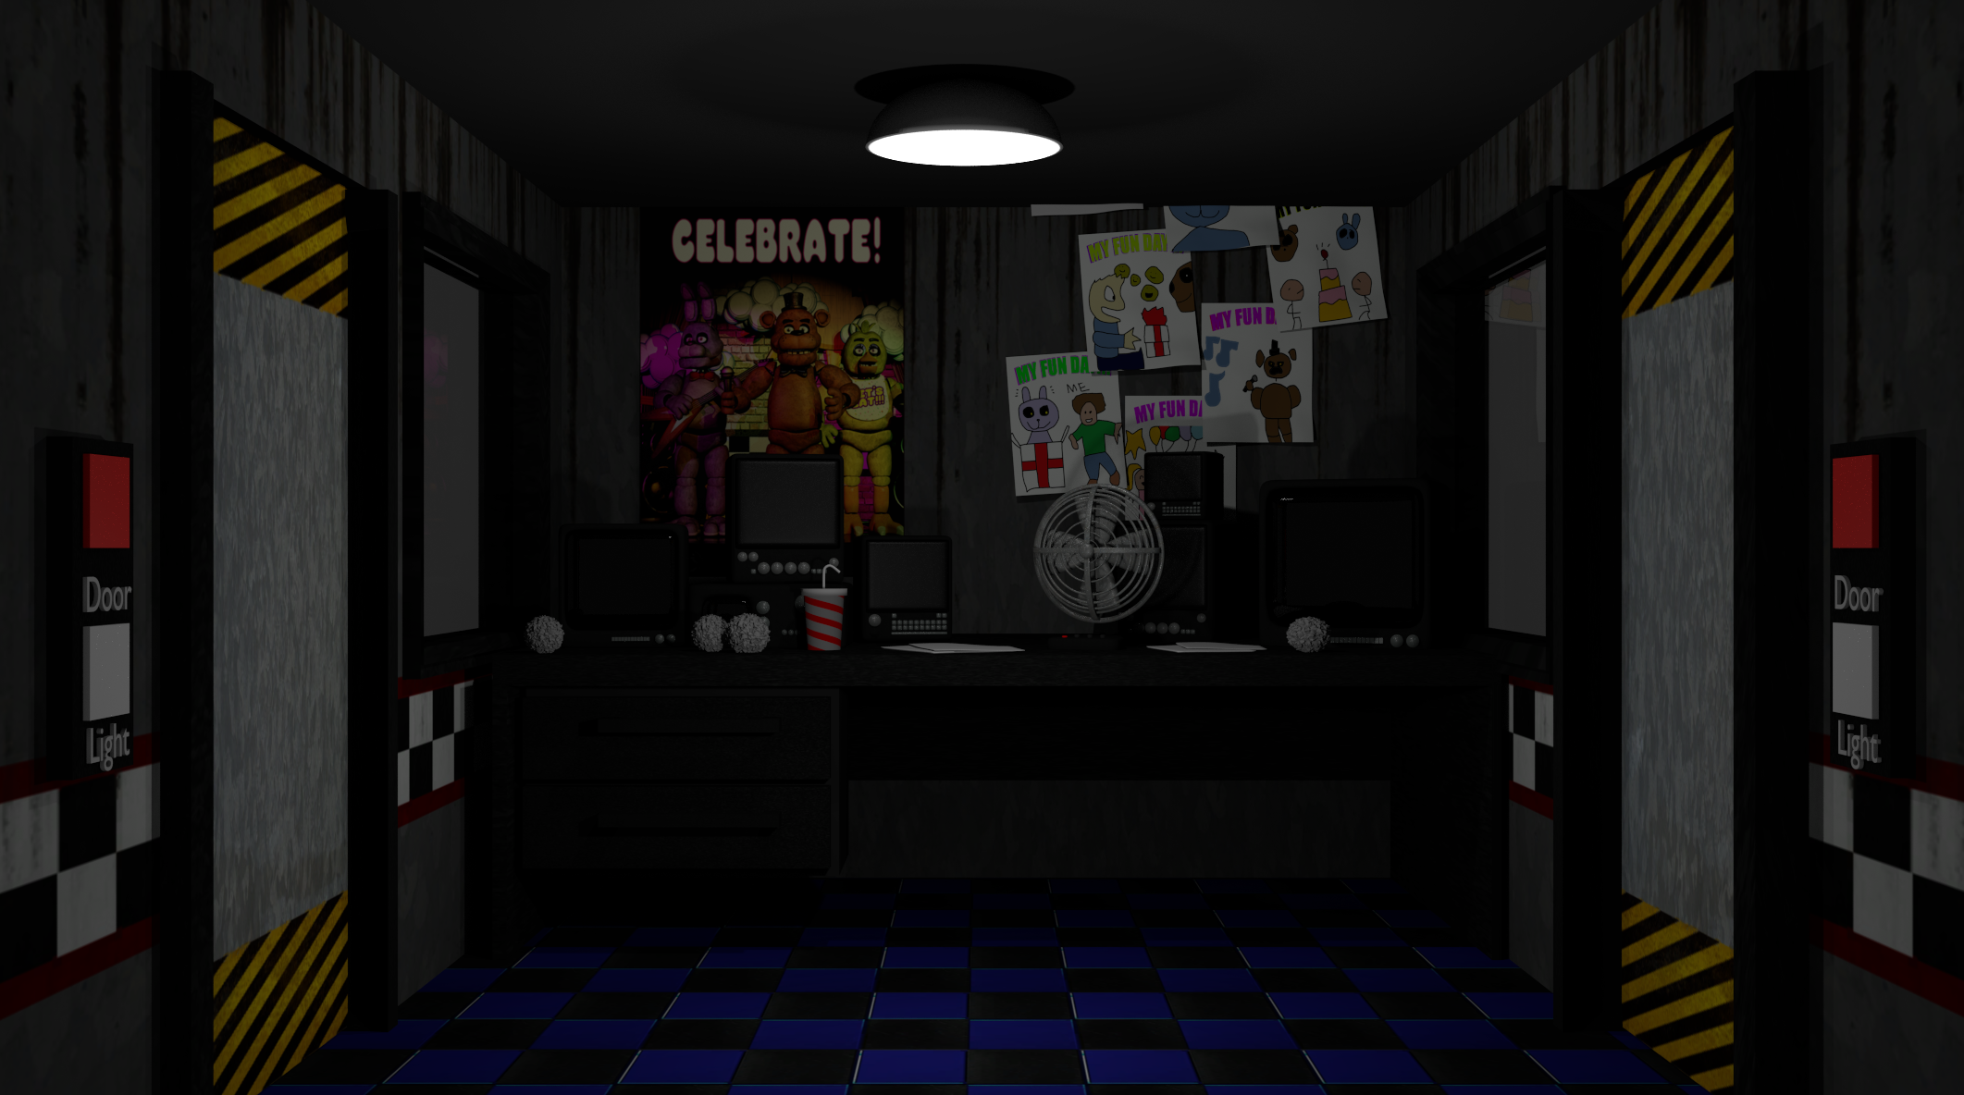
You stayed but you didn’t like it

Slide 4
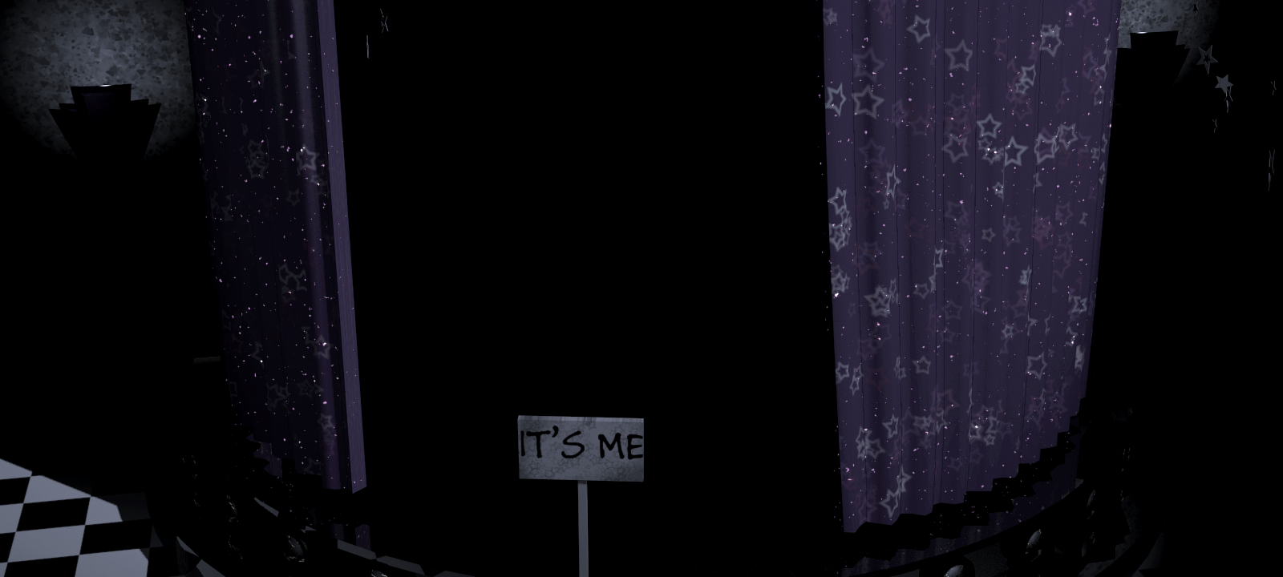
You checked the camera and thought you were seeing things cause foxy cove was empty
Call the police
Run
Shut the door
Dismiss

Slide 5
police
You called the police but the line was cut

Slide 6
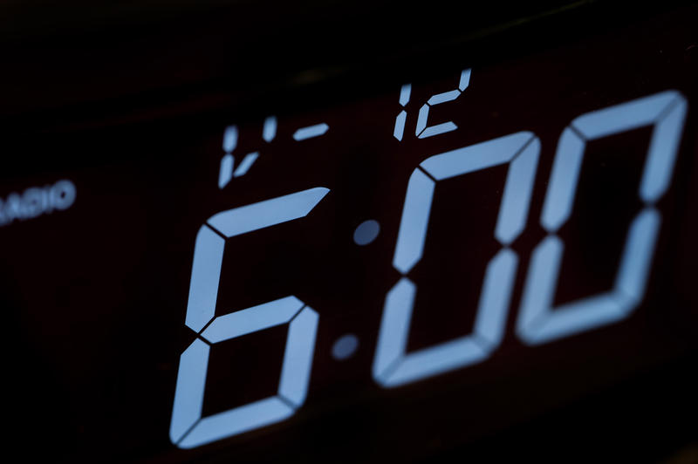
m
You shut the door and heard banging but it soon stopped its 6 am you win.

Slide 7
u
You ran but the door was locked and you died

Slide 8
You chose to leave but were caught off guard by a bite from an animatronic

Slide 9
You dismissed and died from hyperventilatioin cause you didn’t check the puppet

Slide 10
Go home and enjoy a good movie

