Slide 1
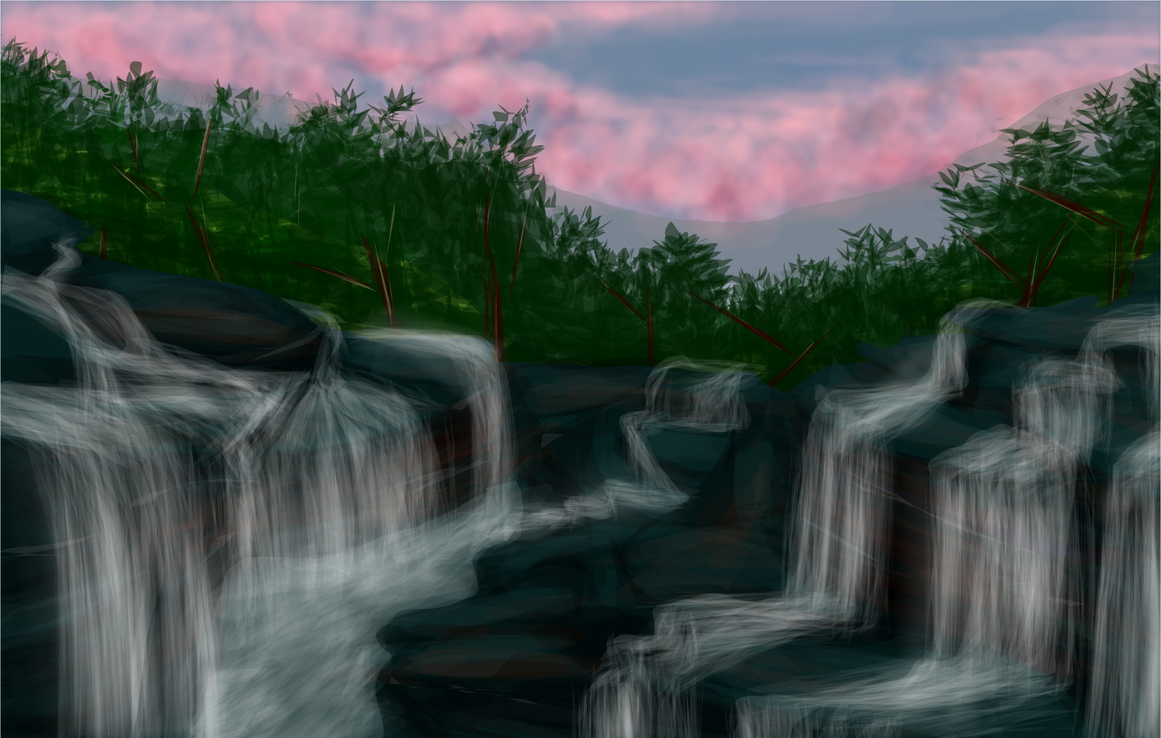
The idk story

Slide 3
Once upon a time...
You were trying to write a story and you didn’t know what to write…
Do you keep thinking
Do you give up

Slide 4
Keep thinking
You keep thinking and…

Slide 5
Give up
Go to sleep

