Slide 1
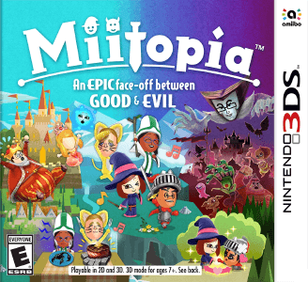
Miitopia
By Daniel.G

Slide 2
The story begins...

Slide 3
Something happens
Choice 1a big boss
Choice 2 your a small boss

Slide 4
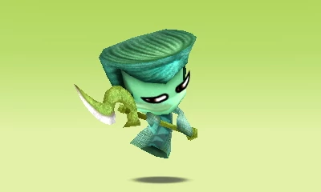
Your fight a imp
You Lose

Slide 5
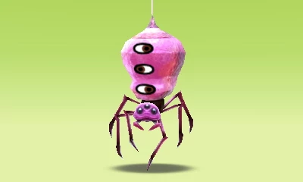
You fight a spier
You win

