Slide 1
Start game
By Daniel

Slide 2
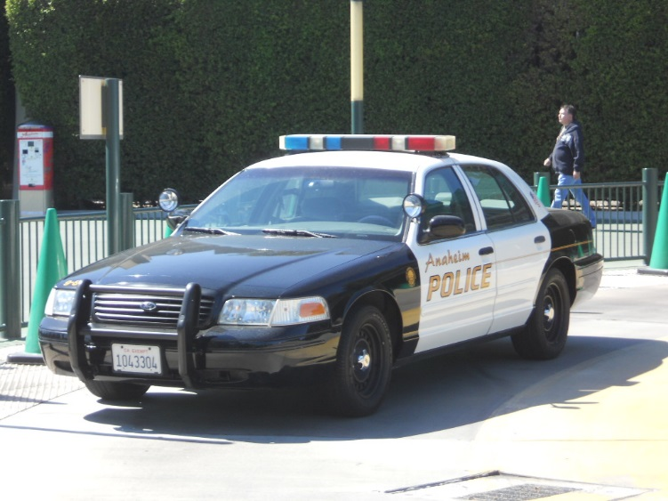
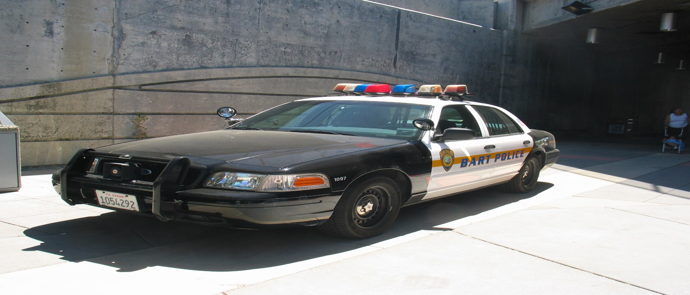
Once upon a time their was a man in jail
On December 25 he broke out it must have been his chrismas wish outside their was a police car and a gtr
Get in the gtr
Get in the police car

Slide 3
He drives away in the gtr the police go after him the police are catching up go
Go faster
Turn to the dark road

Slide 4
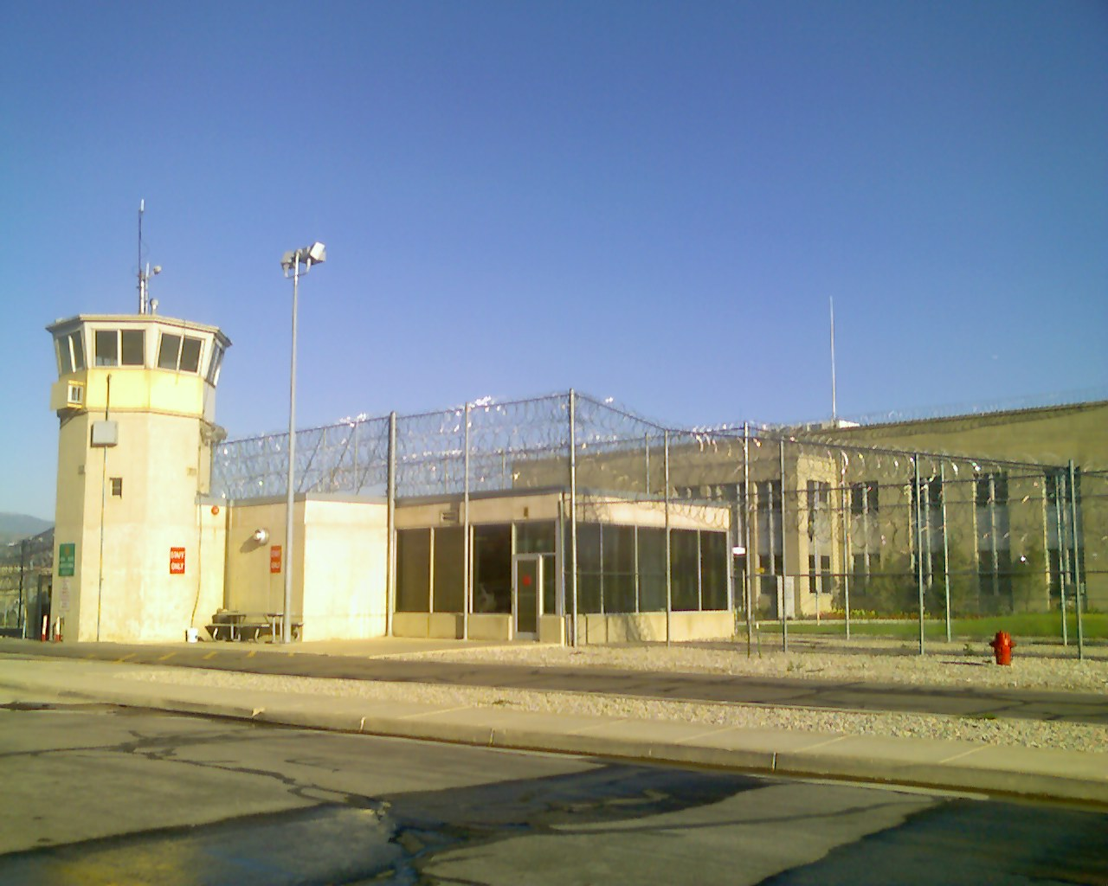
You crash and the police catch you and put you back in prison
You lose

Slide 5
The police crash into a hotel and the man is safe and is going to a hotel
You win

