Slide 1
THE TIGER
BYDANIEL

Slide 2
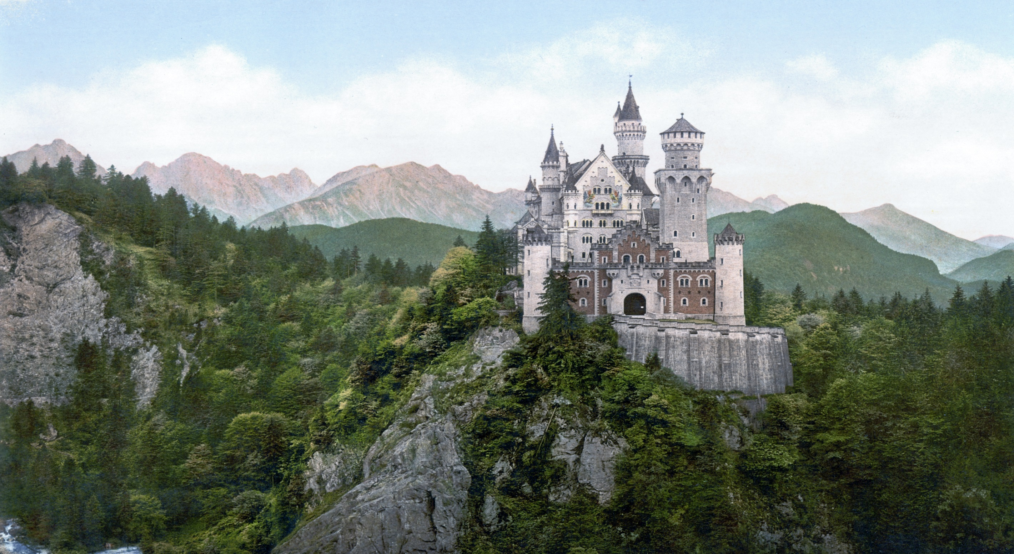
ONCE UPNE a TIME
In a kedowe there in a city

Slide 3
He herd a nose a big tiger
a. Fhigt Back

