Slide 1
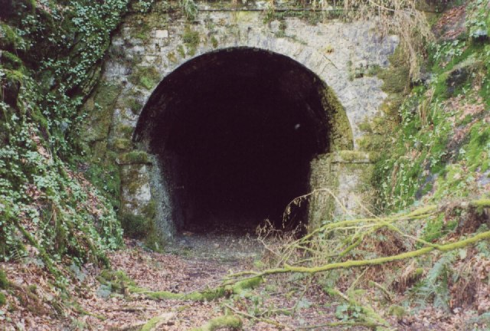
Death tunnel
By Duncan

Slide 2
You wake up what do you do.
Go back to bed
Have a snack

Slide 3
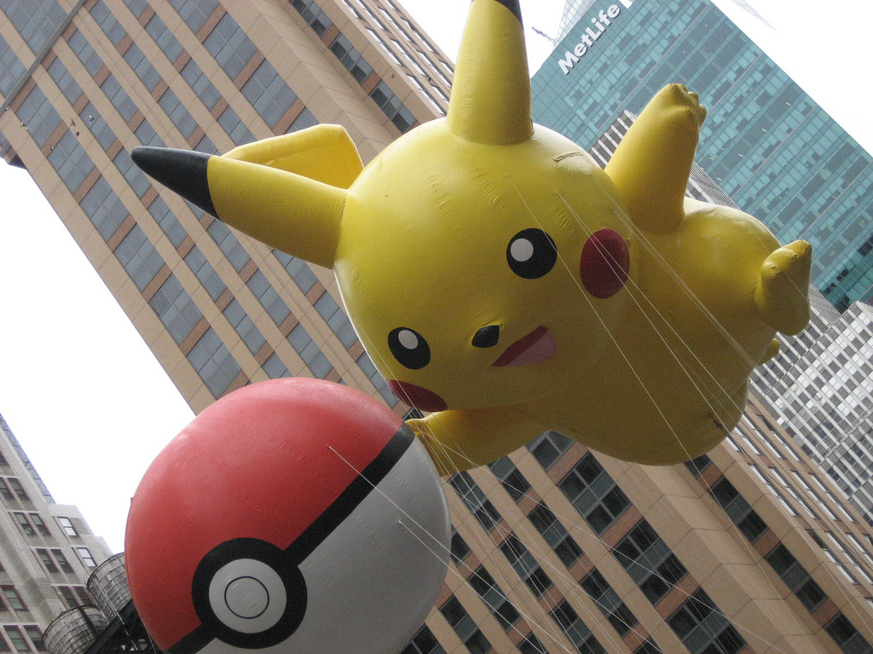
Go back to bed
You have a nightmare you run to your parents room but pikachu catches you in a pokeball.
YOU LOSE

Slide 4
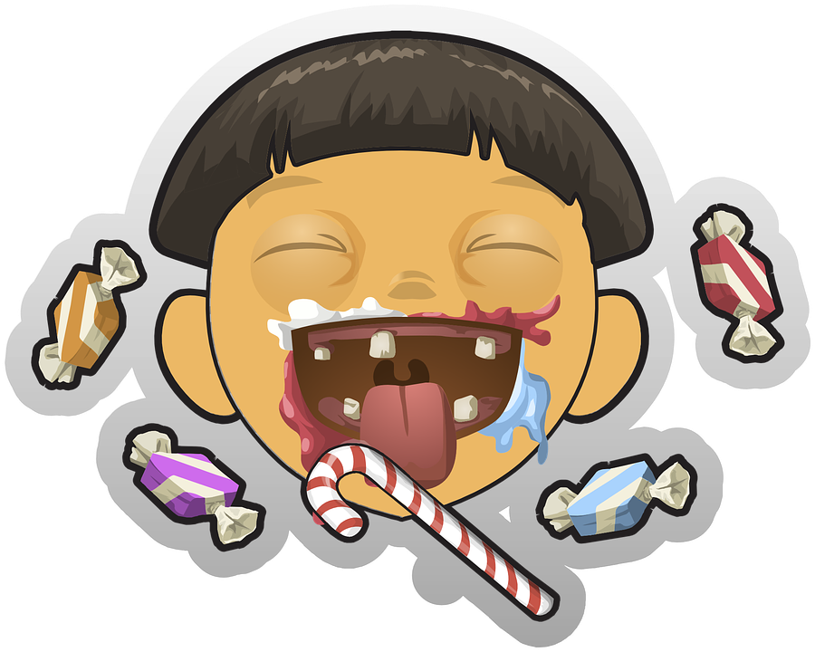
Have a snack
You have a snack downstairs …...then you onto the ground
Do you
Fall asleep on the couch
Go upstairs
Go underground

Slide 5
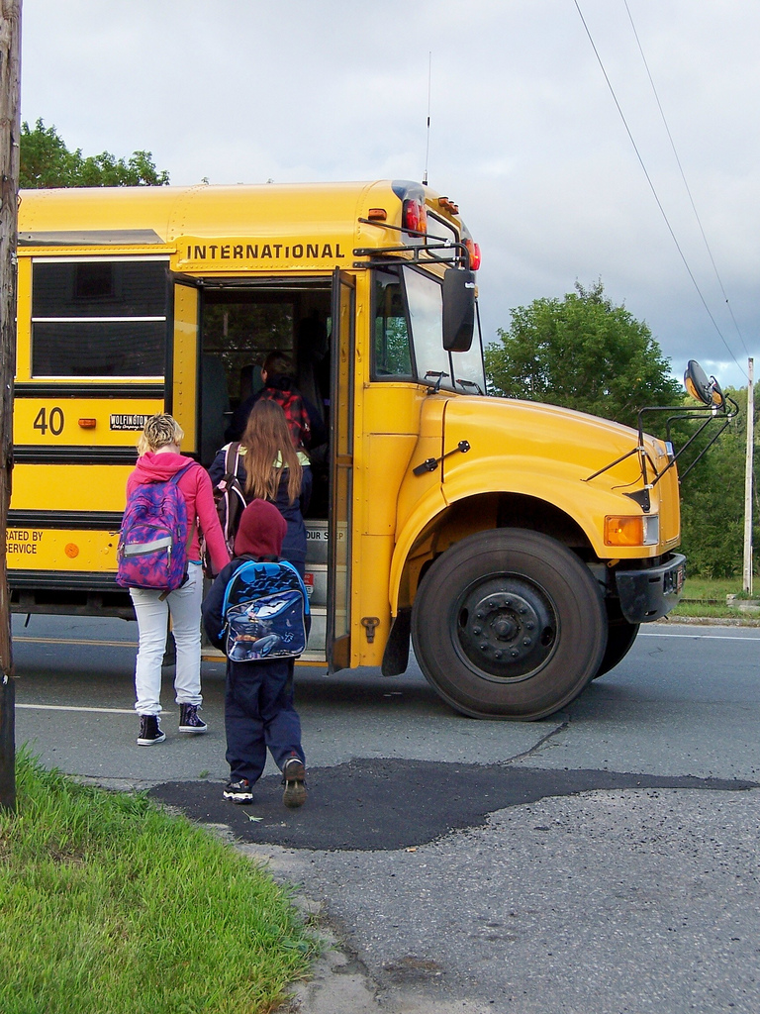
Fall asleep on the couch
You get on the school bus and live a normal life
YOU WIN

Slide 6
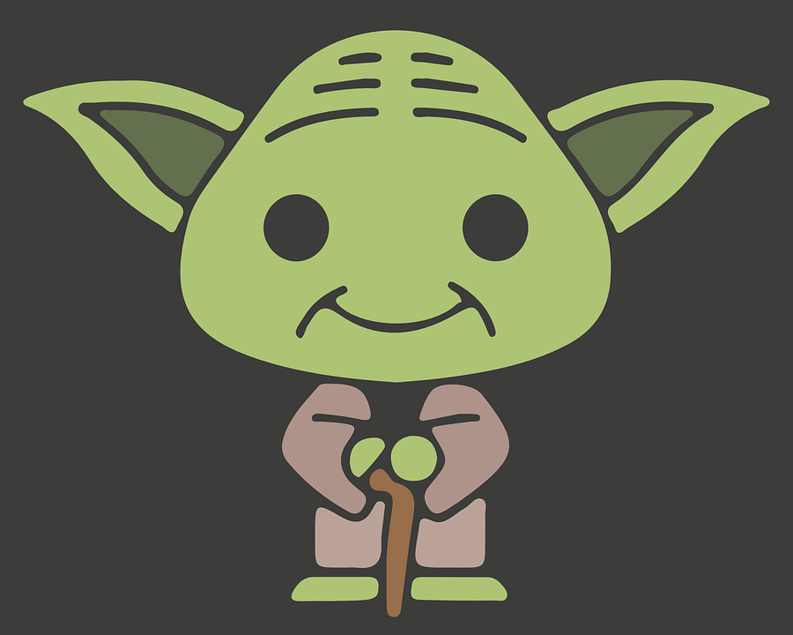
Go up stairs
You fall into bottomless pit and become yoda
You win

Slide 7
Go underground
You fall underground do you
Scream
Stay calm

Slide 8
Scream
You explode

Slide 9
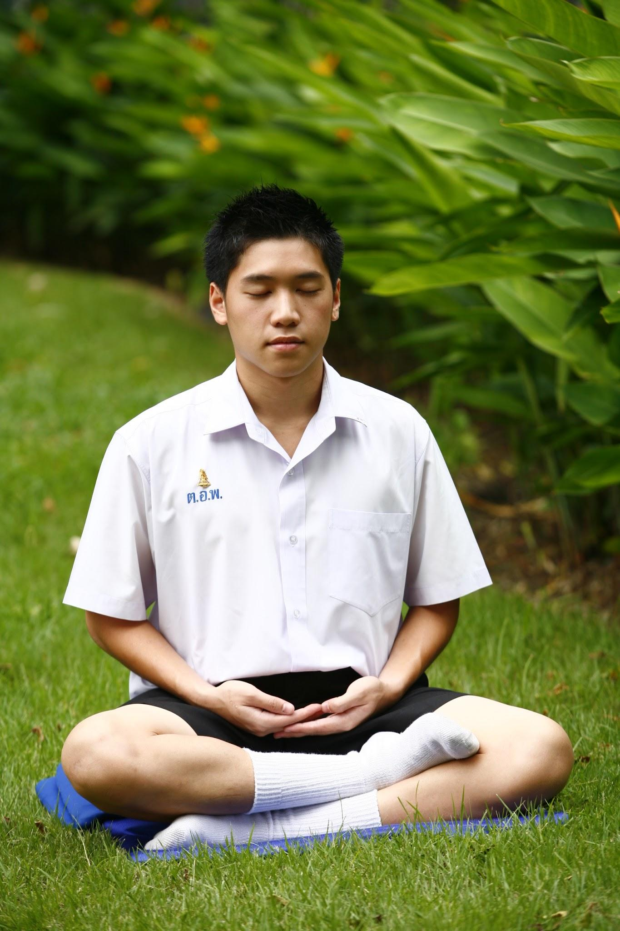
Stay calm
You survive do you
Run
Walk

Slide 10
Run
Arows zip past your head. You see a chest there are 2 bottles of black goo
Do you drink the one on the left or right

Slide 11
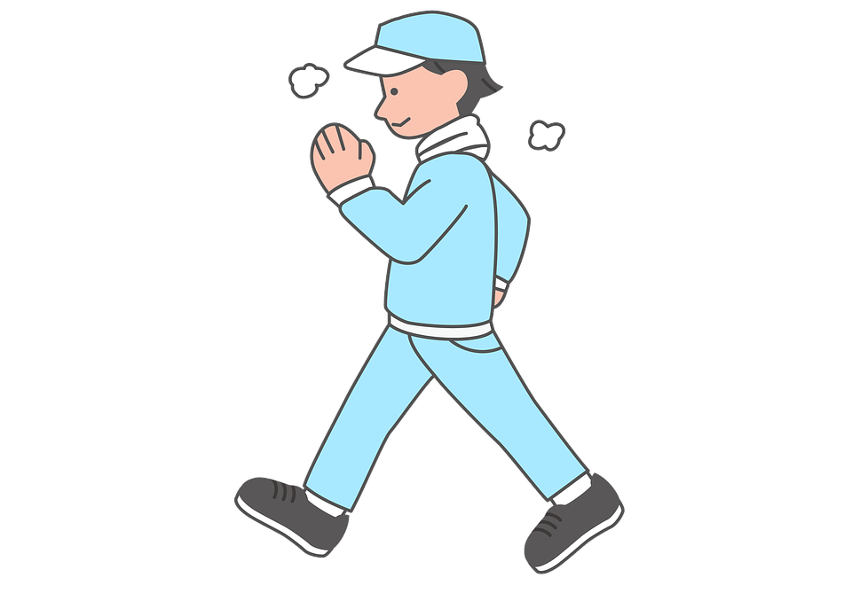
Walk
You lose

Slide 12
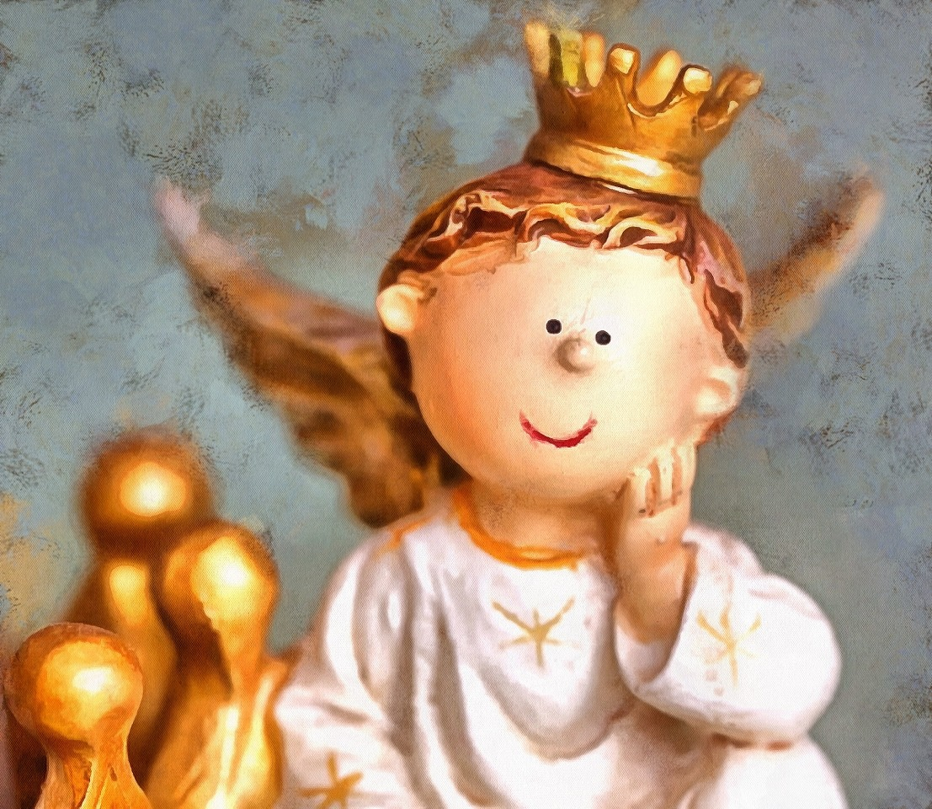
Left
You become an angel You win

Slide 13
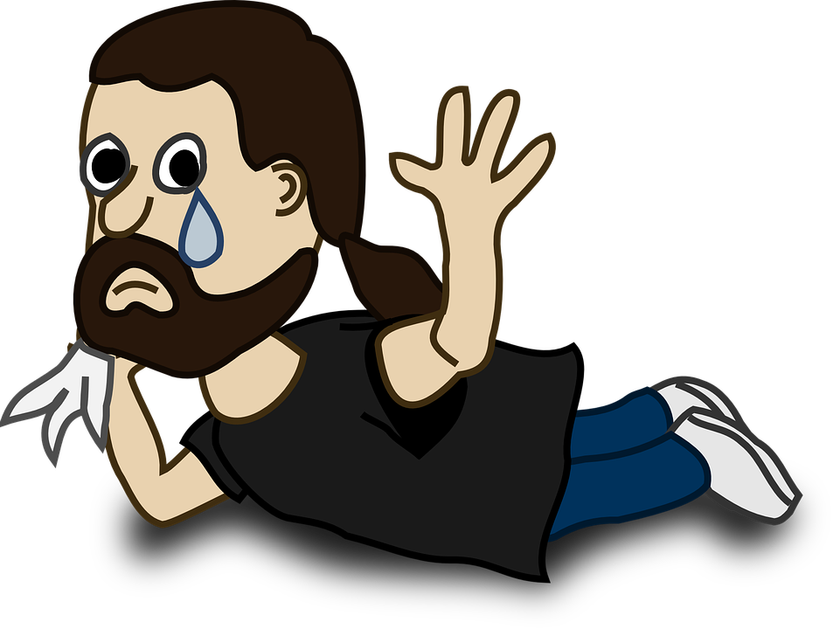
Right
You lose

