Slide 1
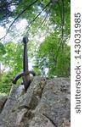
The Adventure for the Legendary Sword
By: Emmitt

Slide 2
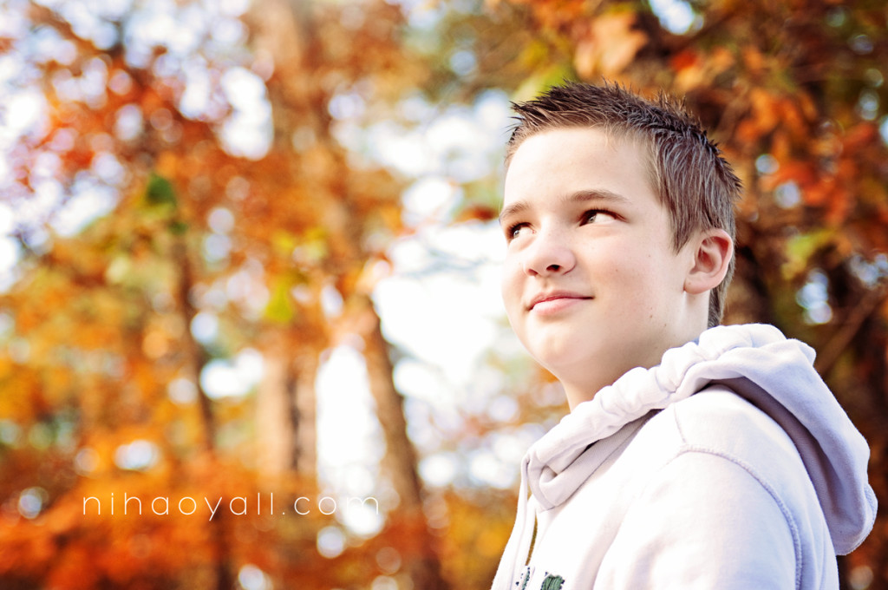
The Adventure begins with a 12 year old boy named Raden …
The boy wants to find his father’s sword to defeat the Overlord
Choice 1 go to a time portal
Choice 2 go to the top of mt. Clacumus

Slide 3
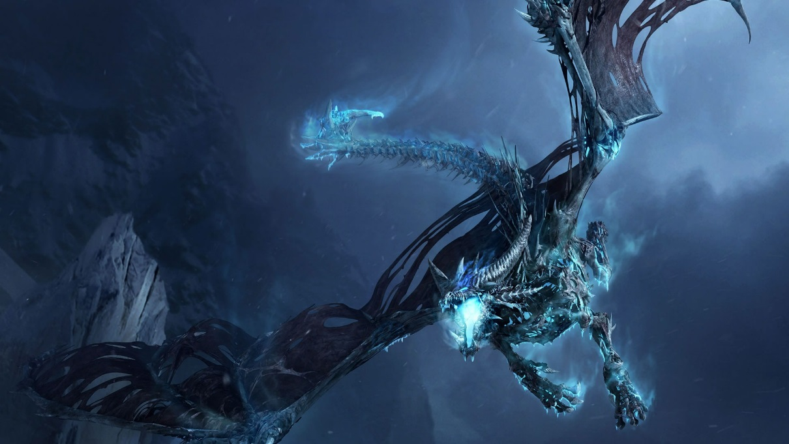
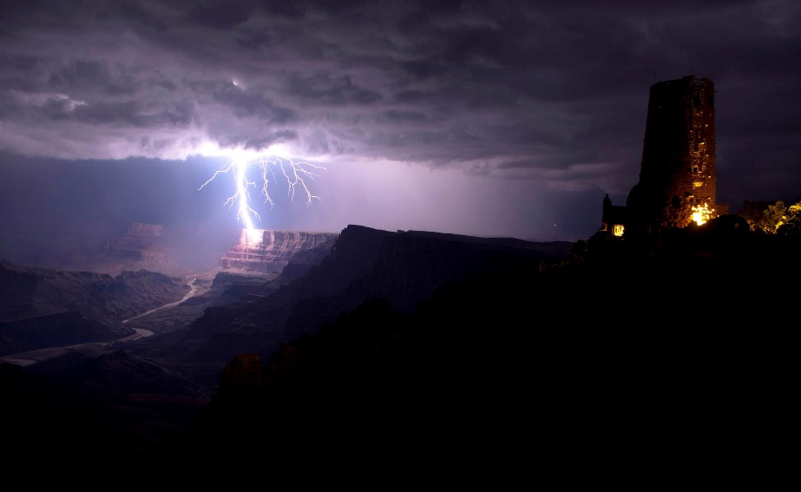
Path 1
Go on
When he got to kingdom Zora he saw something outside
Choice 1 kill it
Choice 2 pet it

Slide 4
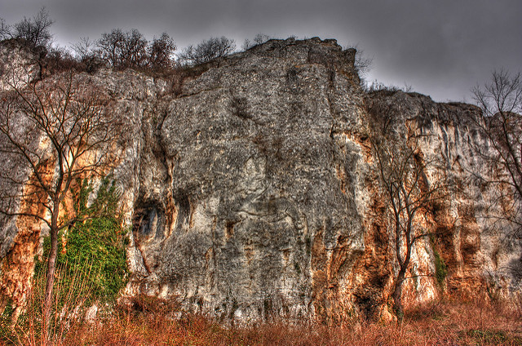
Path 2
lose
At the top
You get killed by a baby dragon

Slide 5
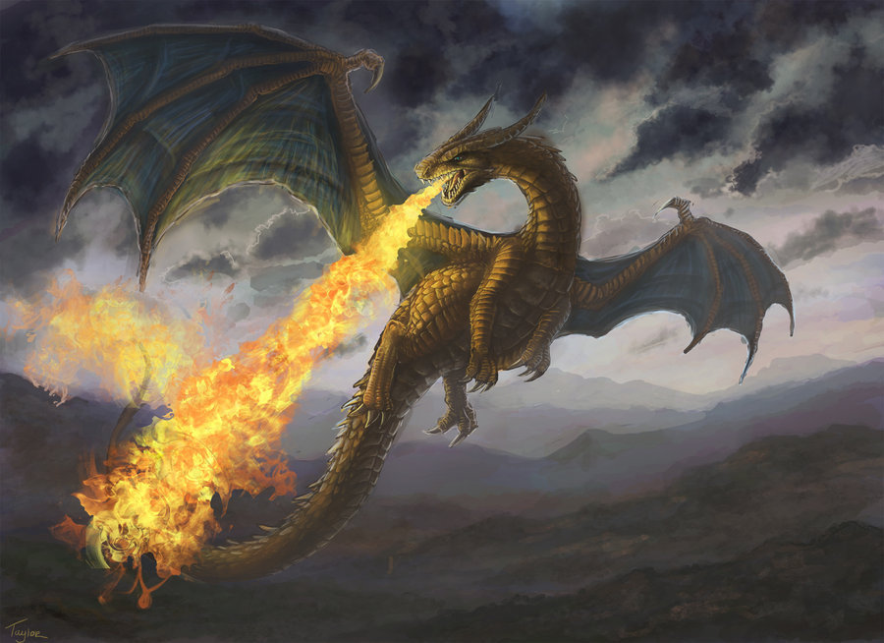
Path 1
Doesn’t want to be killed you die

Slide 6
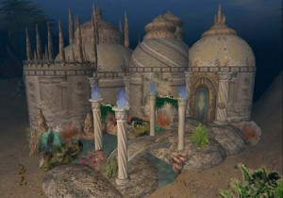
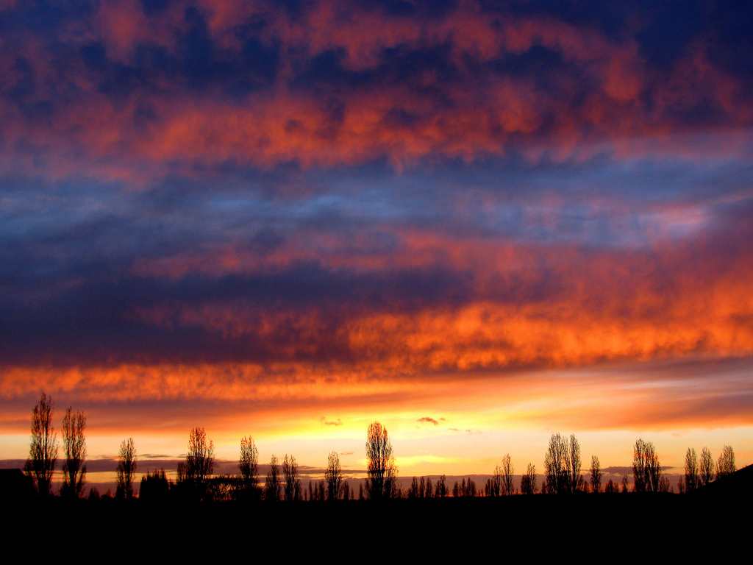
Path 2
Calms down becomes you pet
Path 1 you go to the under water castle
Path 2 you go to the sky war

Slide 7
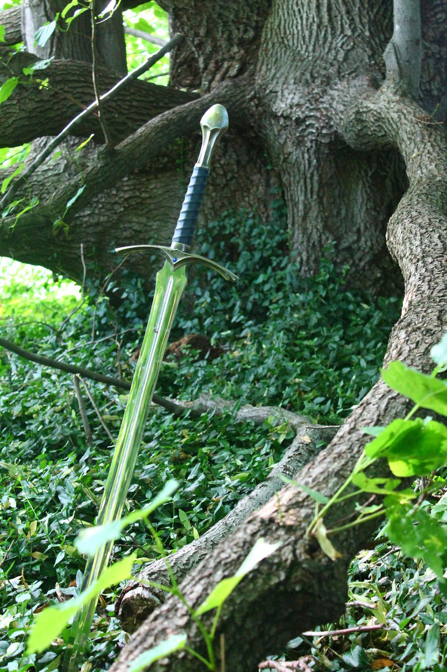
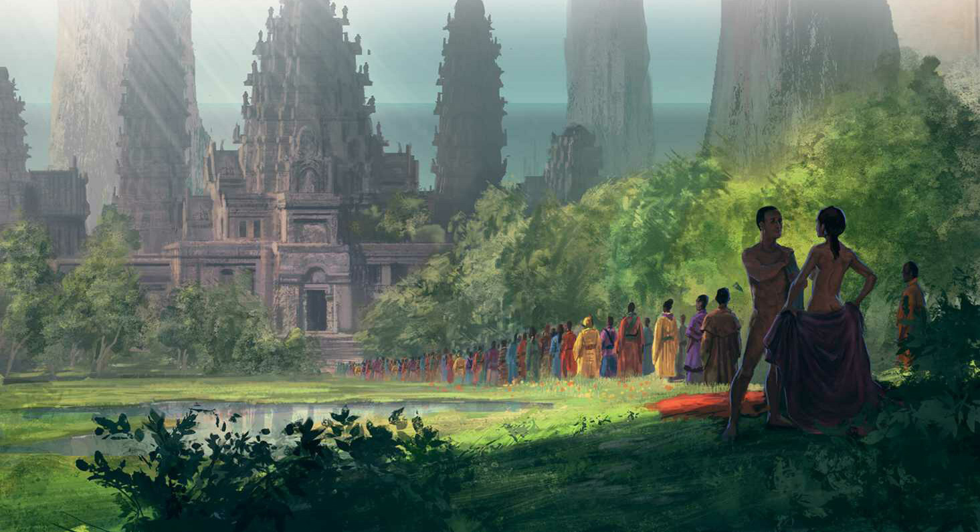
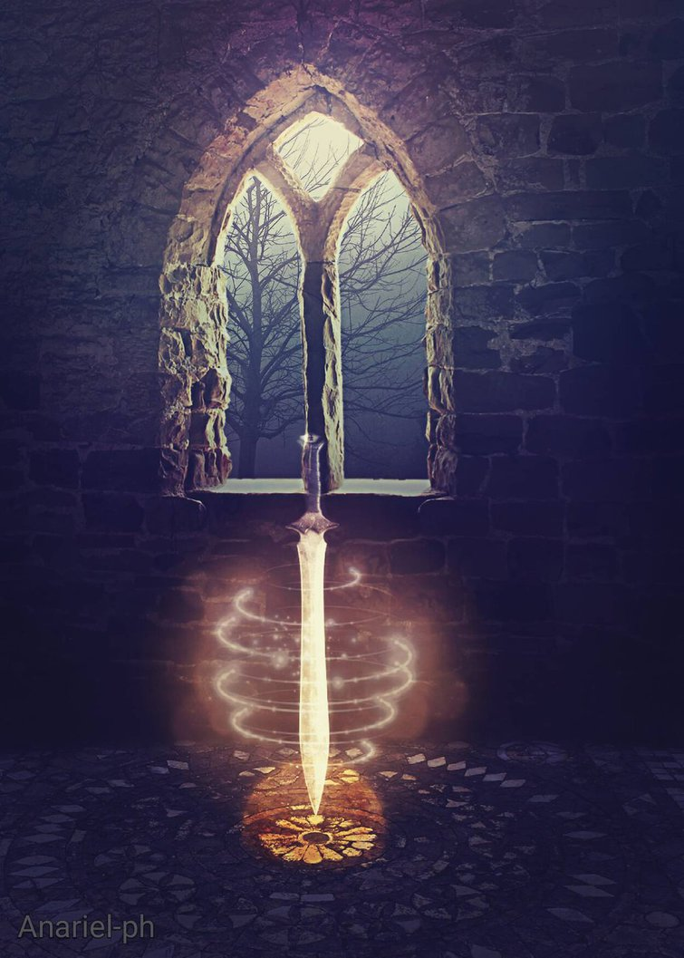
Path 1
You battle everyone and you win

Slide 8
Path 2
You go to the castle and a water king comes and kills you

