Slide 1
The Clown
By: Gioia

Slide 2
It was a dark and scary night…
You wake up to a noise in the kitchen
What do you do
Go to the kitchen and see what's going on
Or
Stay warm and cozy

Slide 3
Choice 1
You go to the kitchen you peek out from the hallway and you see a clown you dash back to you’re room.
Do you …
Call the police
Or
Jump out of you're three story house

Slide 4
Choice 2
The clown goes into you're room and suffocates you with a pillow…
You are dead

Slide 5
Choice 1
You call the police they think it’s a prank so they don’t come the clown kills you…
you are dead

Slide 6
Choice 2
You jump out of you're three story window you hurt you’re knee but you are fine…
Do you
Run to the police station
Or
Go to you’re friends house

Slide 7
Choice 1
You run to the police station they hunt down the clown and lock him up behind bars…
you win

Slide 8
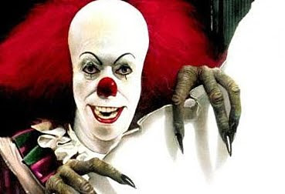
Choice 2
You go to you’re friends house the clown hunts you down and kills you and you’re friend…
You are dead

