Slide 1
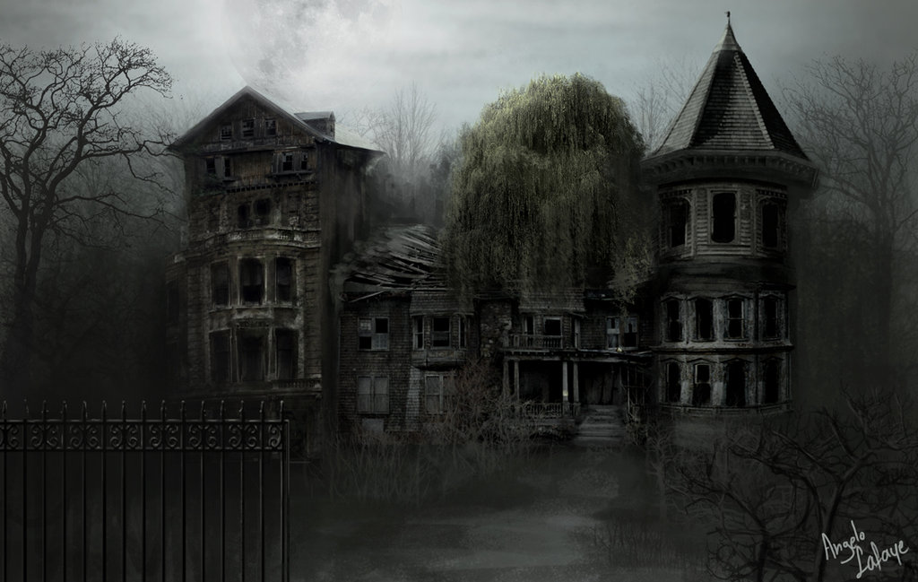
Hounted house
By :hawa omer

Slide 2
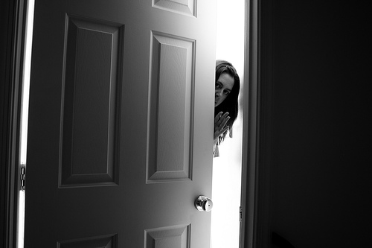
The door is opening
You fined an alian spaship and the gost calling you over and over
Go
Run
hide

Slide 3
go
You check out. Than the Ghost Run into you than your heart stops.
You Die!

Slide 4
You Run away Than You were no plze to

Slide 8
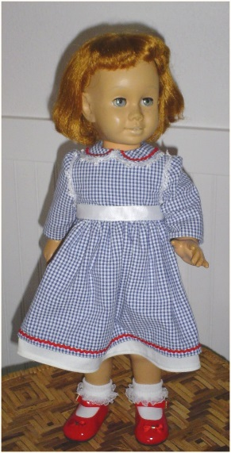
the doll
You run and you see a doll calling you come here and you turn you see it again.aaaaaaaaaaaaaaaaaaaaaaaaaaaaaaaaaaaaaaaaaahhhhhhh should you call some on the phone theres no wifi he puts you in a bage

Slide 9
Hounted house
Ones they put you in a bag and throu you in a space ship and take you to a plant its called blamb and they drop you of at a hounted house theres no food or anything but the ghosts stocking you.

Slide 10
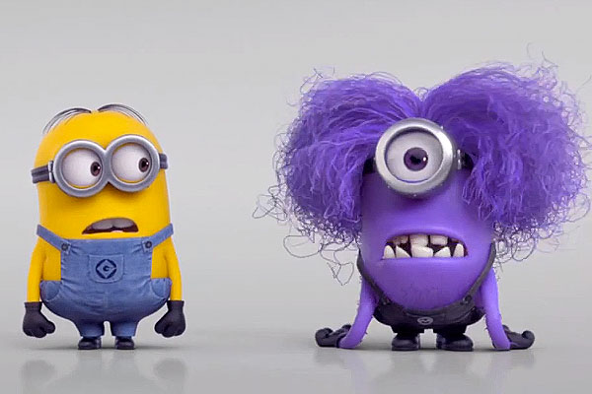
The minnions
You see minnions calling you and all the minnions caring you to a hounted house

Slide 11
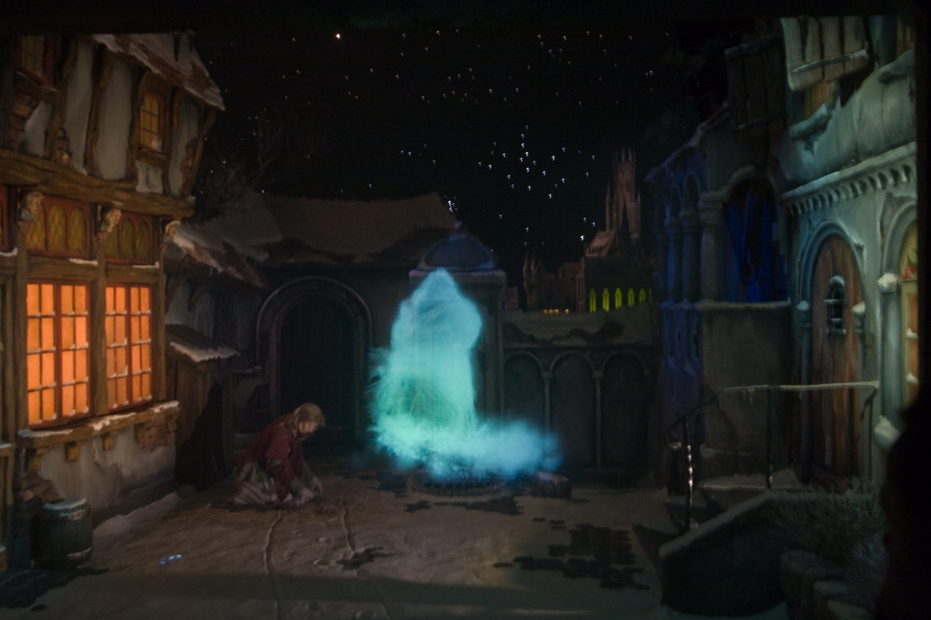
Booooooooooooooooooooooo!!!!!!!!!!!!

