Slide 1
Introduction
By: Hiba Salah

Slide 2
You will LOSE
MUHAHAHAHA

Slide 3
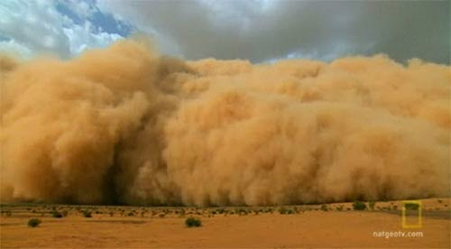
You wake up in the morning and notice there is a tornado coming you way and you don’t know if you should run or hide in a safe underground place. What do you do.
Choice one Hide
Choice two run

Slide 4
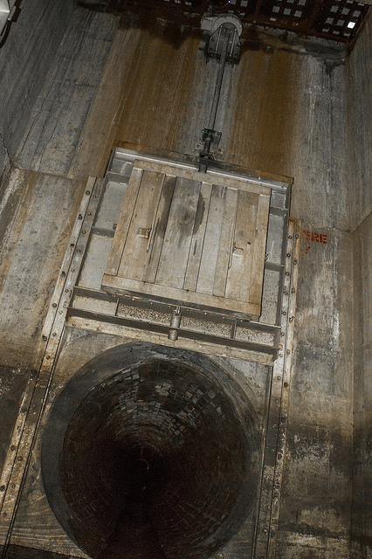
You hid in a underground hatch you don’t know if you should come out or stay in. What do you do?
Stay in
Go out

Slide 5
Go out
You go out and see if its gone good thing it is but your house is gone you can find a village or climb a mounten and look for food.
Climb mounten
Find a village

Slide 6
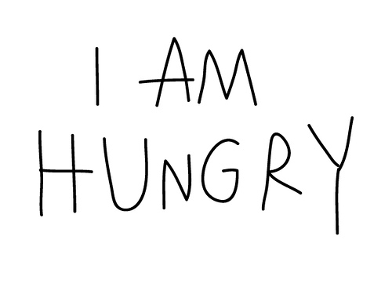
Stay in
You stay in you get real hungry do you go out for food or stay in.
Go out for food.
Stay in.

Slide 7
GAME OVER
You go out for food only to see you house was blew away by the tornado.

Slide 8
You try to out run the tornado how silly could you be you have died shortly in the story
GAME
OVER

Slide 9
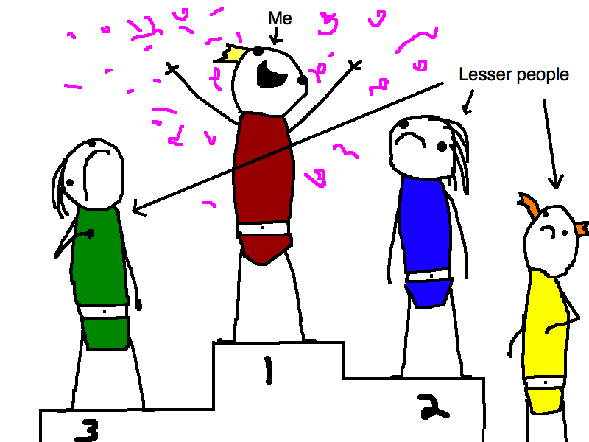
Climb a mounten
You climb the mounten and find a big herd of elk you make a house and kill the elk and you have a lot of food
You Win!!!!!

Slide 10
Find a Village
You look for a village but you cant find one you starve to death
You lose!!!!

