Slide 1
THE Dragons
By IMRAN

Slide 2
IT 7:30 am
Ben was in bed wed he

Slide 3
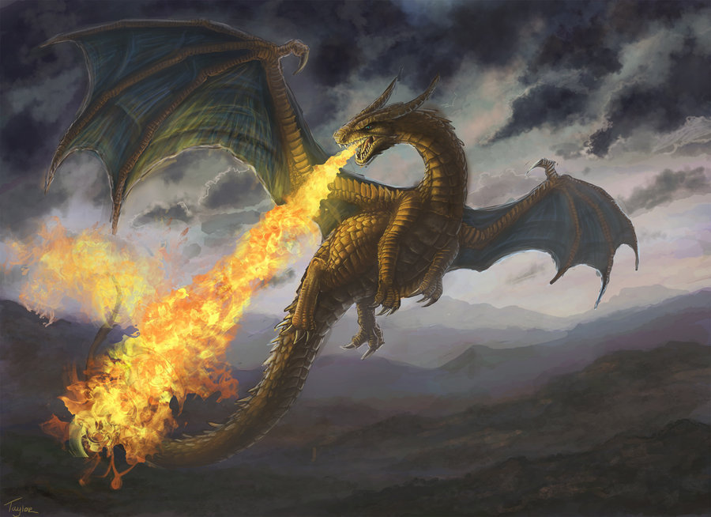
IT 7:54 am

