Slide 1
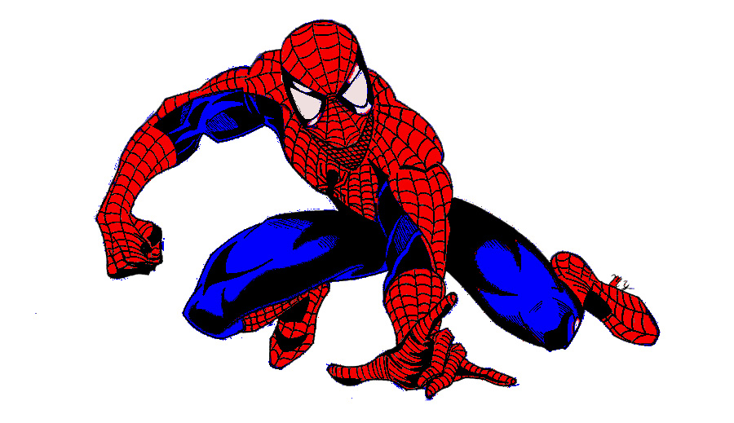
Adventure story
By Isaac

Slide 2
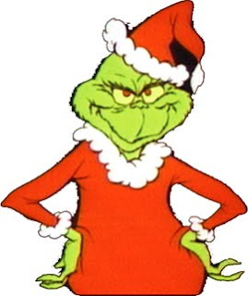
Once upon a time
We came from the park. There was a supper harrow was walking home and see a tree and a bad guy neck's to it.
Fiat bake
Run way
Be come bad guy

Slide 3
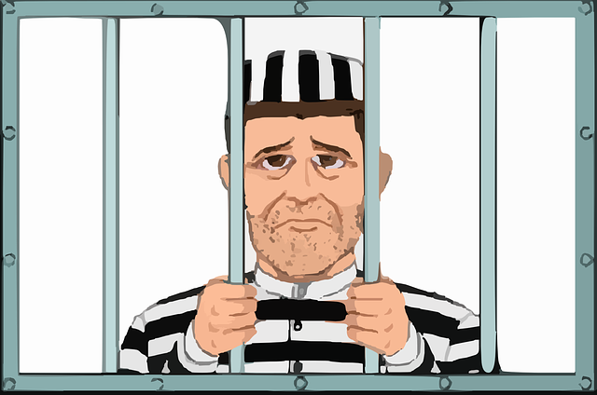
Part 1
He fiat bake for the tree but he win the tree. Then he took the tree home.
YOU WIN

Slide 4
Part 2
The bad guy kill him wen he run way?
YOU LOSE!

Slide 5
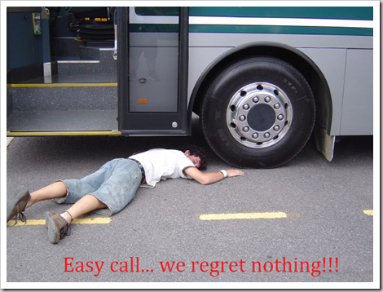
Part 3
You lose? You got run over?

