Slide 1
The danger is here
By Izzy plock

Slide 2
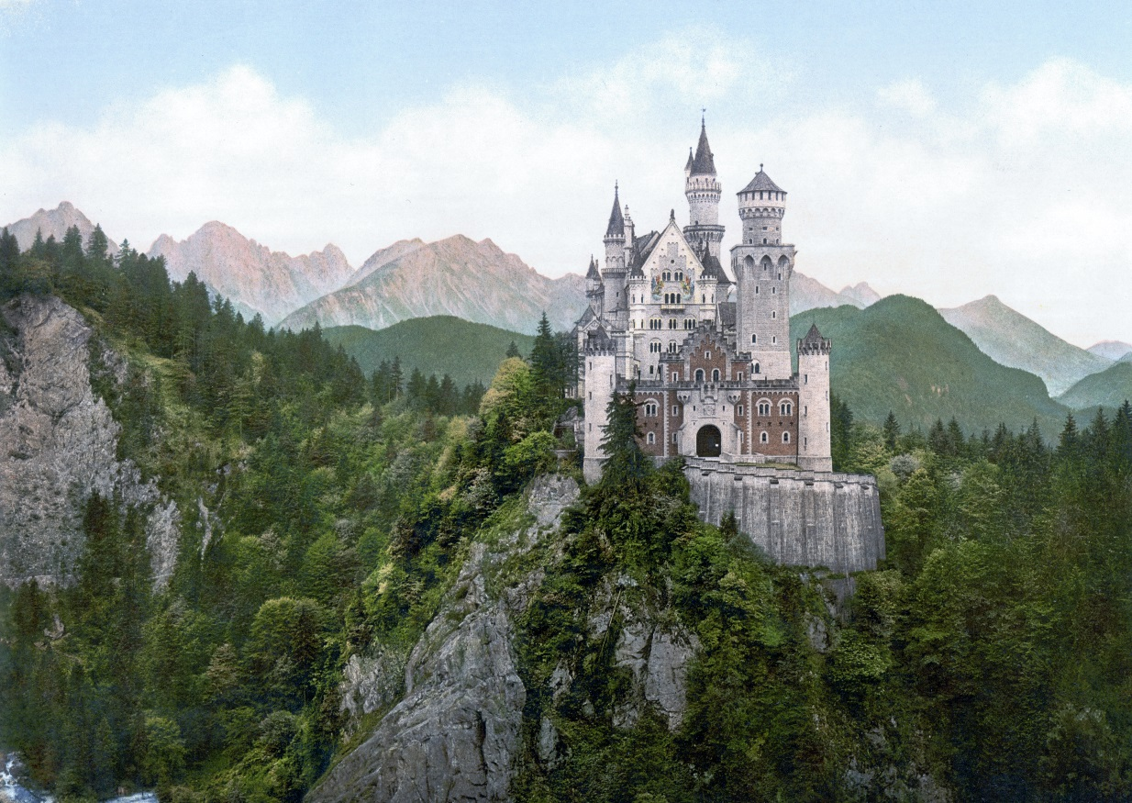
Who danger came to this wrolde.
In a far away villeg there lived a king qeene and a prinnes and her dog the villge was piceful the people were happy to be there they have no danger there.

Slide 3
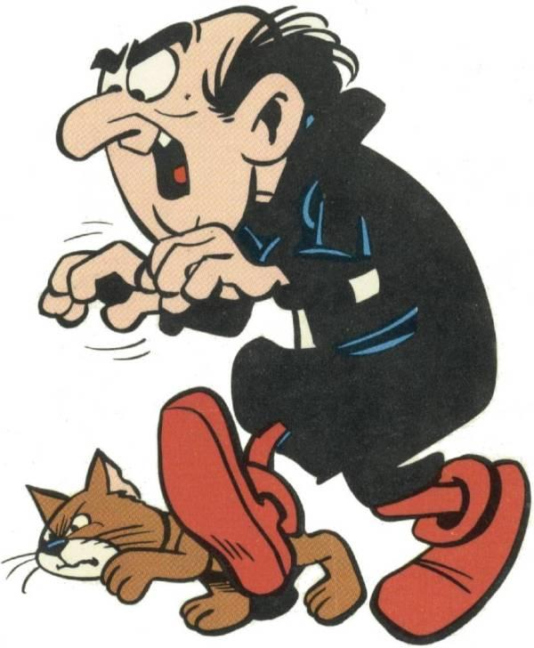
THE DANGER IS HERE
When the thote that they have were but they hered some thing they went over to see what it was it was…bad guy with swrodes evey one was aaaaaaaaaaaahhhhhhhhhhhh.what should you do
1.You run to the casle
2.You fite

Slide 4
You run to the catels
You are running for your life then you reales the catels doors are cloes it is the middle of the knighnt but then the king see you go in and your safe
You win

Slide 5
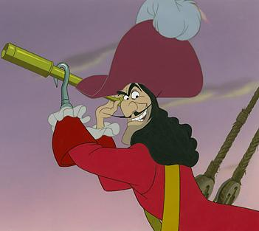
You fite
You fite you see the ship you think to your self you go and their were bad guys
You lose

