Slide 1
The big fight
By: Jack kern

Slide 2
Power’s out
A man was in his house and the power went out.
Duse he fix it him self
Duse he call a repair man

Slide 3
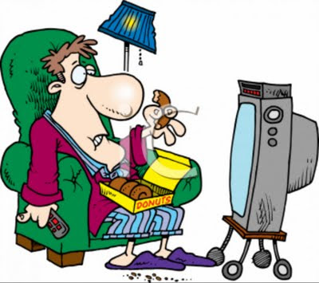
He fixes it
He fixed it and he is watching TV

Slide 4
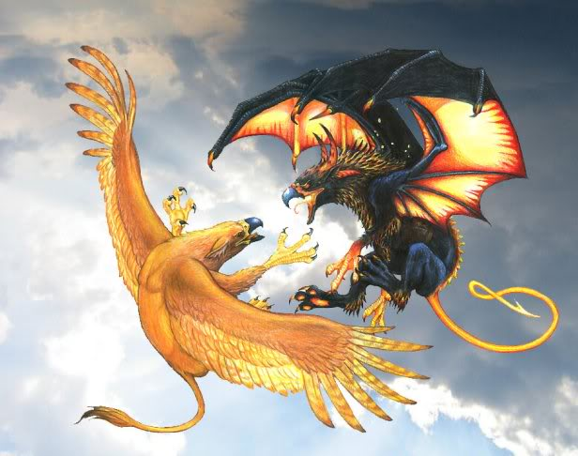
He see’s them…
The man went out of his house and destruction everywhere
He fights for good bad
He fights for bad
you
good

Slide 5
EATIN ALIVE
The man was eaten alive…
The bad greffen got mad and ate the man
game over

Slide 6
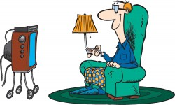
WE WIN
Good job you have slade the greffen
And you have lost some wait
You win yaaaaaaaaaay

