Slide 1
Five nights at Freddy's
BY Jack Skelton

Slide 2
My first day
It was the first night on the job and there was some thing about the animatronics that was weird about
Go check it out
stay

Slide 3
You stay and start whistling to you're self and you here “clank clank” then Your Dead

Slide 4
You go out there to check on them Freddy's ok chica’s ok but when you check bonnie then she tries to get you run hide

Slide 5
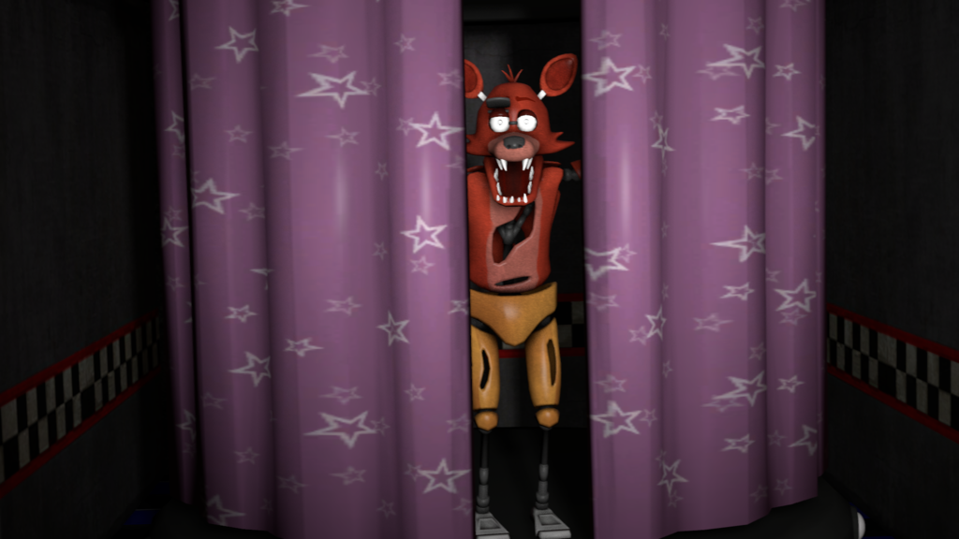
run
You run and run but you get caught off guard you run Into foxy and you die
You died

Slide 6
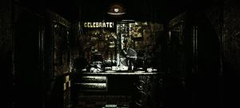
hide
Right left
You find a desk in your office and decide to go to the right or left.

Slide 7
The left
You race to the left but trip in the hallway you quickly get up but an animatronic is there and gets you
Your dead

Slide 8
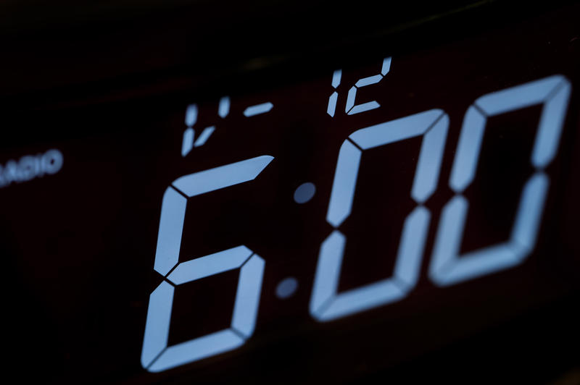
The right
You go to the right and race to the door with every animatronic chasing you Its 6:00 o clock all the animatronics drop to the ground cause your shift is over and you race out of the door you survived the night.
You win!!!!!!!!!

Slide 9
Winner!!!!!!!!!!!
YOU go home and eat popcorn and take the day off

