Slide 1
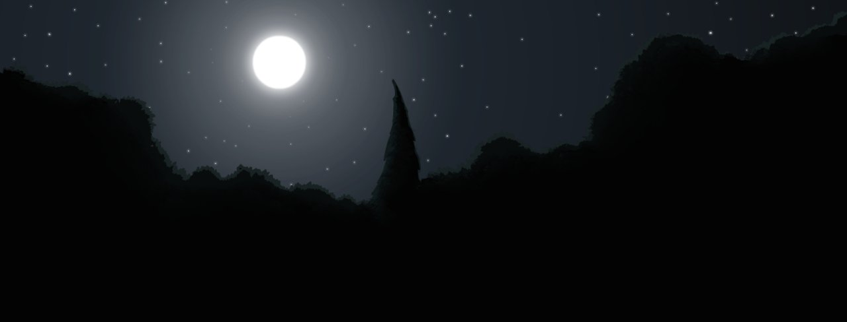
The weird night
By jennifer

Slide 2
Dark night
It was a dark night and you are cozy in your bed and you see something outside weird
Go see the weird thing
Or sleep for hours

Slide 3
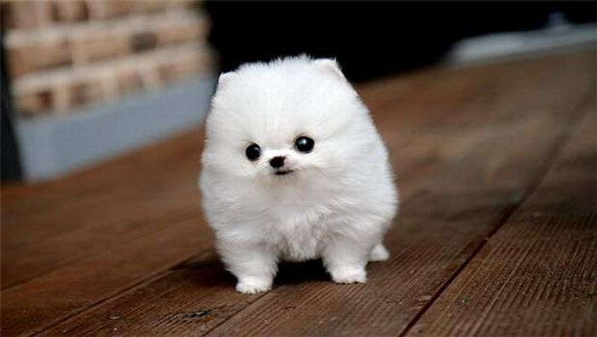
go see the weird thing
You go see the weird thing, it’s a dog do you
keep the cute dog
Or
Walk away

Slide 4
Walk away
You walk away and it starts to rain and the dog

