Slide 1
Adventure story

Slide 2
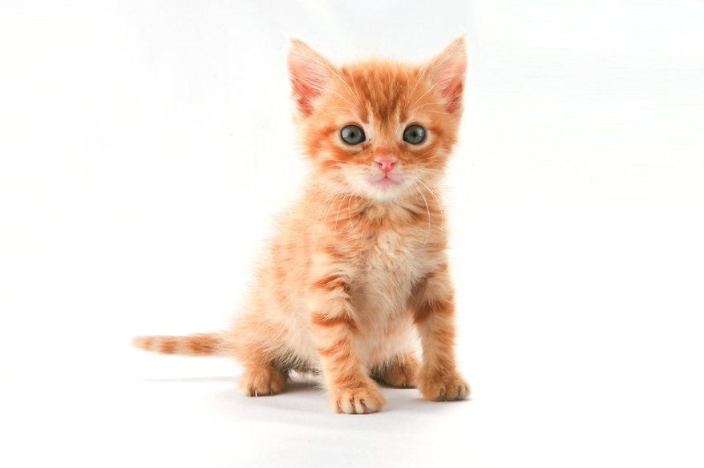
The kingdom of cats
Ones upon a time there was a kingdom of cats the king herd a cat scheme ha
Do you check it awt
Aar do you hide

