Slide 1
Homework horrors
By Keira Jeske

Slide 2
You get home from school
You have a pile of homework
That is due tomorrow
Do you…
.Start homework
.Take a nap

Slide 3
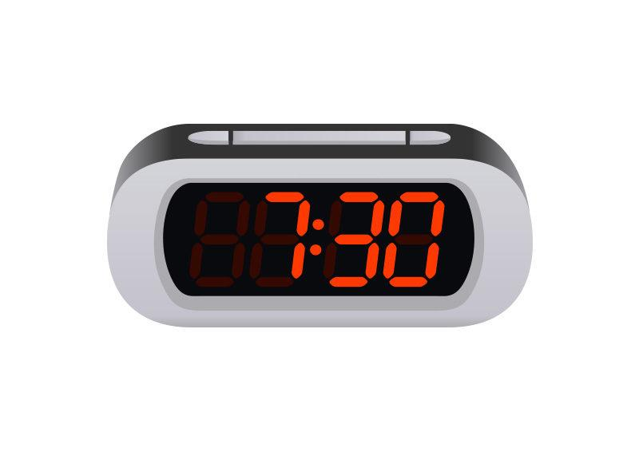
Take a nap
You decide to take a nap
So you go to your room.But,when you wake up,it's 7:30 pm!!
You…
.Do your homework
.Play video games

Slide 4
Start homework
You decide to start your homework,
But you don't know what to do first!
You…..
.start math
.start New Orleans book report

Slide 5
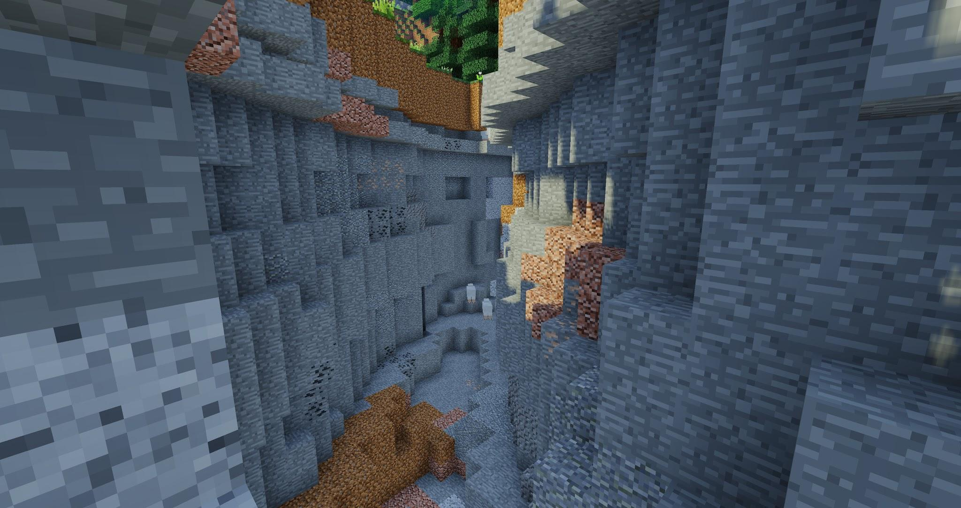
Play video games
You play video games
But you lose track of time!!!!!!!

Slide 10
Start math

