Slide 1
Dumb guy
And the dragon fruit

Slide 2
Once upon a time…
There was a brown dragon fruit. What do you do with it?
Do you
Make a pie with it and give it to your neighbor.
Squeeze and drink it.

Slide 3
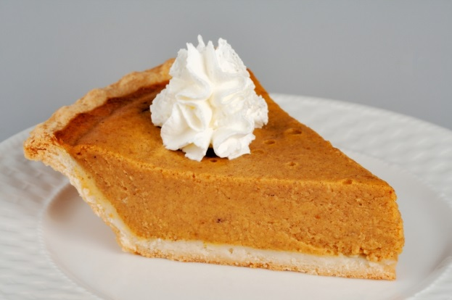
Make a pie…
You made a pie and gave it to your neighbor …
Your neighbor eats it and the next morning he has been transformed into a cat
Should you eat more
or just live with who you are

Slide 4
Scouse it and drink it…
You pass out and when you wake up there is a giant unicorn in your bed.
Do you run away
Keep it as you pet

Slide 5
You ate more…
You died
TRY AGAIN

Slide 6
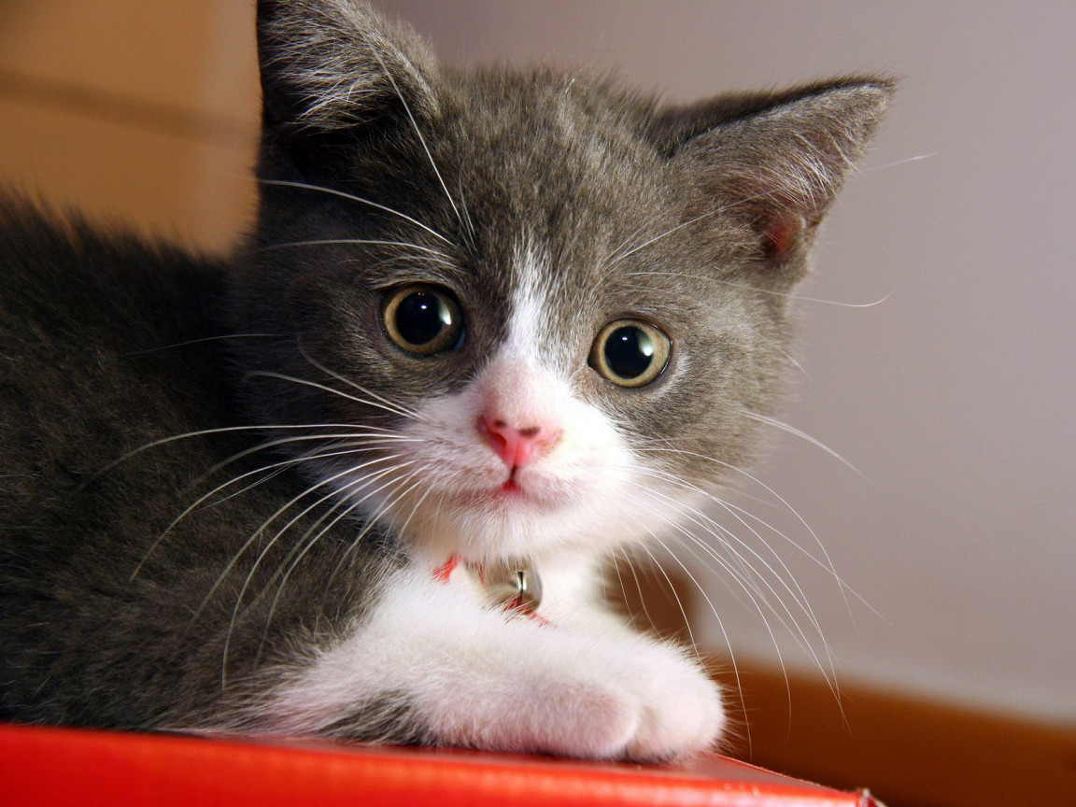
You choose to stay with your self …
You had a good life and you were adopted

Slide 7
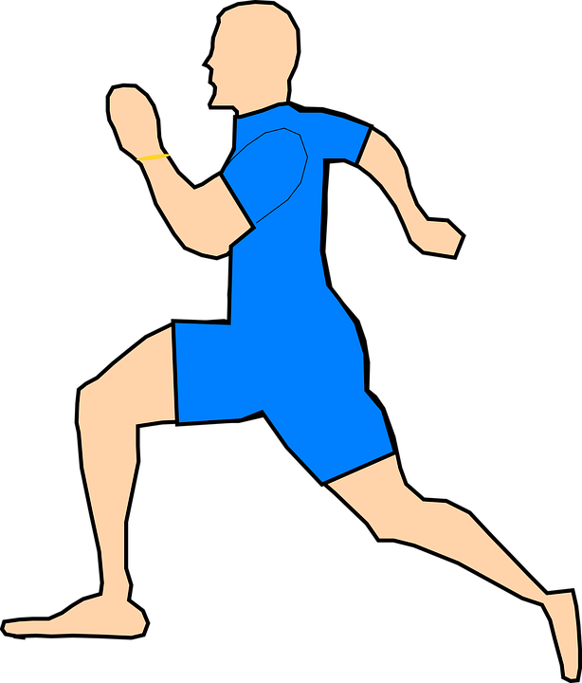
You ran away
It chased you and ate you up.
you lose wawawawawawaaaaa

Slide 8
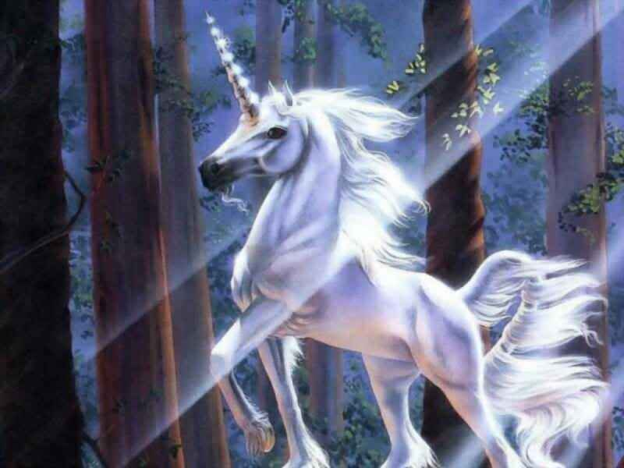
Keep it as you pet
you kept it as your pet and you trained it and you had a happy life.

