Slide 1
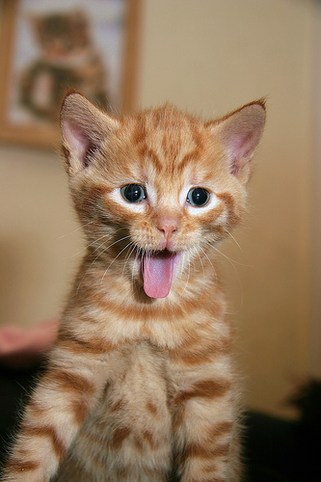
KITTEN STORY!!!!111!!!

Slide 2
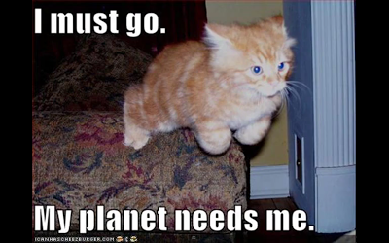
YOU IS KITTEN
POOP CUZ UR EXITE
DON’T POOP AND BE GOOD KITTEH

Slide 3
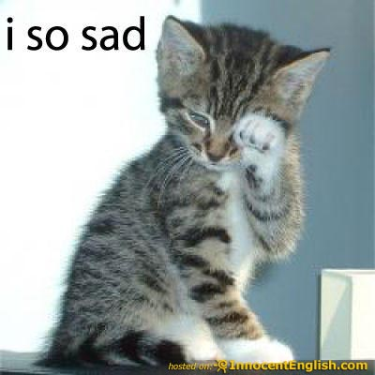
OH NO YOU IN TWUBLE
GEEM OVAHHHHHHHH

Slide 4
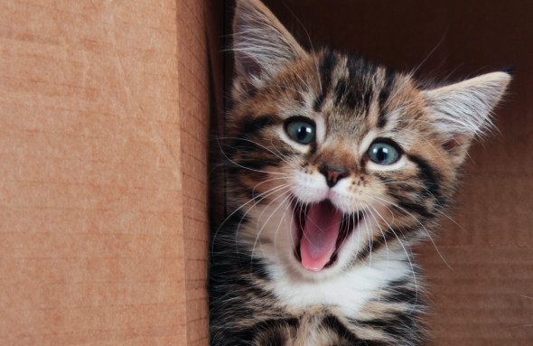
GOOD KITTEH
YEEEEEE KITTEH DRINK WATAAAAAAH
NO!!!!
YESH YESH YESHHHHHHHHH!

Slide 5
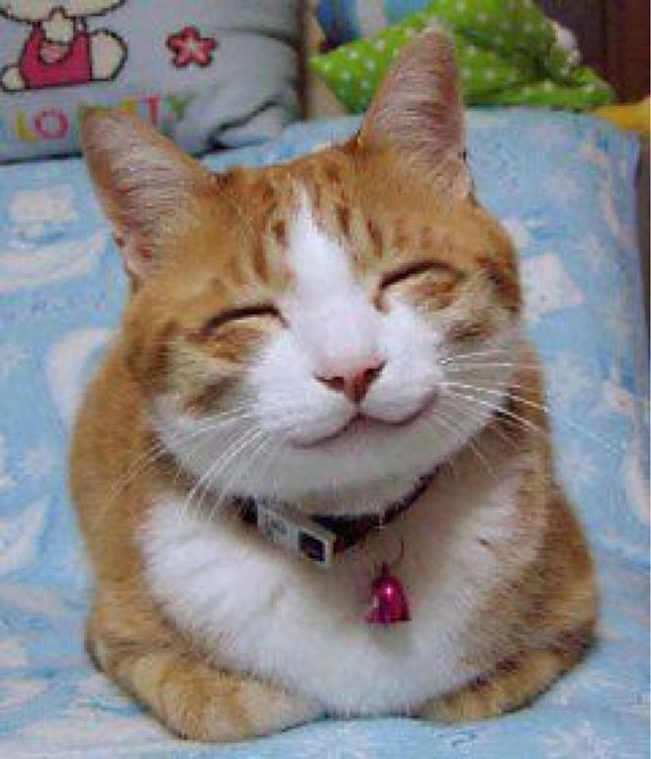
YEEEE
YOU IS HAPPY KITTEH YAH WIN!!!!!!!

Slide 6
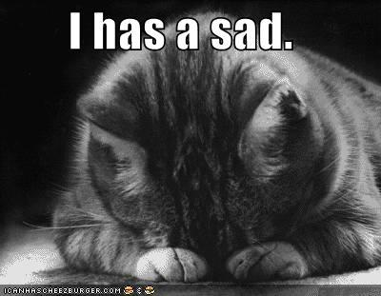
GEEM OVAH
NAWWWW NAOOOW!!!!!

