Slide 1
Adventure story
By: Kylie p.

Slide 2
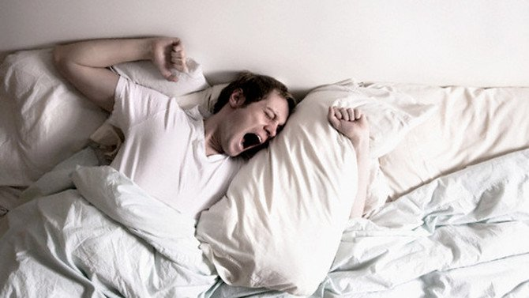
Once upon a time
The sun was already up as a weird guy wakes up. He has the most important job in the town. He can not be late!
Does he rush to work
Or does he take his time

Slide 3
You rush to work and..
Right as you walk out the door you remember the cake you forgot to take out of the oven last night. You take it to work
He makes it to work just as the meeting starts
he had a great day at work
he is one block away from his house and he crashes into a car!
You break both arms and legs
Does he wait for the ambulance to come
Or do you eat the gross cake

Slide 4
You take your time and..
Right as he leave you get a phone call
It is your work and they say you are too late and you are fired
You Die
Try again

Slide 5
The ambulance is too late and
YOU DIE
Try Again

Slide 6
You eat the cake
he Eats the gross cake and He looks at his arms and legs and they are healed
You run out of your car and walk home

