Slide 1
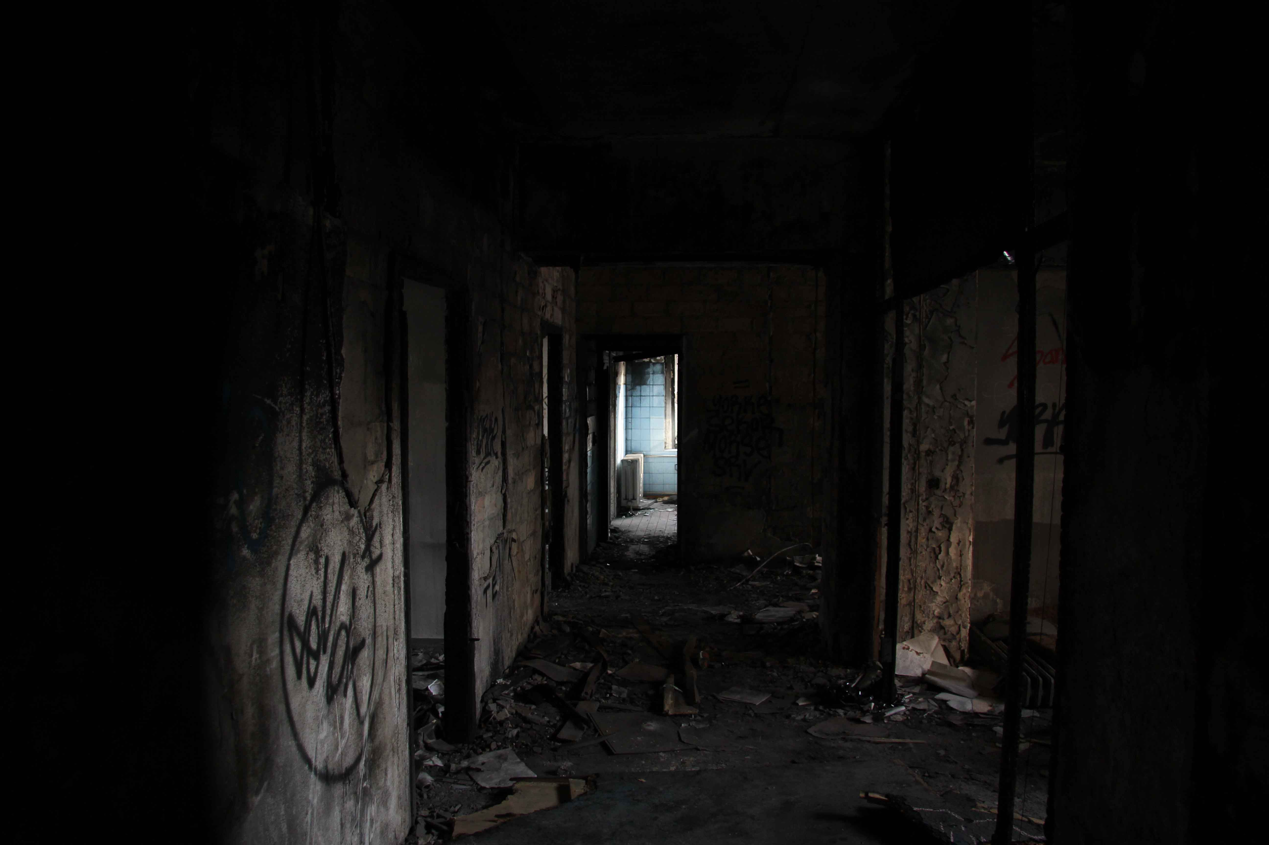
Late 4 work
By Sarah Hobaish
A tale of darkness and you are late…

Slide 2
As you wake up…
You wake up, and you look at the clock: 9:05.You realize you are going to be late if you don`t hurry. What will you do??
Take your time
HURRY HURRY HURRY!

Slide 3
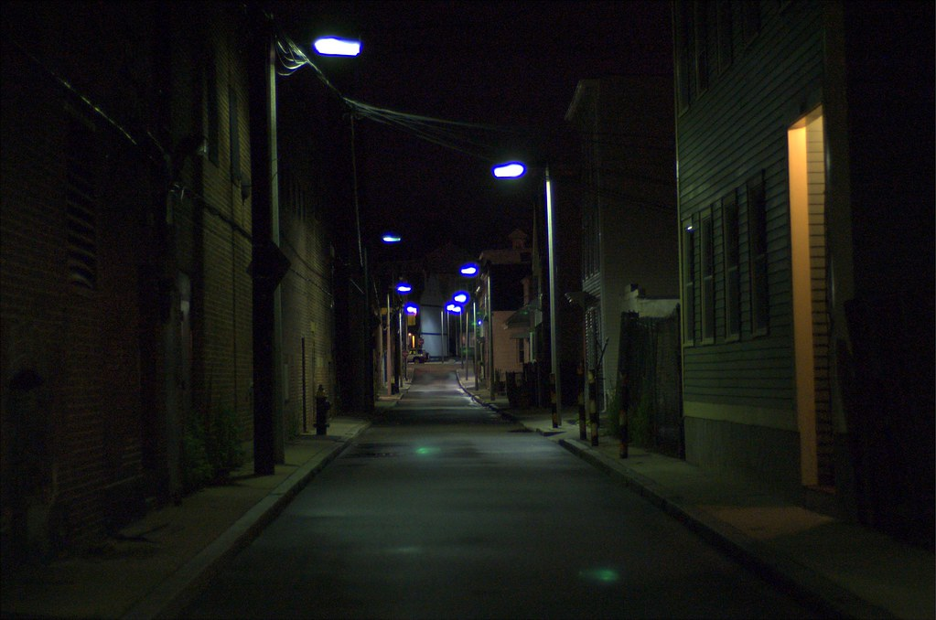
HURRY HURRY HURRY!
You hurry up and run towards the Pokemon Science Lab, where you work.

Slide 4
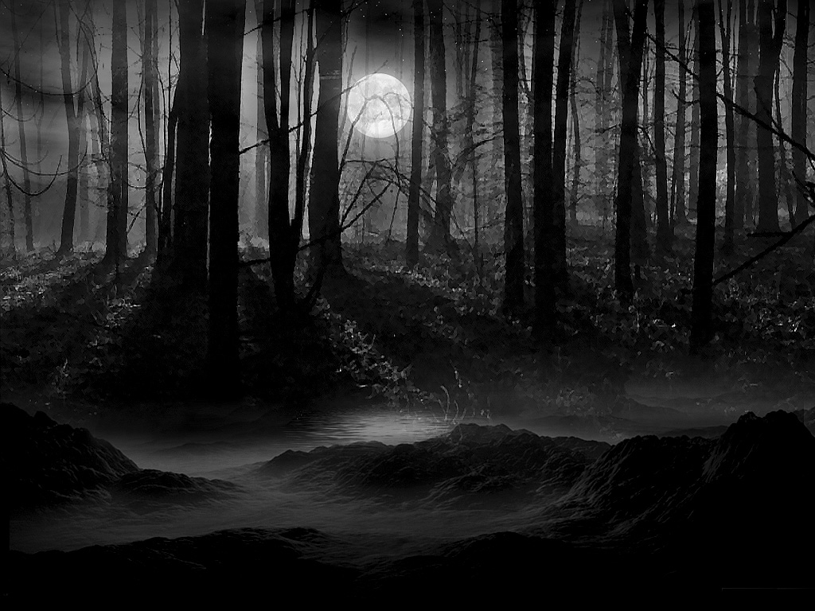
Suddenly…
You come across a mean man who tells you to empty your pockets or face the punishments
What do you do?
Fight back
Empty your pockets

Slide 5
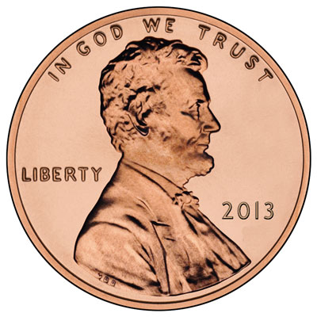
Empty your pockets
You empty them except only a penny comes out, he blasts you away and you have to go to the hospital.

Slide 6
Fight back
You punch him and he burns you to a crisp with flamethrower from his charizard.

Slide 7
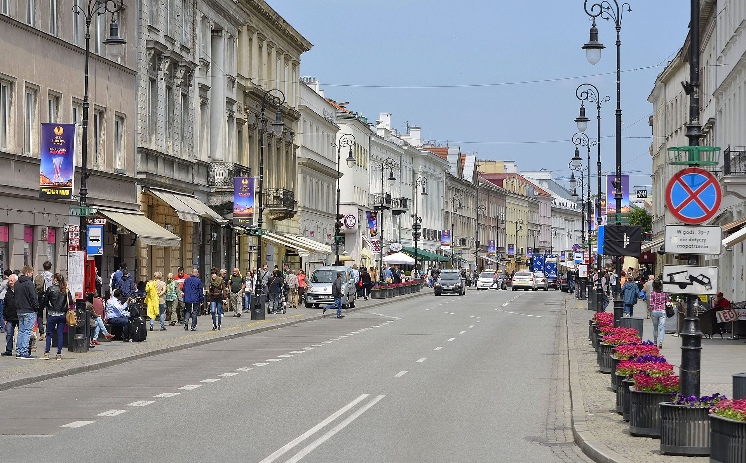
Take your time
You take your time and bring everything you need, and your pets. You walk towards the Pokemon Science Lab where they are probably waiting for you.
You reach the lab and walk inside.

Slide 8
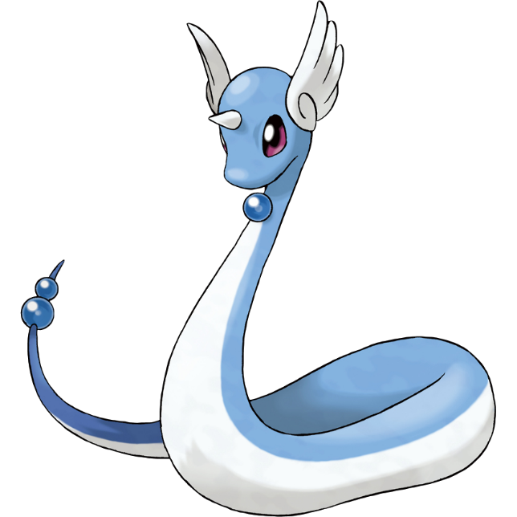
Happy day
You are not late and you do your job and take care of Gumdrop the Goomy, and Pearl the Dragonair, your friendly pets. P.S you
Also take care of the pokemon at the lab.

