Slide 1
The A.I. Breakout
By:Lenna

Slide 2
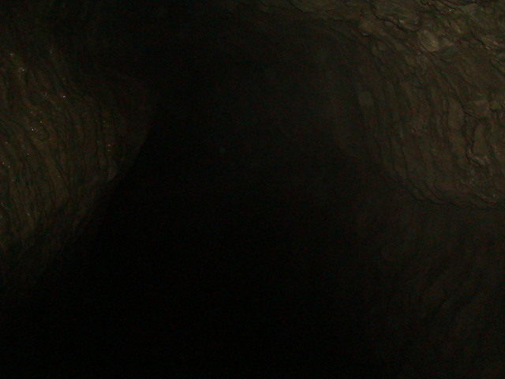
In an A.I. breakout…
You are in the shelter of a dark, dingy cave hidden from the A.I. you are the only person alive, because you are a native to the land. You have no electronics, and no food. You will have to go out to pick food from the forest soon.
You only have two options:
Go Scavenge for food
Stay safe

Slide 3
You Decide to Scavenge for Food…
You creep out of your cave… and scamper into the dark forest. You find some wild berries, but you don’t recognize the species of berries.
You have two options:
Eat the berries
Drop them and look for more food

Slide 4
You Decide to Stay Safe
You stay in your cave, and start a campfire. Soon, the blaze gets out of control. You must put it out before the A.I. find the smoke, but it has started to snow.
You have two options:
Put the fire out
Contain the fire, and hope the A.I. don’t find the smoke.

Slide 5
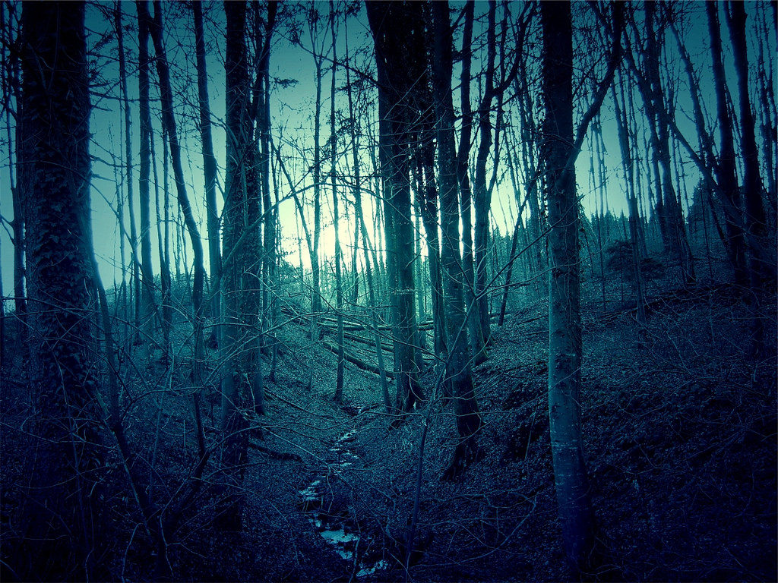
You Eat the Wild Berries
You eat the wild berries, and you feel A.I. poison slowly spreading through your veins.
It was a trap!
You think, as you slowly fade from the world.
YOU DIED
Try again

Slide 6
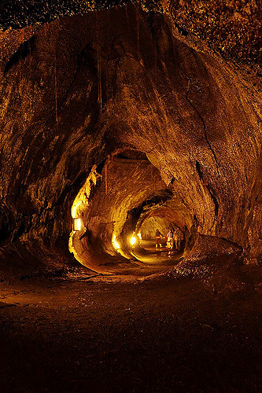
You drop them and look for more
You drop them, and you are safe for the day.
YOU WIN!
Go back

Slide 7
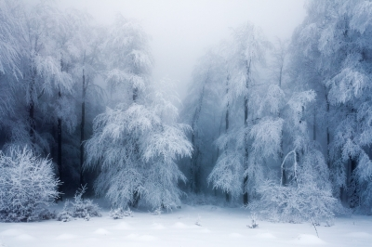
You put the fire out
You put the fire out, but you freeze to death.
YOU LOOSE!
Try again

Slide 8
You keep the fire
You keep the fire, and the A.I. find you.
YOU LOOSE!
Try again

