Slide 1
terapt
H rerrewr e yuetyty I ehvyetvyutv p

Slide 2
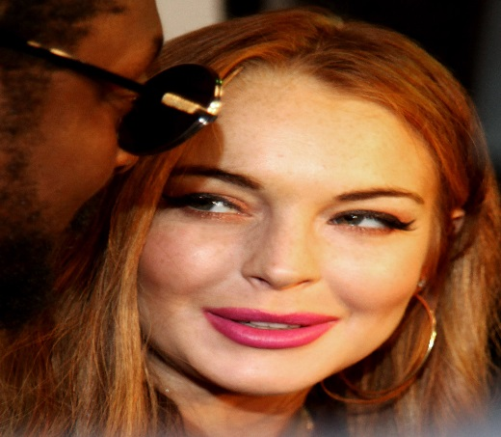
It was dark
She was trap in a scary lab.
She did not now what to do.
Run
stay

Slide 3
run
She ran ran ran and ran and then she saw slenderm.
Hide
run

Slide 4
HIDE

Slide 5
RUN

Slide 6
stay
She gets steraped on table
And she ecscaps
Fight
run

Slide 7
run
You RUN ANDDDDDDDDDDDDDDDDDDDDDDDDDDDDDDD
YOU WIN

Slide 8
HIDD
YOU LOUS
SJHHG

Slide 9
