Slide 1
The Boy
By Lulu Bajali

Slide 2
Your character is alone in a house. A big bang is herd on the wall with a small hole
Leave the house and ignore it
Go check it out

Slide 3
You checked it out. And died because there was a bomb

Slide 4
You ignored it and ran outside for safety. You feel your stomach rumble. Were do you go
McDonalds'
Taco bell

Slide 5
You went to McDonalds and got killed by clown

Slide 6
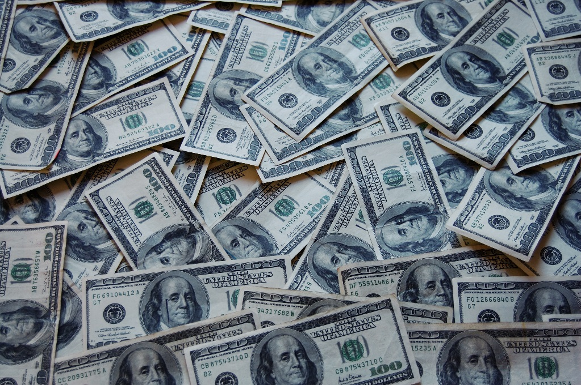
After you had your great meal a man comes and says “ got change” with a red hand of blood in his hand
Give him cash and walk with him to a safe spot
Say no and go to the forest

Slide 7
Some sketchy man comes and askes for money with red blood in his hands.
Run to the forest
Or just die

Slide 8
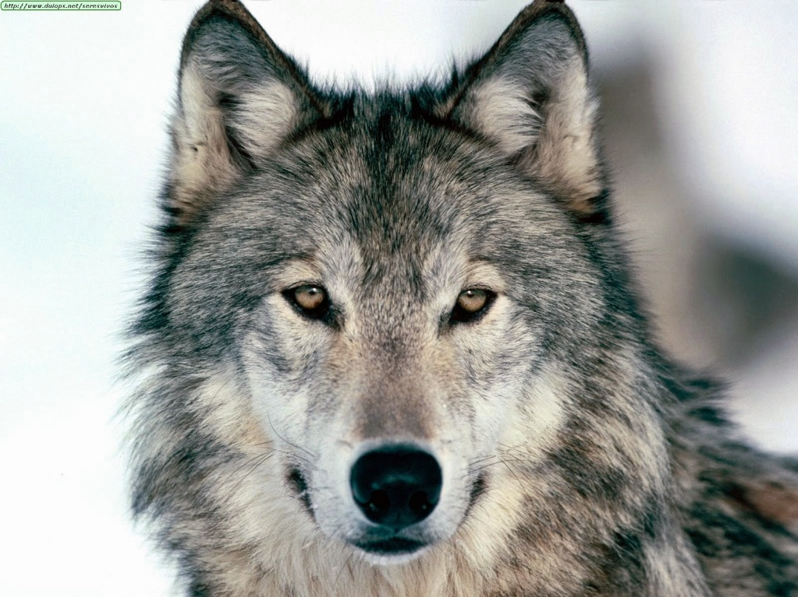
You went to the forest and died because of wolfs
Do you run
Or just die

Slide 9
You win !!!!!!!!!!!

Slide 10
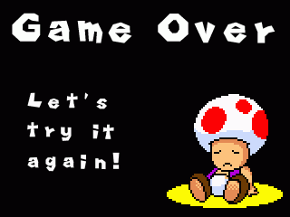
You loose!!!!!
REDO

