Slide 1
An ARBYS Adventure
By: Maddi Lewis and Luna Simpson

Slide 2
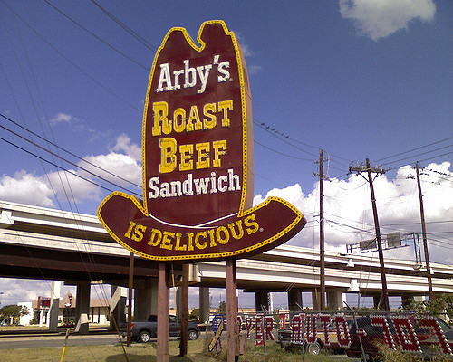
Once upon a time…
You wake up to terrible news, you lost your job at Wendy's for eating the food there
You get up and find a letter on the drive way, It’s a hiring flyer from Arby’s It says only one spot left and you half to be there by noon and arbys is 20 miles away
What do you do to get there first. You don’t have A car.
Bike
Bus

Slide 3
Path 1
You get up and get dressed
You decide to ride the bus
You walk to the nearest bus stop that takes you to arbys
You get on the bus
Your halfway there, the bus brakes down, everyone evacuates the bus
Arbys is 10 minutes away
Ask random person to borrow A bike
Walk the rest of the way

Slide 4
Path 2
You choose to bike all the way to Arbys
It takes 30 minutes to bike
You get up and you're tierd
You start to bike up the hill
Your bike moves and you crash into the road
You get hit by a car
You lost!!!!!!!!!!!!!!!!!

Slide 5
Path 4
You choose to walk the rest of the way
You keep walking and walking
You see Arby’s across the street
Your waiting at the crose walk
A guy asks you were your going you don’t know if he is going to get the same job as you
Tell him the truth
Or keep silent

Slide 6
Path 6
You choose to keep silent
The guy keeps asking you
“ANSWER ME”
You still keep silent
He drags you away and are you are to late to make it Arbys
You Lost!!!!!!!!!!

Slide 7
Path 7
You tell him your going to an interview at Arby’s
The walk sign turns on
You walk across and walk into arbys
You are the first one
YOU WIN!!!!!!!!!

