Slide 1
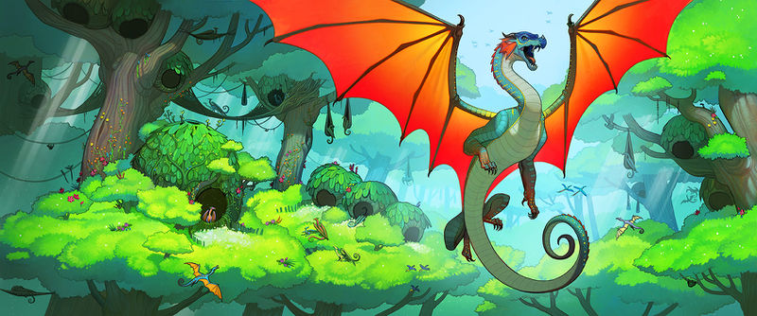
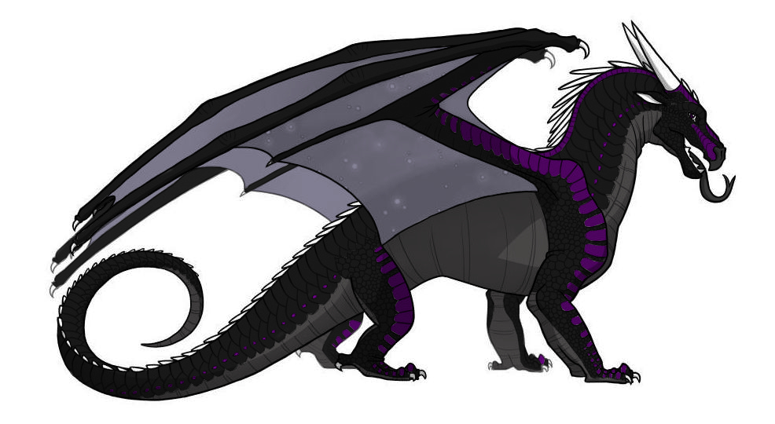
Meftuha Talons Of Power

Slide 2
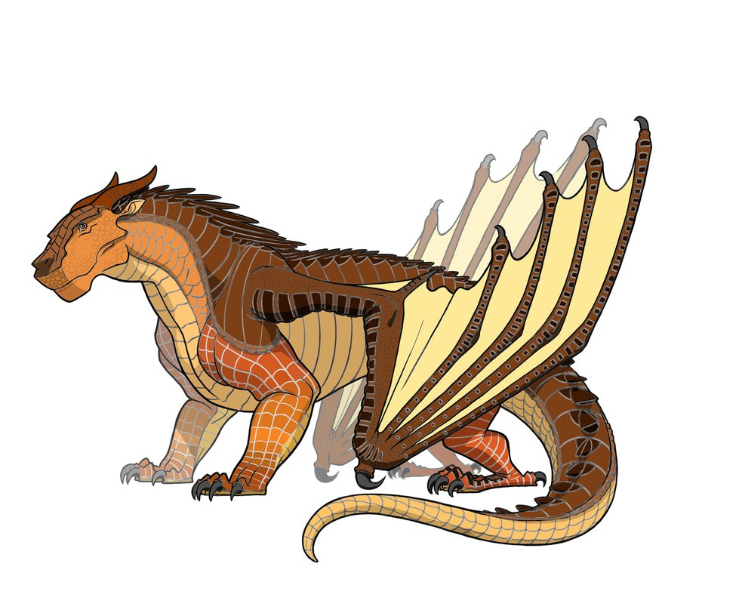
INTRODUCTION!
The dragonets were hiking in the rainforest then they saw 2 Mudwings…they were talking about “how RAINWINGS are lazy fruiteaters!”What should you do?

Slide 3
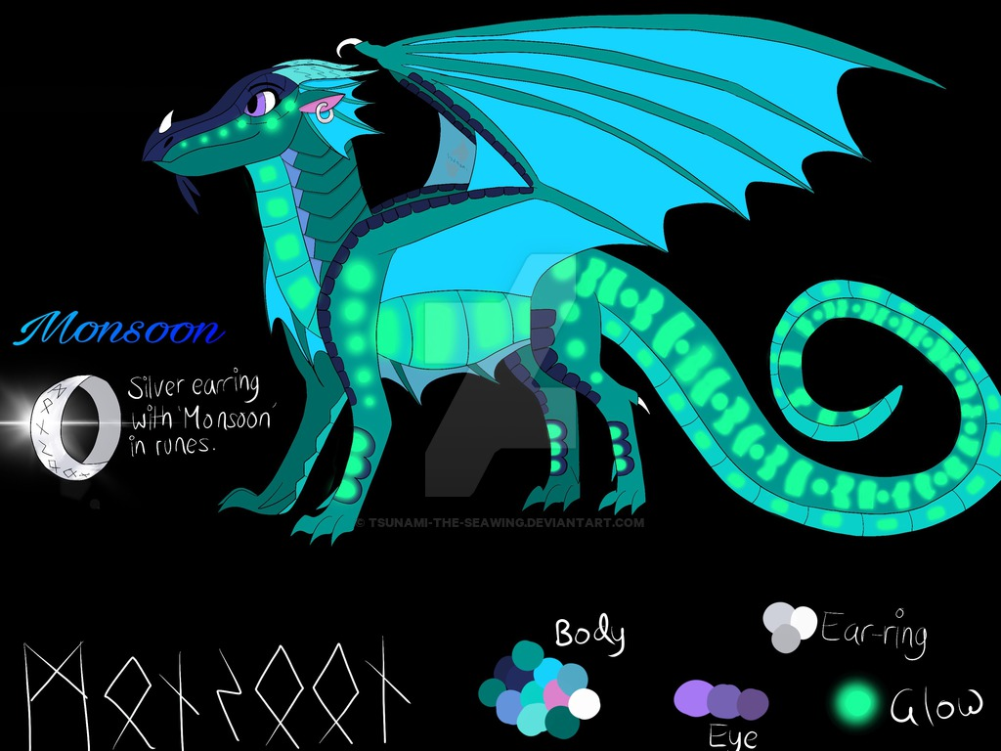
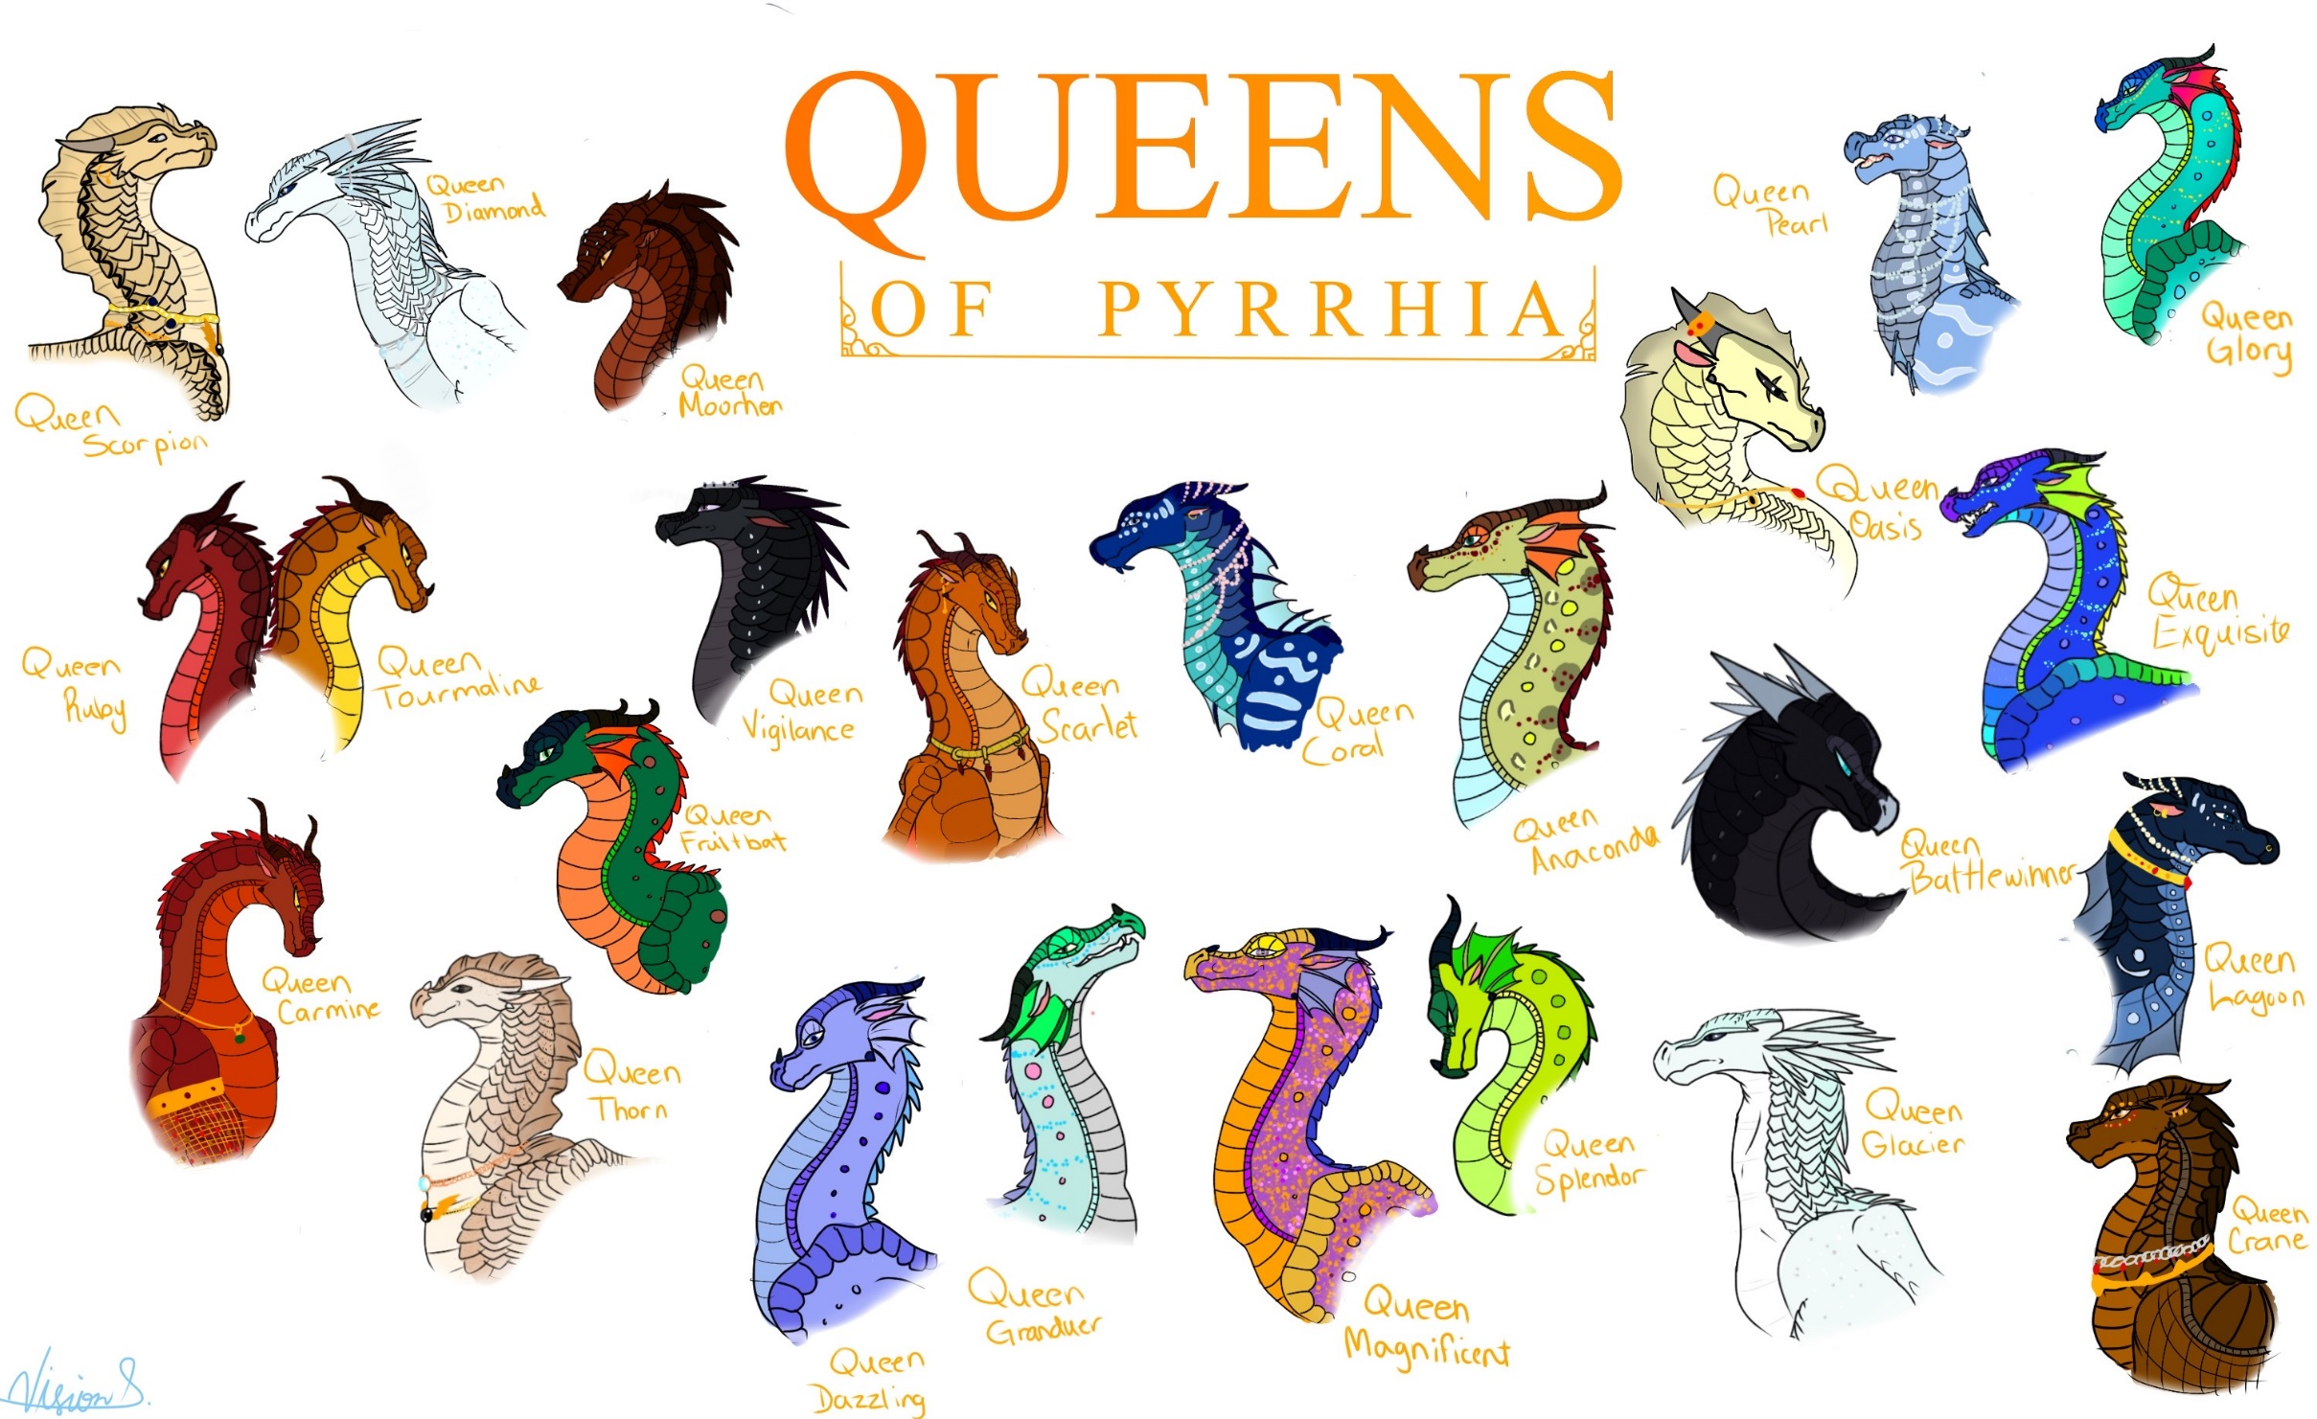
YOU HAVE 2 CHOICES
You keep listening
Or you keep on walking

Slide 4
KEEP LISTENING
YOU KEEP LISTENING BUT THEN SUNNY DISSAPERS.
THEN WEBS,TSUNAMI,&CLAY ARE GONE TO!!
WAIT

Slide 5
KEEP WALKING
THEY SEE YOU!

Slide 6
THEY SEE YOU…
THEY SAY”GET LOST OR ELSE BURN WILL KILL YOU!”

Slide 7
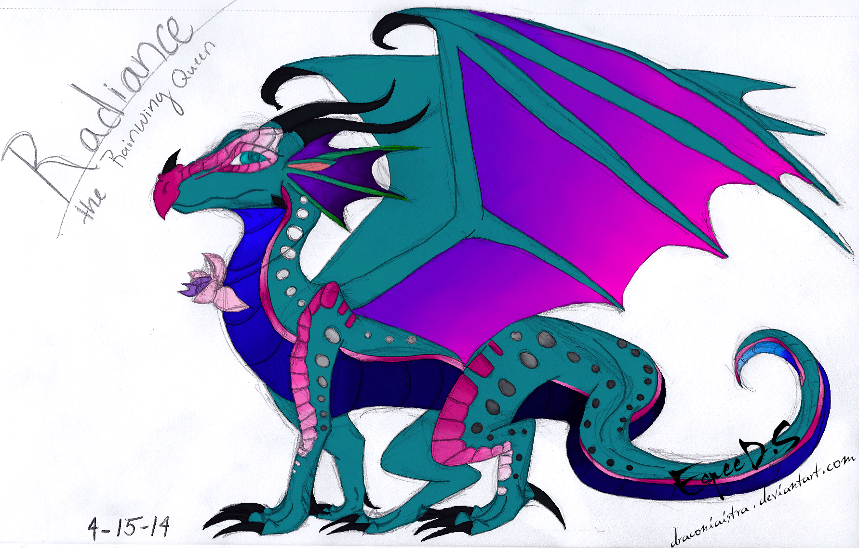
WAIT
YOU WAIT.
GLORY SAYS “COME OUT WE KNOW YOU’RE HERE!”

Slide 8
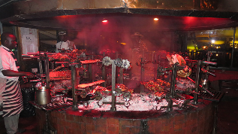
The dragons go to a museum

Slide 9
BURN WILL KILL YOU!

Slide 10
