Slide 1
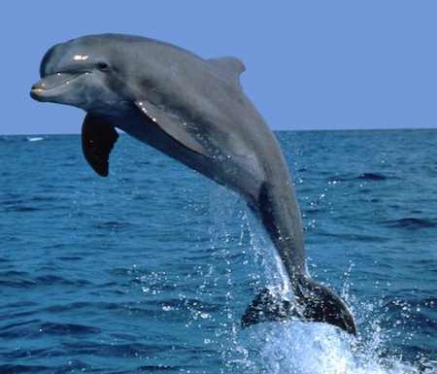
The dolphin
The dolphin and the fisher man

Slide 2
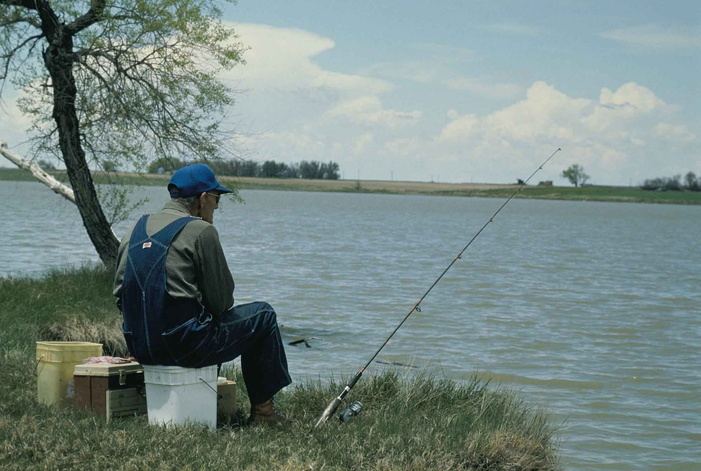
Once upon a time…
There was a fisher man he was just trying to get a fish for dinner and then he cout a dolphin dun dun dun

Slide 3
What did he do
Fight it
Let it free

Slide 4
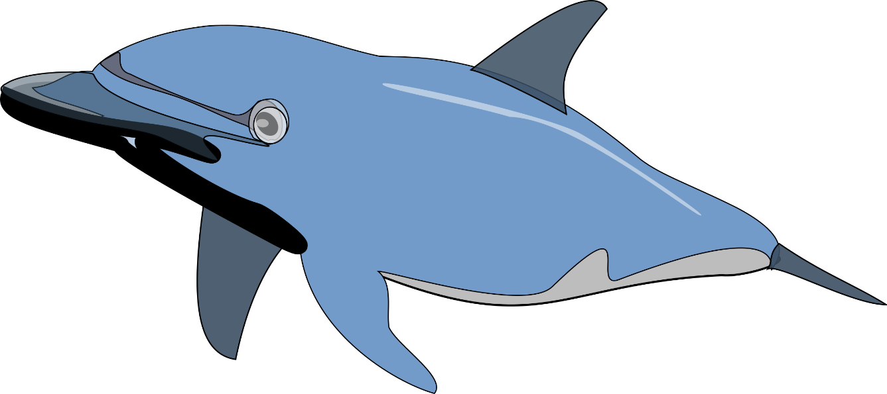
Chocie one
you chose to fight the dolphin
You try to fight it but then there is more , you dead
YOU LOSE

Slide 5
Chocie 2
You chose to let it free it jumps up and eats you ,you dead
You lose

