Slide 1
My name jeff
By Andres jk it was not

Slide 2
Scary v
You wake up your eating talkis what do you do
Eat takis
Dab like denis

Slide 3
dab
Click
to see denis

Slide 4
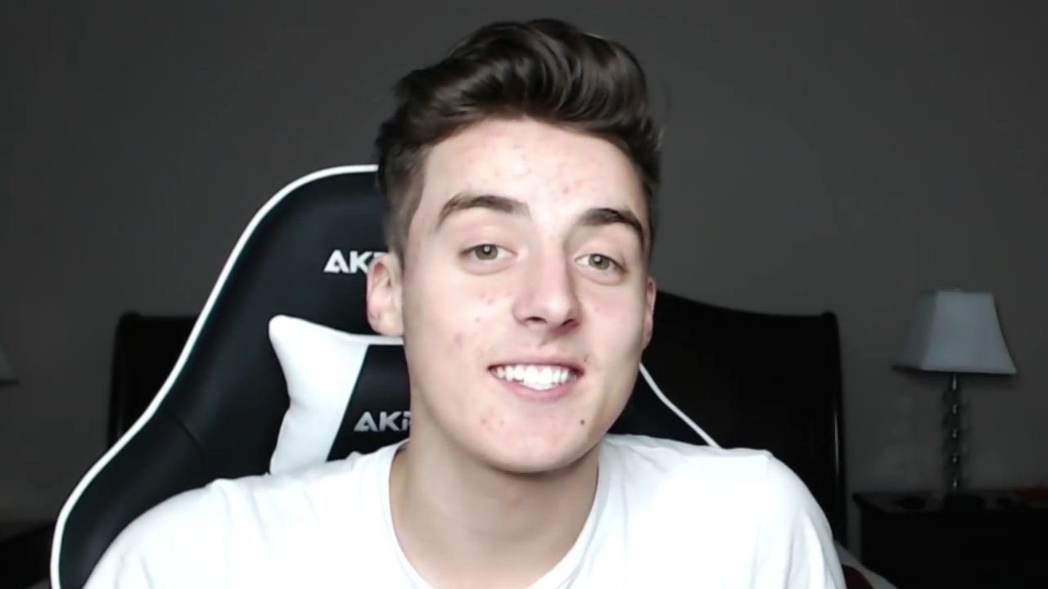
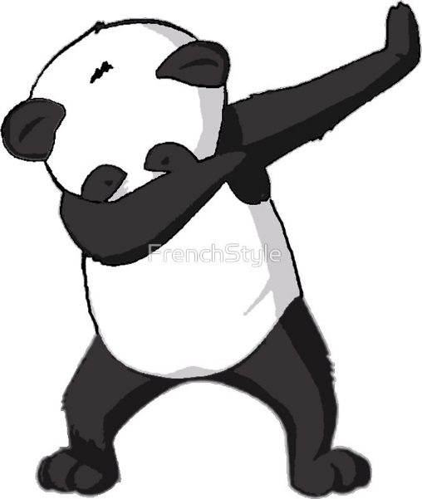
Denis so bueteful ps this is not how you spell this lol

Slide 5
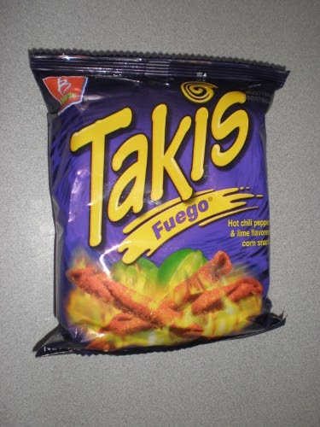
talkis
Yum spicy y is the bag purple AHHHHHHHHHHH
Throw it way
Be savage

Slide 6
Savage

Slide 7
Throw it away

