Slide 1
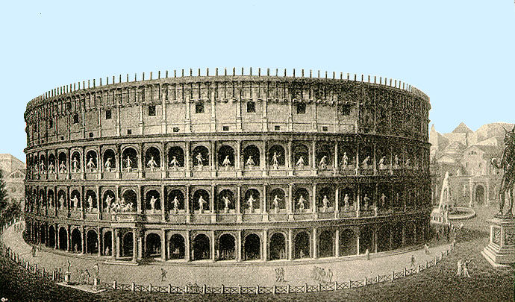
Blood and glory By Nehemias

Slide 2
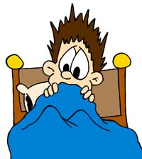
.
You wake up to a nock on the door
1.Do you open the door

Slide 3
Open the door

Slide 4
Just go back to bed

Slide 5
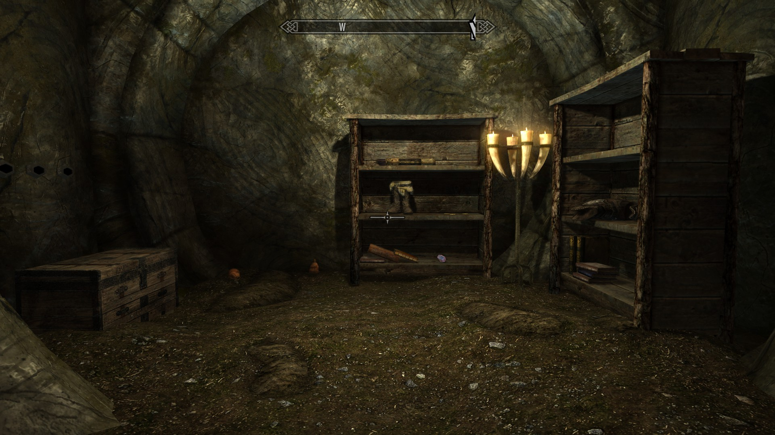
You join

Slide 6
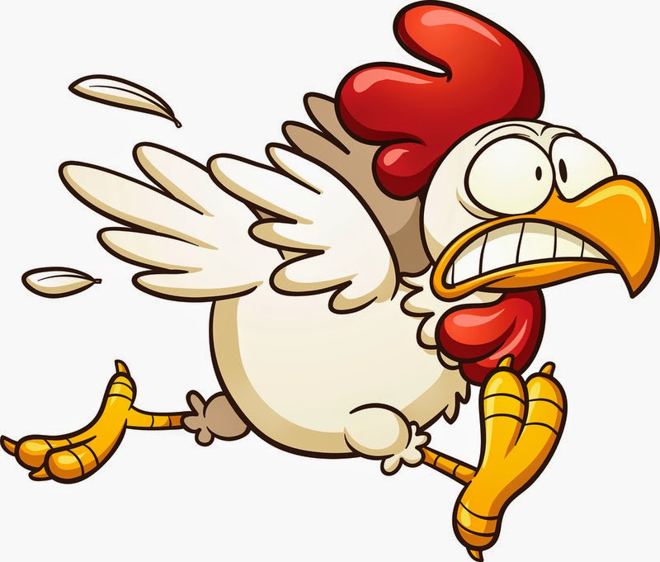
run

