Slide 1
The Story
By Noah

Slide 2
In The Morning…
It is time to get up and you are late to your drama class.
You have different dictions!
Choice 1 Go to drama.
Choice 2 Stay in bed.

Slide 3
At Drama Class
Teacher say hi and you get ready for rehearsal.
You have two dictions.
Choice 1 Help your teacher.
Choice 2 Walk away

Slide 4
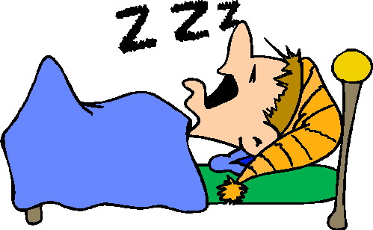
In Bed
You choose to stay in your bed for drama class.
Choice 1 go to sleep
Choice 2 Stay awake and do nothing

Slide 5
You are sleeping
You Are sleeping and a wild wolf eat you alive you lose
Play again
Yes
No

Slide 6
Helping your teacher
Your helping your teacher. She needs more help!
What Do You Do?!
1 Leave because you are annoyed
2 Help Her

Slide 7
You Helped her
You WIN you helped your teacher and the play was successful!
Play again ?
Yes
No

Slide 8
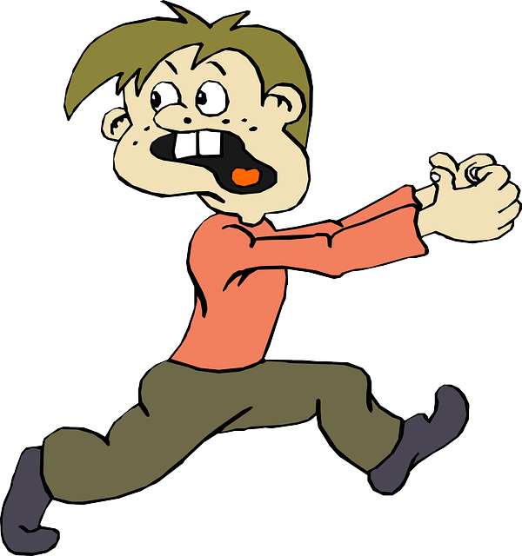
You walked away
Your teacher is mad! SHE IS GOING TO HURT YOU!!!
What do you do now
Choice 1 Run away
Choice 2 stay their and fight

Slide 9
You are awake doing nothing
You here something outside! What do you do?
Go check it out
Stay in bed

Slide 10
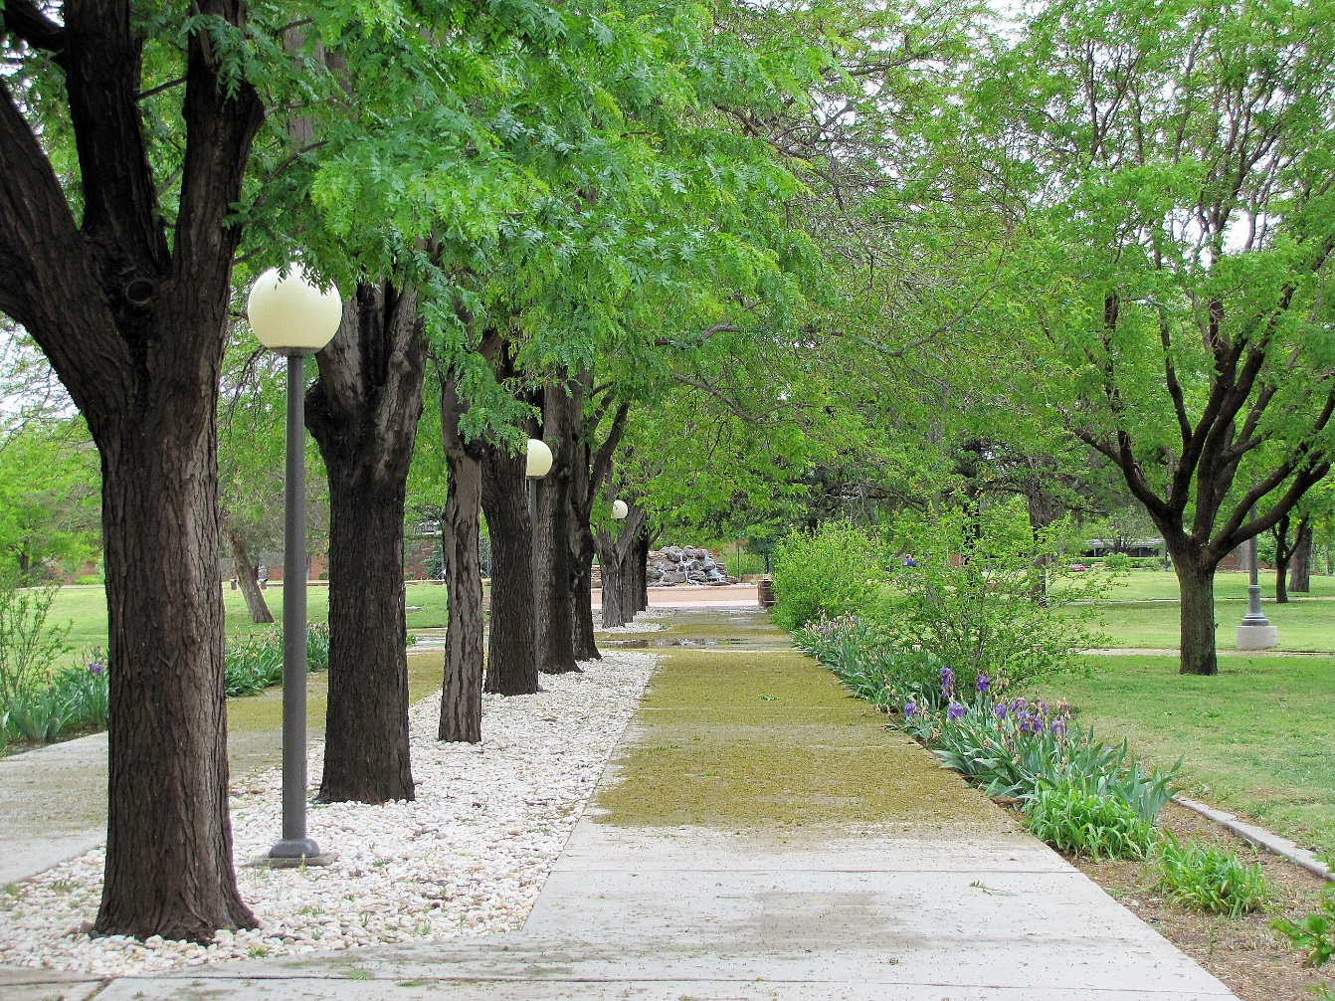
You Go check it out
No You Went To Check It out now you will be eaten alive
SO YOU LOSE!!!!!
Try again

Slide 11
You stayed in bed
Someone broke down your door down!
YOU LOSE
Try again?
Yes
No

Slide 12
YOU LOSE
You ran away and now the director caught you 5 feet outside of the room at 6:30.
Try again
No
Yes

Slide 13
YOU LOSE
You are now passed out and on then ground FOR ETERITY!!
Try Again
Yes
No

